Slide 1
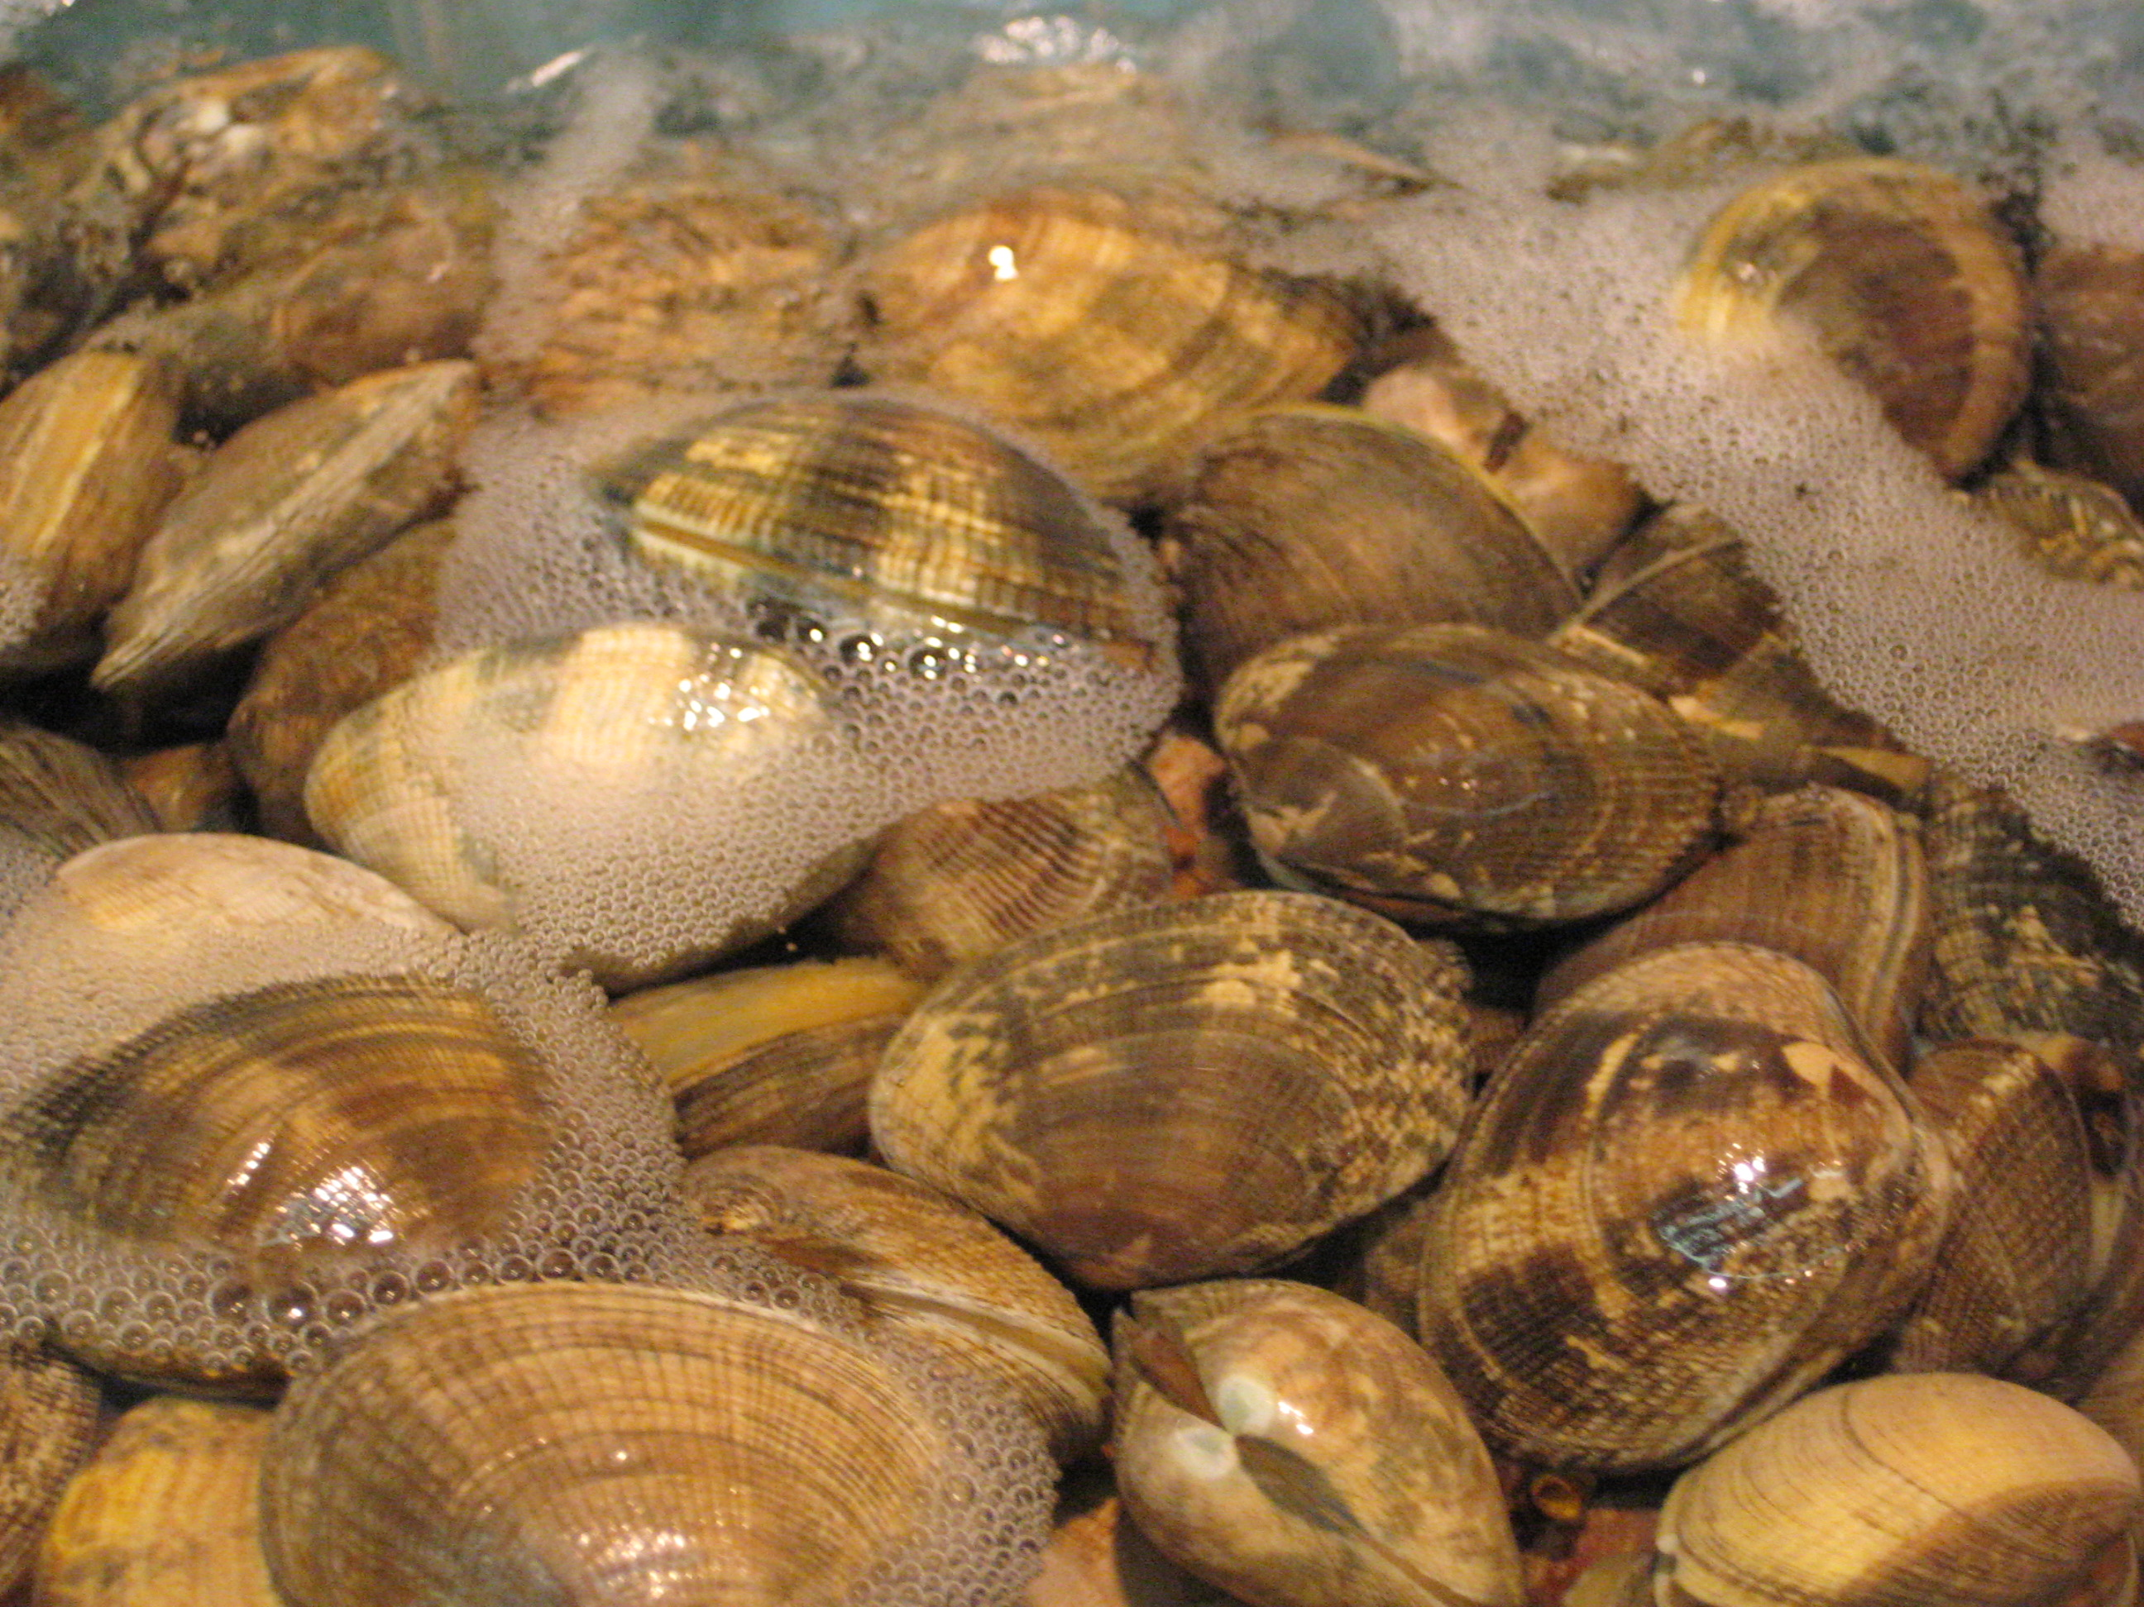
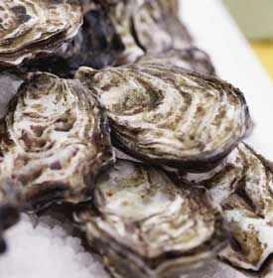
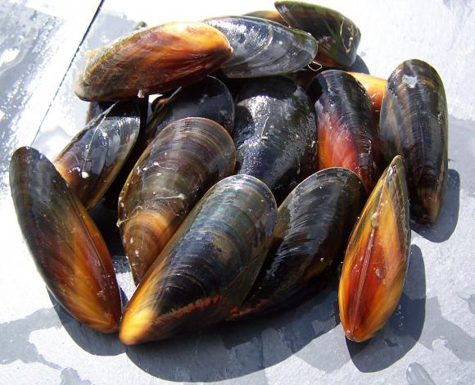
Flex your mussels! …and clams and oysters
Seattle Expanding Your Horizons
2014

Slide 2
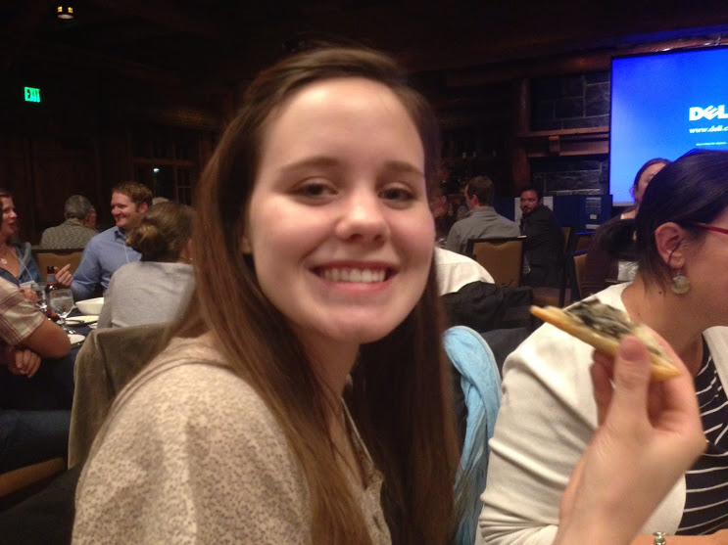
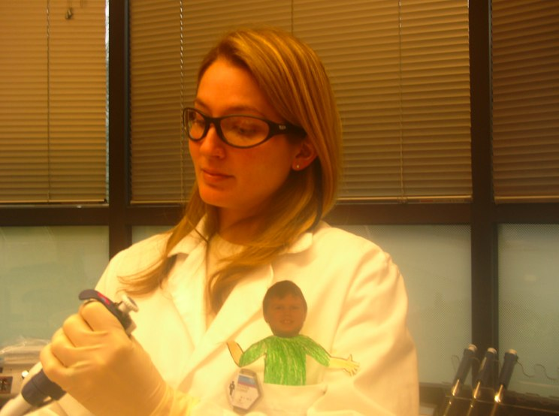
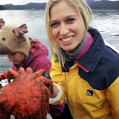
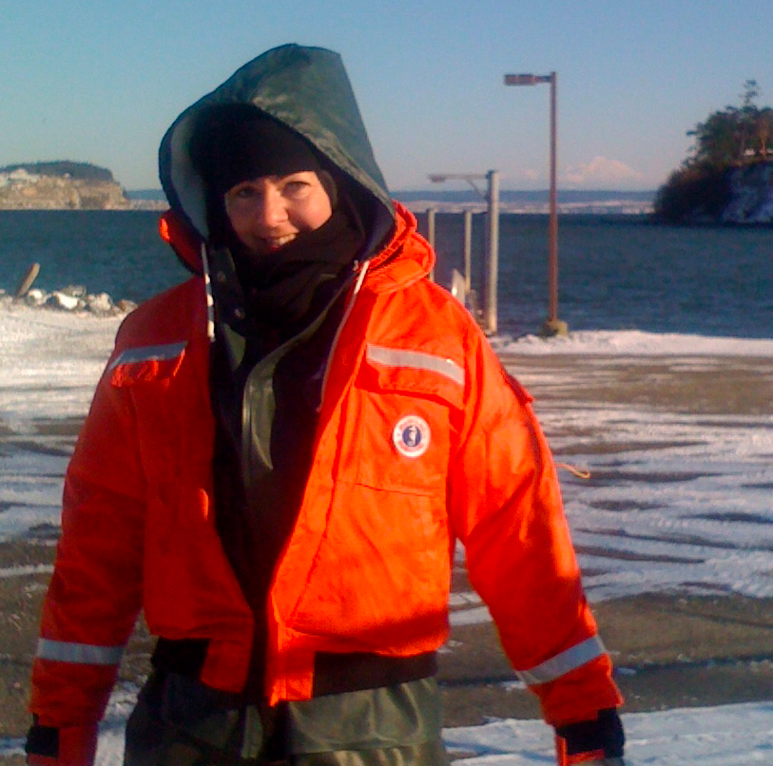
About us
Katie
Mac
Anne
Jessica

Slide 3
What images come to your mind when you hear “bivalves”?

Slide 4
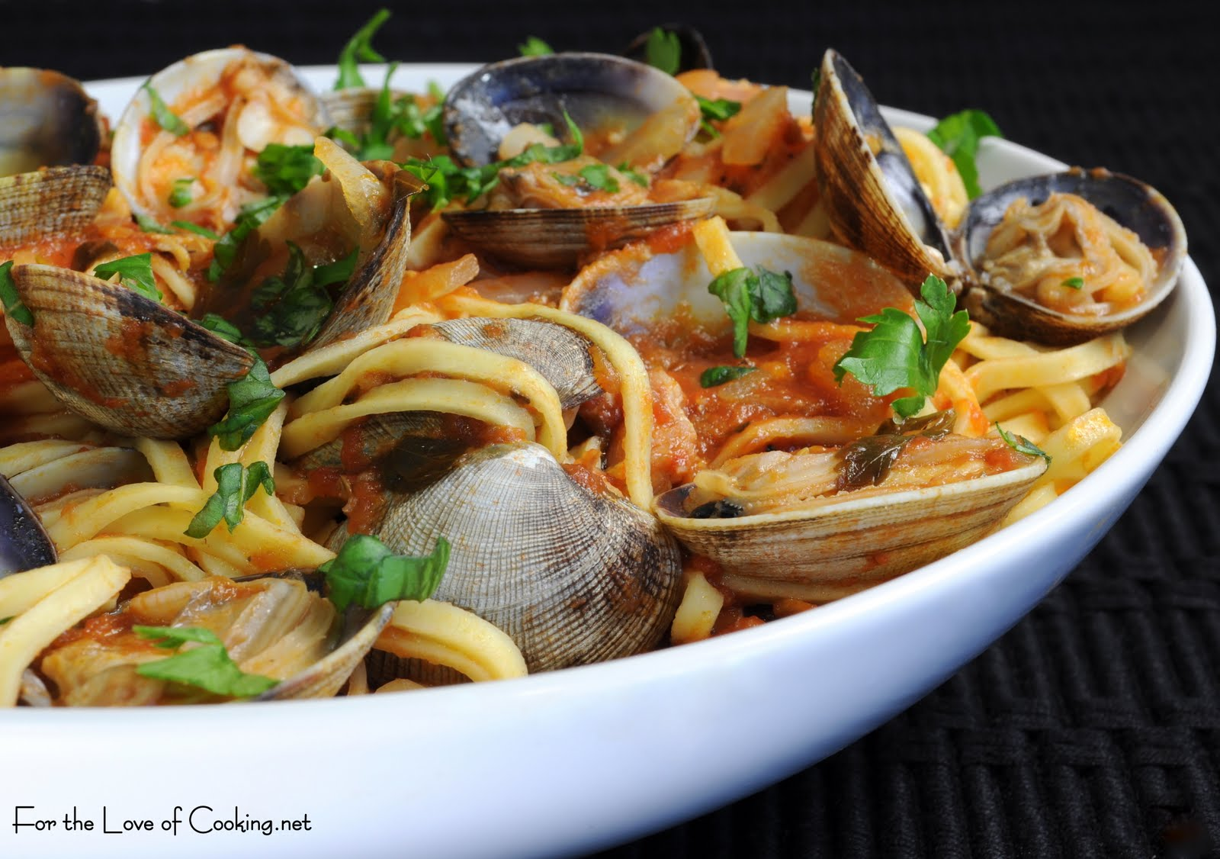
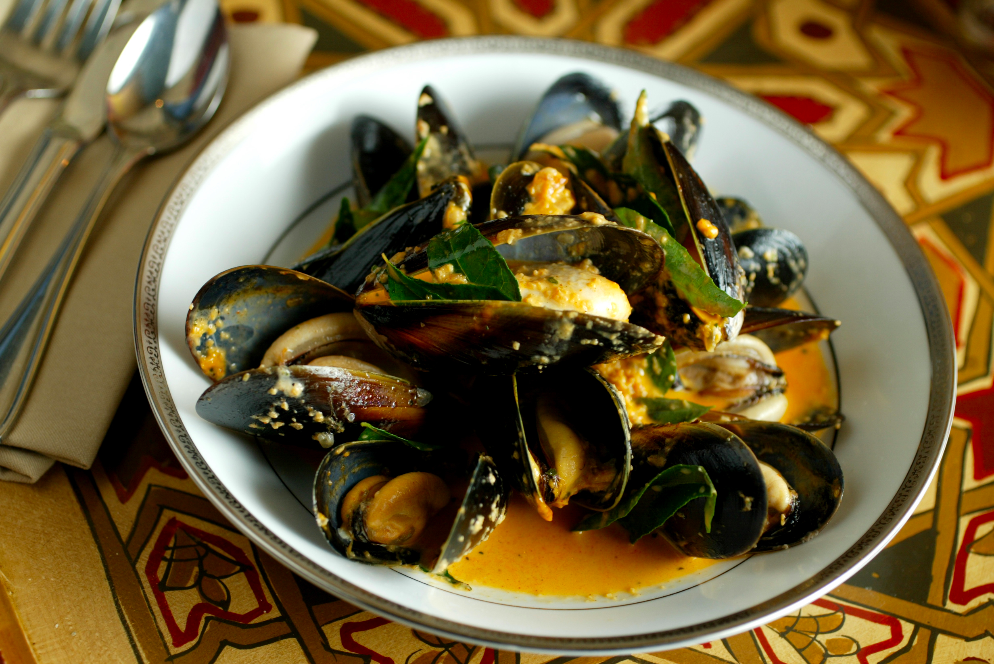
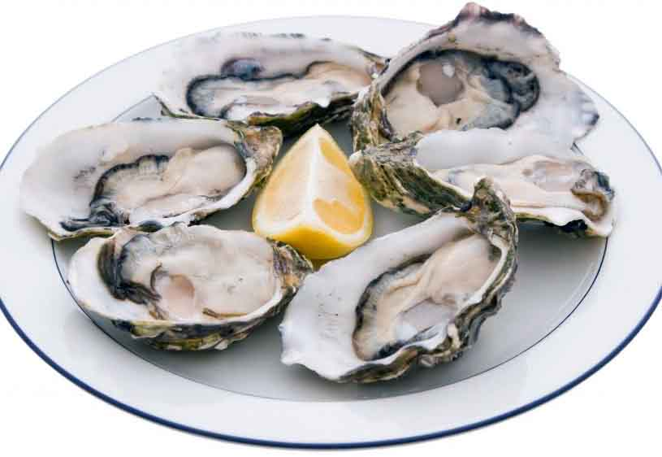
What images come to your mind when you hear “bivalves”?

Slide 5
What images come to your mind when you hear “the Puget Sound”?

Slide 6
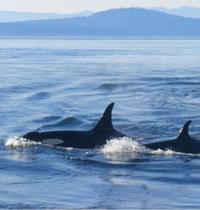
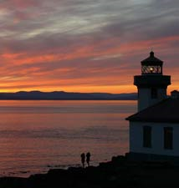
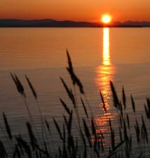
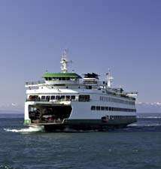
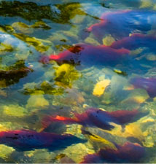
What images come to your mind when you hear “the Puget Sound”?

Slide 7
What are some of the threats to Puget Sound Health?

Slide 8
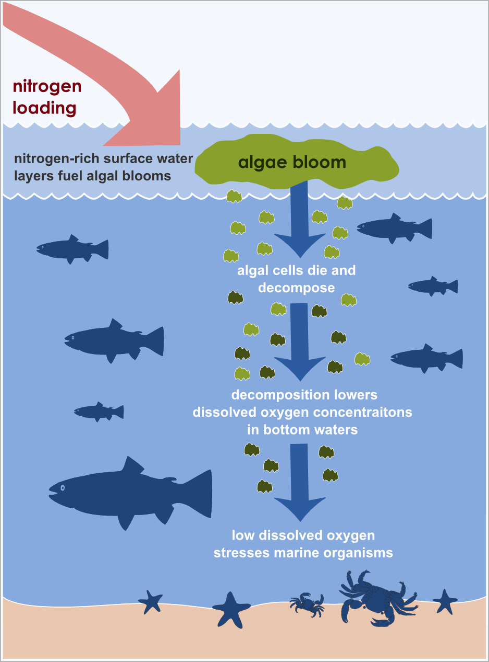
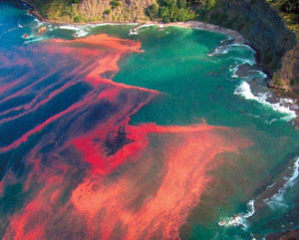
What are some of the threats to Puget Sound Health?
Eutrophication
WA Dept of Ecology

Slide 9
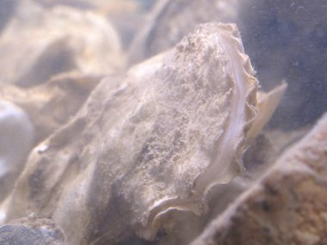
Who can help?
Bivalves!!
(Ben Raines/Press-Register)
Bruce Plante

Slide 10
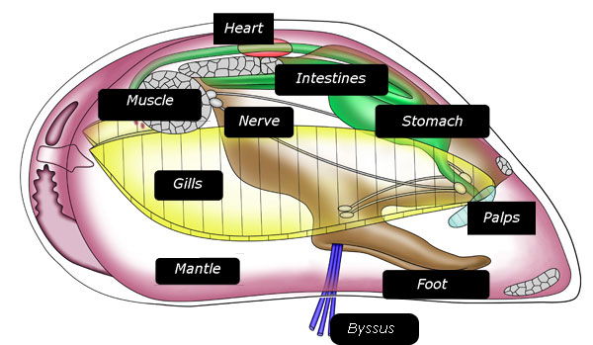
Mussel Anatomy
water
flow

Slide 11
Let’s get started!!
Station 1: Mussel Dissection
Observe and draw mussel anatomy
Gently ‘feed’ your oyster and describe what happens
Station 2: Plankton Investigation
Observe the microscopic organisms the mussels are filtering
Can you identify what you see?

