Slide 1
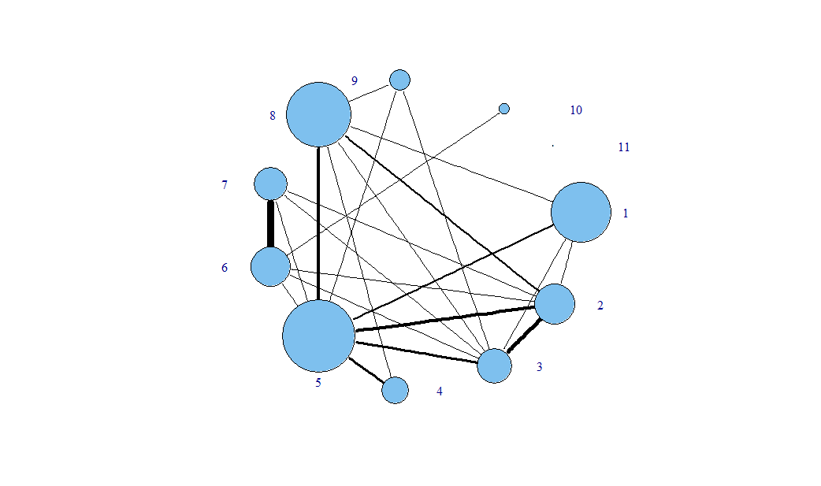
Developmental processes
Protein metabolism
Death
Cell adhesion
DNA metabolism
Transport
Stress response
Cell cycle and proliferation
RNA metabolism
Cell organization and biogenesis
Signal transduction
Legend:
1 shared gene
2 genes
4 shared genes
10-50 genes
9 shared genes
> 50 genes

Slide 2
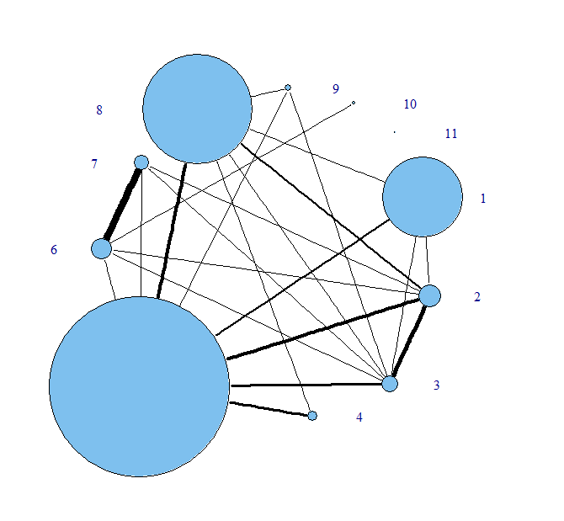
Developmental processes
Legend:
Protein metabolism
Death
1 shared gene
Cell adhesion
4 shared genes
DNA metabolism
9 shared genes
Transport
2 genes
Stress response
10 genes
Cell cycle and proliferation
50 genes
Cell organization and biogenesis
Signal transduction
RNA metabolism

