Slide 1
Fig1
A
Survival
B
Shell Area (μm²⁾
Sampling Day
Figure 1. Average (+/- SE) larval survival (A) and shell area (B) at ambient (diamonds) and elevated (squares) pCO₂ conditions (n=3). Arrows indicate time at which samples were taken for transcriptomic analysis.

Slide 2
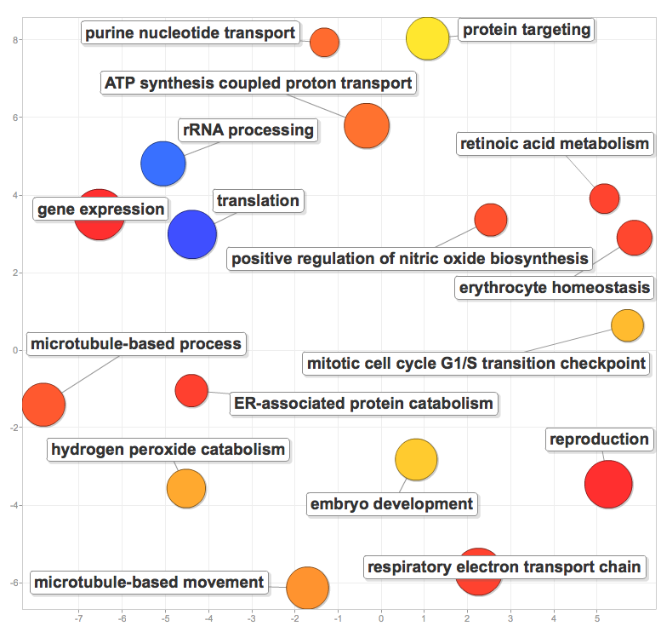
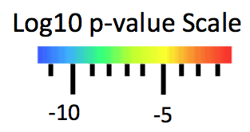
Fig2
Log10 p-value Scale
-5
-10
Semantic Space Y
Semantic Space X

Slide 3
Fig2
Semantic Space Y
Semantic Space X
Figure 2. Visualization of enriched Gene Ontology biological processes identified from hypergeometric tests on gene annotations. Distance between processes represents semantic similarity and color indicates –log10 p-values.

Slide 4
Table1

