Slide 1


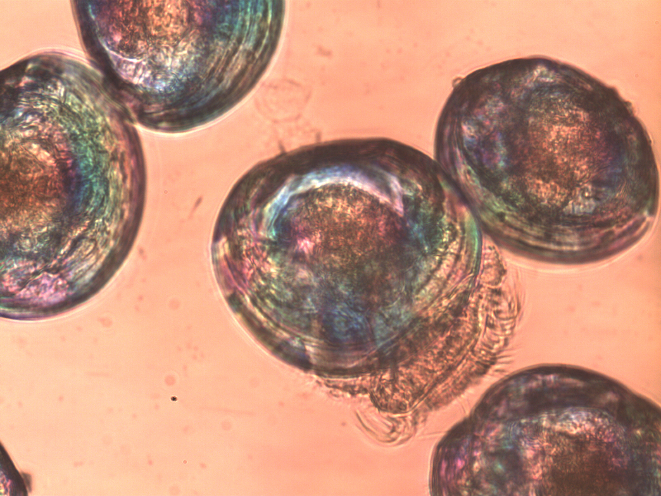


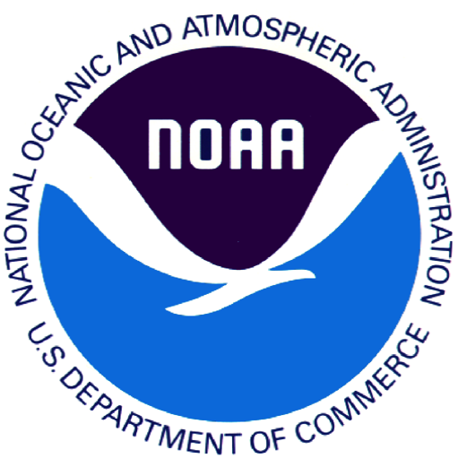

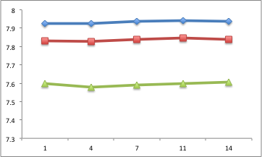
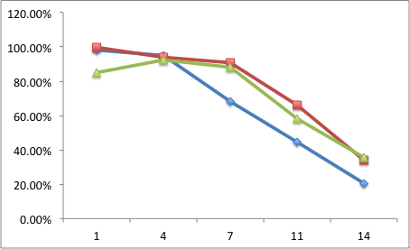
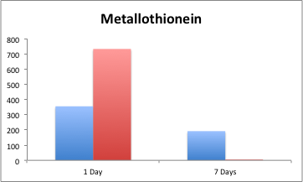
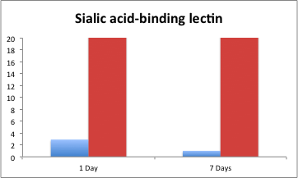
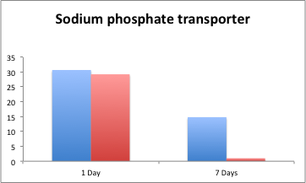
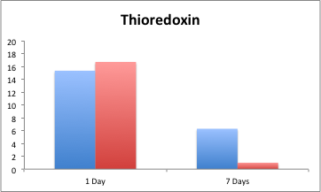
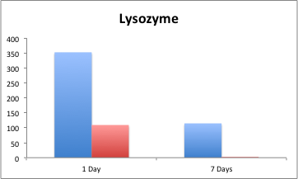
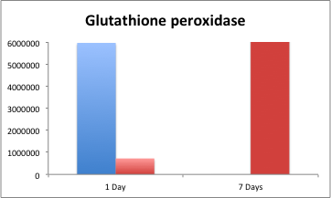
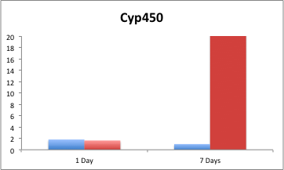
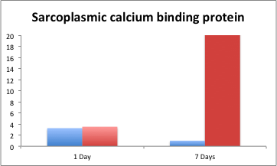
Assessment of Manila Clam Larval Survival and
Physiology at Increased pCO₂ Levels
David C. Metzger*¹, Shallin Busch², Paul McElhany², Carolyn S. Friedman¹, Steven B. Roberts¹
¹School of Aquatic and Fishery Sciences, University of Washington, Seattle, WA., ²Northwest Fisheries Science Center, NOAA, Seattle, WA
Introduction
Ocean Acidification as a result of increasing levels of dissolved CO₂ has been shown to impact the survival, physiology, and morphology of calcifying organisms.
Larval stages are thought to be at particular risk among bivalve species due to their dependences on soluble calcium.
Limited studies exist that focus on the transcriptional response of calcifying organisms exposed to increased pCO₂.
Summary of pH measurements and survival at 400, 520, and 1000ppm CO₂
Conclusions
Elevated pCO₂ levels appear to have no impact on 5 day old larval clam survival.
Gene expression varies significantly depending on the physiological function.
Genes associated with stress response and ion transport are dramatically induced after one week of treatment at 1000ppm CO_{2.}
Future Directions
Generate transcriptome libraries from 1 week samples at 400 and 1000ppm CO₂ treatments.
Further validation of qPCR results including additional replicates and more time points.
Sequence and measure transcripts of genes identified in other organisms (ie sea urchins) that are thought to be impacted by ocean acidification.
Complete assessment of larval growth rates under different pCO2 conditions.
pH
% Survival
Number of days in pCO₂ treatment
= 400ppm CO₂
= 520ppm CO₂
= 1000ppm CO₂
Gene expression
= 400ppm CO₂
=1000ppm CO₂
Goals
1. Assess the impacts of elevated pCO₂ treatments on clam larval survival and morphology.
2. Characterize physiological changes at the molecular level as a result of elevated pCO₂ conditions.
>1x10⁹
>1x10⁹
>1x10⁹
>1x10⁹
>1x10⁹
>1x10⁹
Experimental Design
i
t
5 day old larvae
Relative gene expression (fold change/min)
Split into three
pCO₂ treatments with 6 replicates
per treatment.
Acknowledgements
Special thanks to Taylor Shellfish farms, NOAA’s Northwest Fisheries Science Center, and the University of Washington School of Aquatic and Fishery Sciences for assistance with this research. This work was funded by Washington Sea Grant and NOAA’s Saltonstall-Kennedy program.
400ppm
520ppm
1000ppm
Take samples for mortality, morphometrics,
and qPCR.
1, 4, 7, 11, and 14 days
Number of days in pCO₂ treatment

