Slide 1
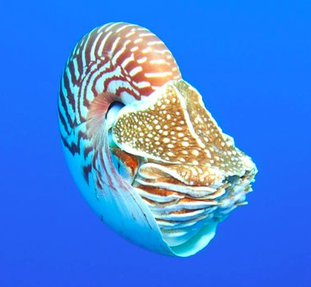
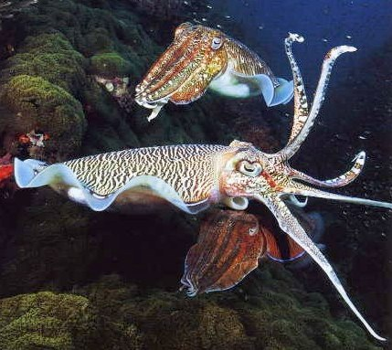
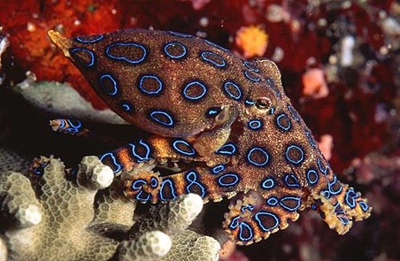
Mollusca: Class Cephalopoda
Lecture 11
FISH 310 April 29th, 2013
Notes:
Cephalopoda= head foot
Squid, octopus, cuttlefish, and chambered nautilus

Slide 2
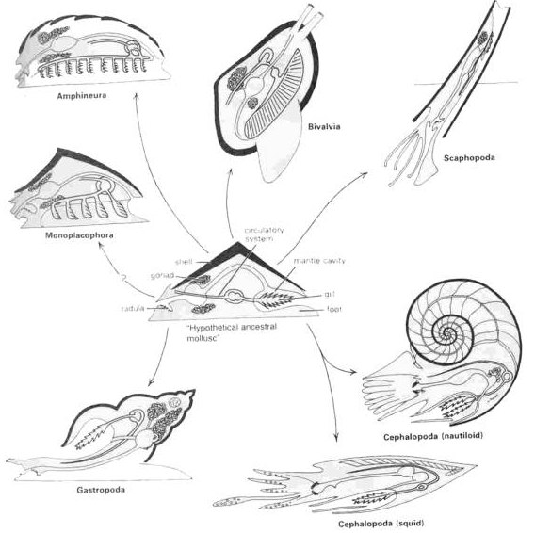
Cephalophod Characteristics
Characteristics of class
All marine
Most 6-70 cm up to 20m Architeuthis
Shell divided by septa, chambers connected by siphuncle
Closed circulatory system
Foot modification
Ganglia fused to form large brain in cartilaginous cranium
~700 species (~10K extinct) & 46 families
Notes:
Septa- series of compartments
Siphuncle= vascularized strand of tissue contained within a tube of calcium carbonate
-Shell is reduced or lost in many species
-Foot modified into flexible arms and siphon

Slide 3
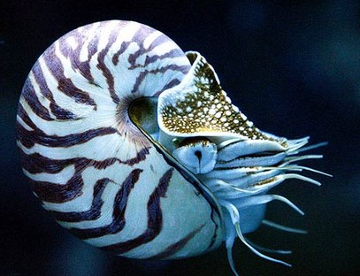
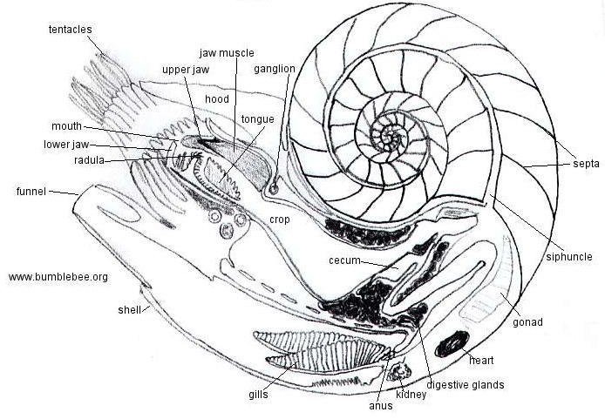
Cephalopod Morphology
Shell
Tentacles
Siphuncle
Septa
Radula
Funnel
Shell
Gills
Heart

Slide 4
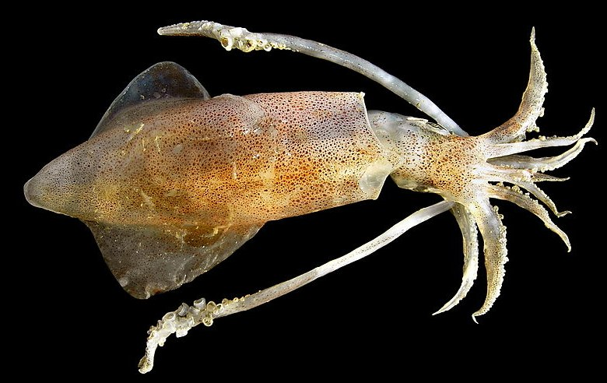
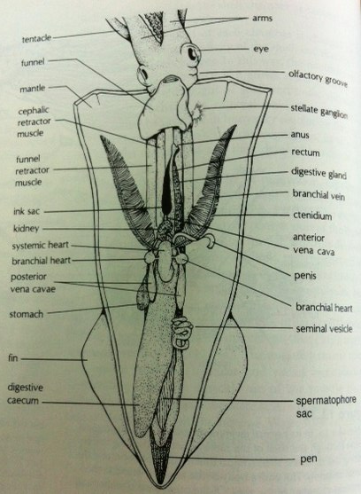
Cephalopod Morphology
Mantle
Arms
Fins
Extendable Tentacle

Slide 5
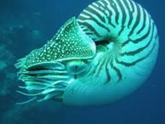
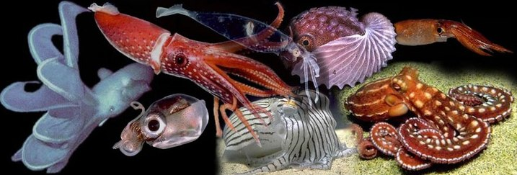
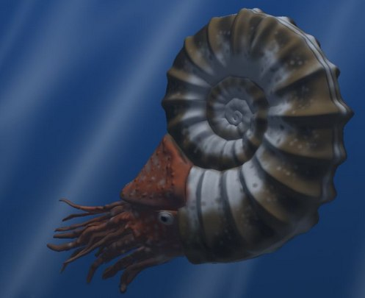
Taxonomy
Nautiloidea
Coleoidea
Ammonoidea
Notes:
Coleoidea= soft-bodied creatures (octopus, squid, cuttlefish), shell internalized or absent
Ammonoidea= Ammonites, extinct but shells common as fossils, more closely related to coleoids than nautilus

Slide 6
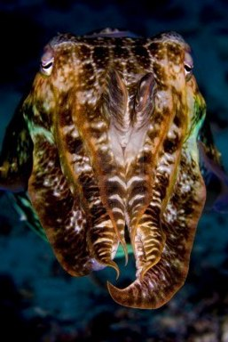
Cephalopod ecology
Strictly marine, none can tolerate freshwater
Occupy most depths of ocean- from abyssal plain to sea surface
All are predators and use tentacles to catch prey, beak to consume
Notes:
Abyssal plain=deep ocean floor, 3000-6000m

Slide 7
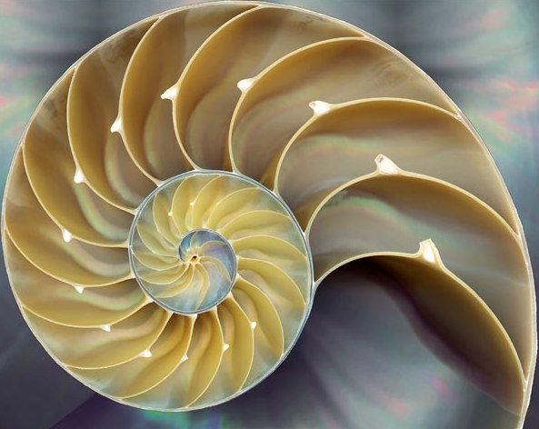
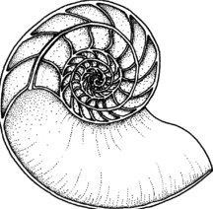
Cephalopod Shells
Nautilus possess a true external shell
Hypostracum, Ostracum, Periostracum
Shell spiral and divided by septa
Animal in largest outermost chamber
Septa penetrated by siphuncle
Calcified tube
Osmotic pump empty water from chambers, buoyancy
http://www.fhperry.com/pages/relationships.html
Notes:
Basic construction plan of calcium carbonate laid down in layers. Hypostracum= inner nacreous layer. Periostracum= covering, thin organic surface coating (prisms of calcium carbonate)
Unlike gastropods divided by septa into a series of compartments. Siphuncle=strand of tissue enclosed in delicate calcareous tube passing longitudinally through shellOsmotic pump to remove liquid from chambers and replace it with gas (buoyancy). Also buoyancy regulation during vertical migrations. Transport liquid to and from chambers, gas diffusing into or out of the chambers as the fluid volumes are altered. Salts actively pumped out of siphuncle, water passively diffuse out of chamber and is replaced by gas.

Slide 8
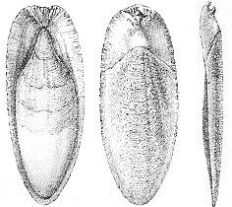
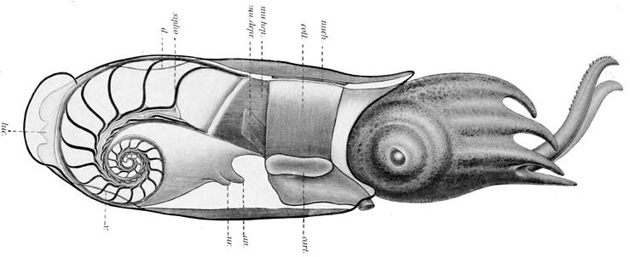
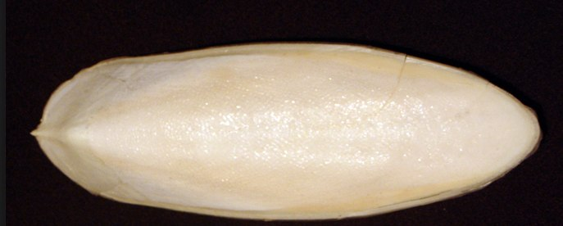
Shells and Buoyancy Regulation
Nautilus: chambered shell
Gas diffusion into gap between mantle and shell
Cuttlefish: internal chambered shell involved in buoyancy regulation
Squid: internalized shell=pen
Regulate water volume
Notes:
Most modern cephalopods retain a shell (bear it internally). Pen=thin, stiff, proteinaceous sheet called the pen. squid compensate for their own body weight by accumulating high concentrations of ammonium ions in the coelomic fluid.
In octopuses, no vestiges of a shell remain.
Regulate water volume: allow purer water to ooze from their kindeys, forcing out denser salt water from the body cavity. Water volume regulated to control gas volume.
Reduction or loss of shell is major theme in cephalopod evolution. As external shells have become reduced or lost in evolution, cephalopods have become increasingly vulnerable to predation. What adaptive advantages might have been gained by loosing their shells?
-not restricted having to carry shells around with them
-Can move through water much faster
-can change colors/patterns to match surroundings (chromatophores)

Slide 9
Movement
Jet propulsion
Nautilus: Expel water from mantle cavity through funnel
Other cephalopods: contract and expand mantle tissue
Escaping predators and capturing prey
Arms (Octopus) or muscular lateral fins (squid and cuttlefish)
Notes:
Jet propulsion- nautilus, expel water from siphon or funnel=flexible, hollow tube
The muscular funnel, which is derived from the foot of of the “typical” mollusc.
Mantle can play a major role in movement. Mantle tissue thick with musculature, contracting musculature of mantle tissue increases volume of mantle cavity.
Picture- time series showing up and down movement of a cirrate octopod.

Slide 10
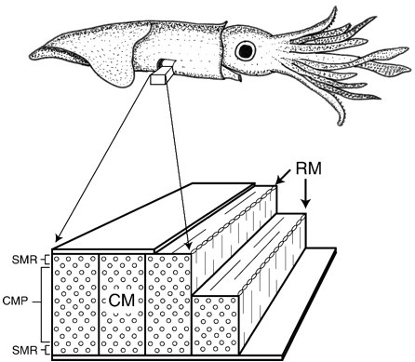
Jet Propulsion
Water enter cavity through one-way valves
Influx cause animal to draw forward
Muscles relax, large volume of water expelled
Enable cephalopod to move at high speed
Circular and radial muscles
Notes:
Water enters mantle cavity through one-way valves. Influx of water causes animal to be drawn forward. When the muscles relax, a large volume of water is forcefully expelled through the hollow funnel. Greater water expelled =enables cephalopods to move at high speeds. Jet propulsion used for escaping predators and capturing prey. For leisurely locomotion, many species use arms (Octopus) or muscular lateral fins (squid and cuttlefish).
Why wouldn’t they always move by jet propulsion? Very energy-consuming way to travel.

Slide 11
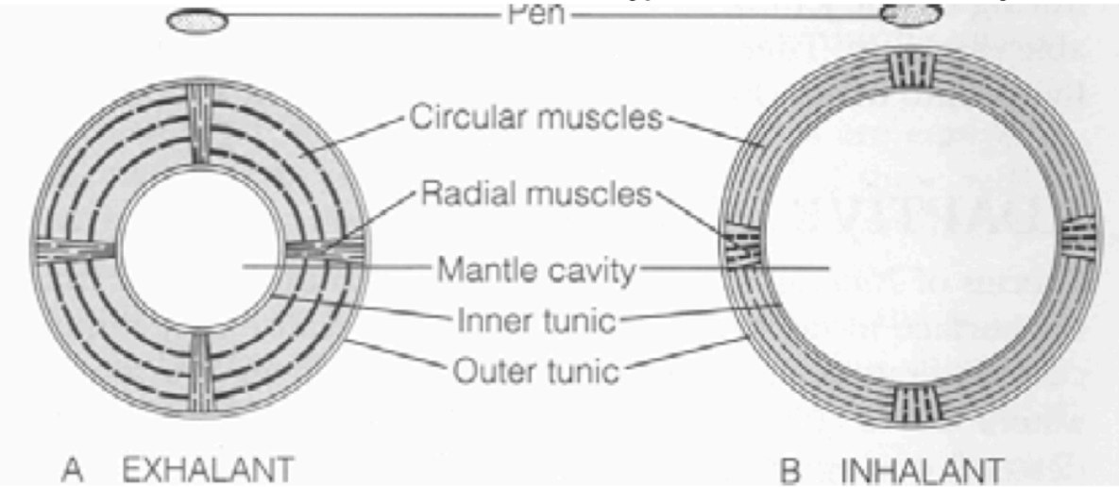
Jet Propulsion
Circular and radial muscles
Contraction of circular muscles expels water
Contractions of radial muscle hyperextends mantle cavity

Slide 12
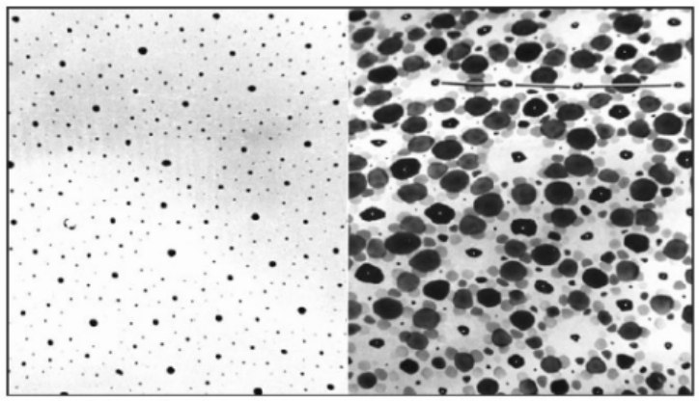
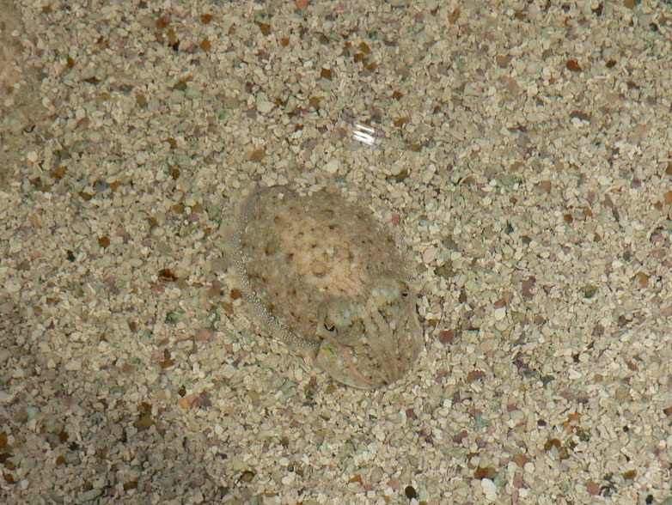
Cephalopod protection
Chromatophores
Tiny colored cells or pigment sacs that overlay reflective cells (iridocytes)
Muscle contraction=sac expansion
Defensive, camouflaging, and courtship behaviors
Red, yellow, black and brown
Notes:
Chromatophores- Skin of most cephalopods contains several layers of tiny colored cells/pigment sacs. Skin of a single individual contains hundreds of thousands of chromatophores. When the muscles contract, the pigment stretches out and colors the skin.
Expansions and contractions of them are mediated by muscle elements in the skin and are under direct nervous control from brain. Coloration of cephalopod skin may change extremely quickly. Defensive, camouflaging, and courtship behaviors have been described. Nautilus lacks chromatophores. Pigments=brown, black, brown yellow, and red.
Chromatophores on top pigmented red, yellow and brown.
Picture=cuttlefish
Photo= chromatophores in a squid. Left=contracted, right=expanded
When the muscles around chromatophores relaxed, pigment is concentrated into a tiny point, making the area of the skin appear white.

Slide 13
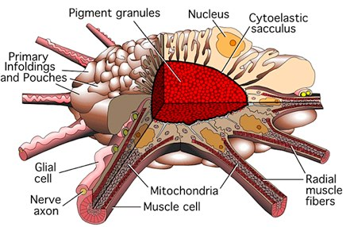
Cephalopod protection
Iridophores
Brain reads changing light passing through eye, trigger electrical instructions
Appear as shifting iridescent colors depending on the angle of light
Notes:
Create illusions of passing clouds and bands across the skin.
Can fool predators in 2 ways- creating a close match to the background, or a pattern that disrupts recognition of the shape of the cuttlefish.
Under chromatophores are iridophores.
As cuttlefish swim, brain reads the changing light passing through the eye, triggering electrical instructions in the nevrous system. As iridiphores shift with the light, the top layers of cells adjust into the right color blend to add up to a match.

Slide 14
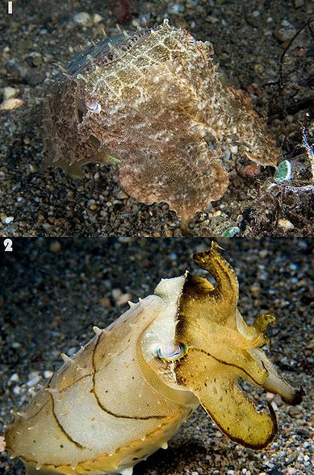
Cephalopod protection
Iridophores
Pigment cells that diffract light using plates of crystalline chemochromes
When illuminated, generate iridescent colors from reflecting light within stacked plates
Light hits plates, some reflected and some passes through
Can match wavelength of different colors of light by controlling size of gap between plates
Metallic greens and blues
Notes:
Iridophores- pigment cells that reflect light using plates of crystalline chemochromes made from guanine. When illuminated they generate iridescent colors because of the diffraction of light within the stacked plates.
Contain stacks of plates of protein separated by liquid.
When light hits each plate, some is reflected but the rest passes through to plates below.
By controlling the size of the gap between the plates, can match wavelength of different colors of light.
Responsible for metallic greens and blues- intense bursts of color- iridescence.

Slide 15
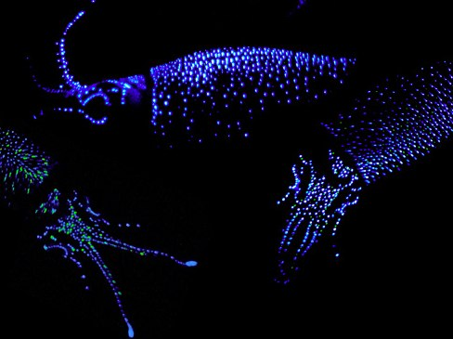
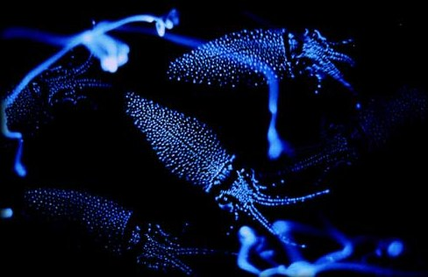
Cephalopod protection
Photophores- light production by biochemical reactions
Bioluminescence: biochemical production of light with minimal heat
Produced by symbiotic bacteria living within photophores
Attracting/recognizing mates, luring in prey, and protecting against predation
Notes:
Many midwater and deep-water squid have light organs called photophores. Distributed on body in distinctive patterns. Light produced by biochemical reactions that parallel to a remarkable degree those demonstrated by many arthropods.
In at least 3 dozen squid species, the bioluminescence is produced by symbiotic bacteria living within the photophores.
May play a role in attracting or recognizing mates and in luring potential prey, and certainly protects against predation. At night or in deep water flashes of light may startle predators.

Slide 16
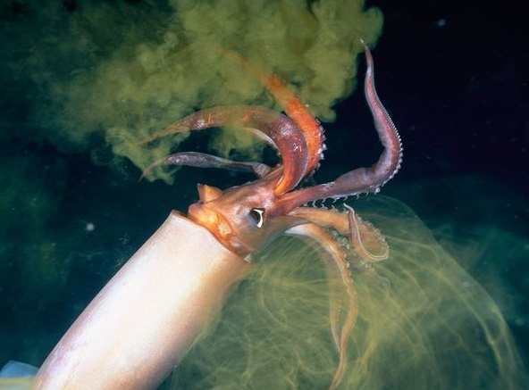
Cephalopod protection
Ink Sac
Most cephalopods other than Nautilus
Dark-pigmented fluid=melanin and mucous
Form a cloud that confuses potential predators
May act as mild narcotic
Notes:
Most cephalopods other than Nautilus have an ink sac associated with the digestive system. The dark-pigmented fluid secreted by the ink sac may be discharged deliberately through the anus, forming a cloud that presumably confuses potential predators and that also may act as a mild narcotic- visual and chemosensory impairment.

Slide 17
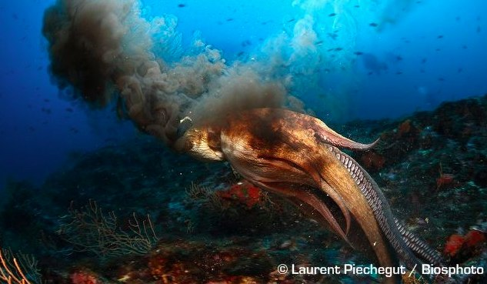
Cephalopod protection
Ink Sac
Pseuodomorph decoy
Greater mucus content
Resemblance to cephalopod that released it
Notes:
Sophisticated behavior of inking. Cephalopod releases a cloud with a greater mucous content that approximately resembles the cephalopod that released it. Decoy=pseudomorph=false bodies. Greater mucous content allows them to hold their shape for longer. This strategy often results in the predator attacking the pseudomorph, rather than its rapidly departing prey.

Slide 18
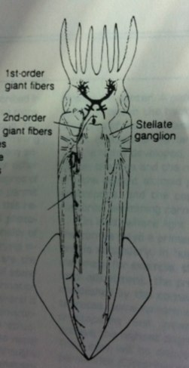
Nervous System
Highly developed- correlated with locomotor dexterity
Cephalization encased in cartilaginous cranium
Large complex highly differentiated brain
Nerves from visceral ganglia supply the mantle
Command center: pair of very large neurons, fired by impulses from sensory organs
Notes:
Think of octopus- clear capability for memory and learning.
High degree of development of cephalopod NS compared to other inverts. Correlated with locomotor dexterity and carnivorous habit. Strongly concentrated, cephalized (ganglia concentrated, concentration of sensory and nervous tissue at anterior end) encased in cartilaginous cranium, and bilaterally symmetrical.
A large pair of nerves from the visceral ganglia supplies the mantle. For swimming and contractions of mantle musculature.
Neurons are fired by impulses from the sense organs.

Slide 19
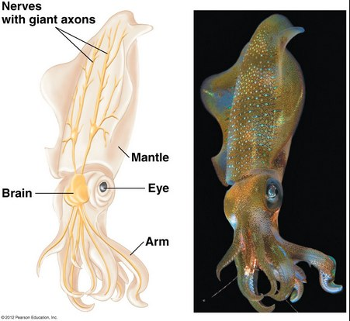
Squid giant axon: providing clues to nerve cell repair
Giant axon up to 1mm in diameter
Model for nerve cell repair
Inject membrane with fluorescent dyes visualize what occurs when nerve injured
Axon membrane diameter shrinks and vesicles travel to site of injury
Notes:
Axon=nerve fibre, normally 0.5mm. Axon that controls part of the water jet propulsion system in squid. Squid use this system for making brief but very fast movements through water.
Research developed a model for nerve cell repair by studying the giant axon of the squid. Inject fluorescent dyes into the membrane of the squid axon visually see what occurs when a nerve is injured. The fluorescently labeled vesicles then travel to the injury site and plug the hole in the cell membrane.

Slide 20
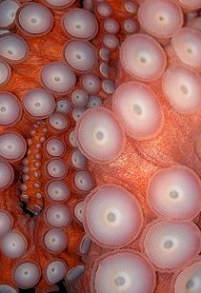
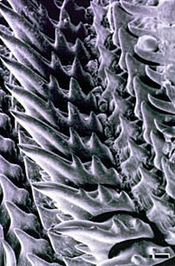
Feeding Mechanisms
Raptorial feeding and carnivorous diet
Tentacles with adhesive suckers
Rim is toothed and inner wall has hooks
Radula
Pair of powerful beak-like jaws
Two pairs of salivary glands
Anterior=mucous
Posterior=poison, proteolytic enzymes (Octopus)
Notes:
Prey located with highly developed eyes, capture effected by tentacles or arms. Some have tentacles with adhesive suckers. Rim of sucker is commonly horny and toothed and the inner wall sometimes has hooks.
Radula present in cephalopods, but more important is pair of powerful beaklike jaws in buccal cavity. Beak can bite off and tear large pieces of tissue, which are then pulled into the buccal cavity by a tongue-like action of the radula and finally swallowed.
Two pairs of salivary glands empty into the buccal cavity. Posterior salivary glands secrete poison and proteolytic enzymes in Octopus. Poison can enter the tissues of the prey through a wound inflicted by the jaws. E.g. blue-ringed octopus in the Indo-Pacific- extremely venomous an its bite has resulted in a few human fatalities.

Slide 21
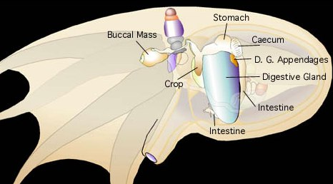
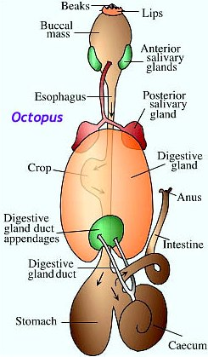
Digestive System
Complete digestive system with food transport via peristalsis
Digestive glands or digestive caeca
Digestion is extracellular
Absorption
Cecal walls=thin (Loligo)
Digestive gland=thick (Sepia and Octopus)
Waste through anus
Notes:
Peristalsis=radially symmetrical contraction and relaxation of muscles which propagates in a wave down muscular tube.
Most molluscs have a complete digestive system with a separate mouth an anus.
Associated with the stomach are one or more digestive glands or digestive caeca. Digestive enzymes are secreted into the lumen of these glands. Additional extracellular digestion takes place in the stomach.
Absorption takes place in the cecal walls- thin walls (loligo=squid) or in digestive gland- thick walls (Sepia=cuttlefish and Octopus).

Slide 22
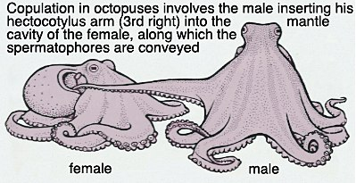
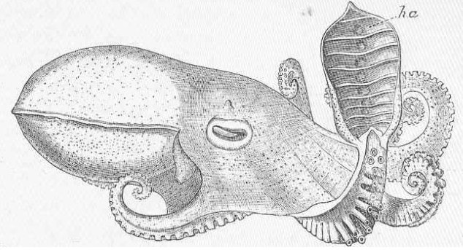
Cephalopod Reproduction
No known hermaphrodites
Usually dioecious: gonads in posterior of body
Internal fertilization
One arm of male modified as a copulatory organ to transfer sperm (hectocotylus)
Notes:
External fertilization in scaphopods and monoplacophorans, common among bivalves, chitons, and aplacophorans, but non-existent among cephalopods.
Internal fertilization? Adaptation to stressful conditions.
Cephalopods show a particularly distinctive set of adaptations for achieving internal fertilization: one arm modified as hectocotylus (intremittent organ), transfer packets of sperm (spermatophores) to the famale. Remove spermatophore from mantle cavity and insert into female’s mantle cavity. May get broken off while mating and retained in female’s cavity.
Pic- Octopus with hectocotylized arm. Arm turned up to show where spermatophores will be carried. Hectocotylus of most cephalopods is not so highly modified.

Slide 23
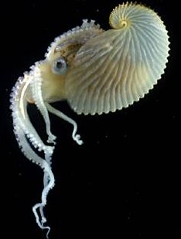
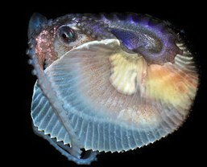
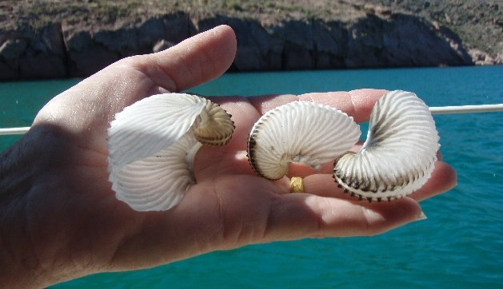
Paper Nautilus: Argonauta
Pelagic octopus
Adaptation for egg deposition
Eggcase secreted by tips of two expanded dorsal arms of female
Deposit eggs directly into case
Shell act as a brood chamber and a retreat for the female
Eggcase contains bubble of air used for buoyancy
Notes:
Pelagic octopus. Called paper nautilus due to their paper-thin egg case that females secrete. Used as a brood chamber and for trapped surface air to maintain buoyancy. Females produce a laterally-compressed calcareous egg case in which they reside. Eggcase secreted by the tips of the female’s two greatly expanded dorsal tentacles before egg laying. She deposits her egg in the floating eggcase, then takes shelter in it, often retaining the male’s detached hectocotylus. Eggcase contains a bubble of air that animal captures at the surface of the water and uses for buoyancy.

Slide 24
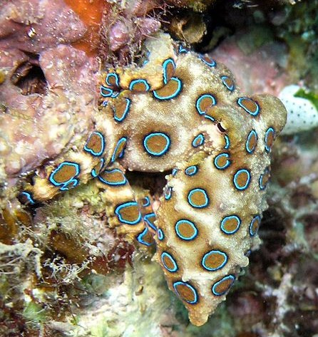
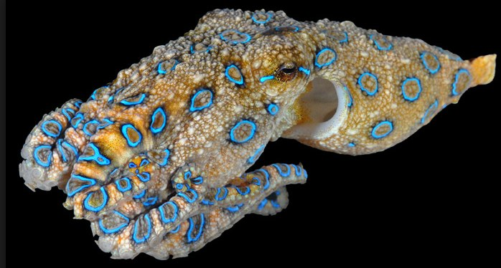
Blue-ringed octopus
Genus Hapalochlaena
Tide pools and coral reefs in Indian and Pacific Oceans
Use chromatophores to camouflage, changes color when provoked
One of the world’s most venomous animals, powerful enough to kill humans with no antivenom
Neurotoxin 100x more powerful than cyanide
Blocks sodium channels, causing motor paralysis and respiratory arrest
Produced by bacteria in salivary glands
Notes:
About 3 species of octopus that live in tide pools and coral reefs in Pacific and Indian Oceans.
Despite smalls size, recognized as one of the world’s most venomous animals.
Uses dermal chromatophore cells to camouflage itself until provoked, at which point It quickly changes color, becoming bright yellow with blue rings or lines.
Neurotoxin also found in pufferfish that is 100x more toxin than cyanide.
Toxin blocks sodium channels, within minutes of exposure leading to cardiac arrest due to lack of oxygen.
Toxin produced by bacteria in salivary glands of octopus

Slide 25
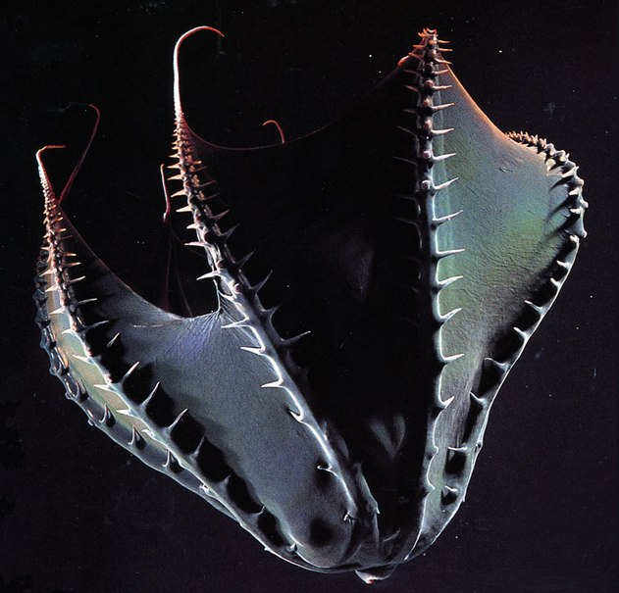
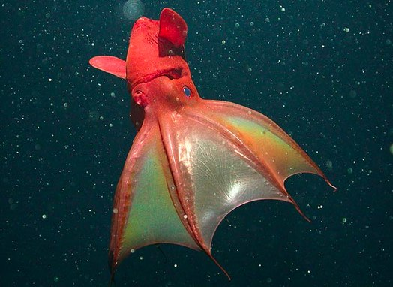
Vampire squid Vampyroteuthis infernalis
Deep sea in temperate and tropical areas
Radical adaptations to life in deep sea
Lowest mass-specific metabolic rate
Sophisticated statocysts
Ammonium-rich tissues
No ink sac,
Bioluminescent mucus as defense system
Turn inside-out
Notes:
“living fossil”
Deep sea cephalopod in temperate and tropical areas
Webbing of skin connects 8 arms.
To cope with suffocating at depth, vampire squid have developed several radical adaptations.
Mass-specific metabolic rate lowest: transport oxygen more efficiently than other cephalopods, and gills with especially large surface areas.
Animals have weak musculature, but maintain agility and buoyancy with little effort because of sophisticated statocysts (balancing organs).
Ammonium rich genatinous tissues closely matching density of surrounding seawater.
Vampire squid lacks ink sacs. If threatened, instead of ink, a sticky cloud of bioluminescent mucus containing innumerable orbs of blue light is ejected from the arm tips. Dazes predators and allows squid to dissapear. Also turns itself inside out- change in appearance may help it avoid being attacked by predators.

Slide 26
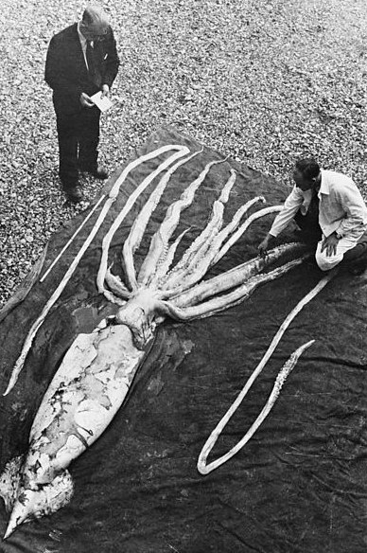
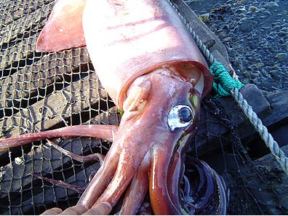
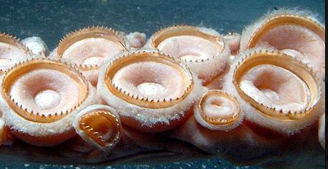
The Giant Squid: Architeuthis dux
Elusive creature
Eyes among the largest in the world- adaptation
Tentacles with suction cups with rings of chitin
Highly complex nervous system and highly developed brain
Notes:
Thought to be highly intelligent and may be one of the smartest invertebrates in the ocean. Eyes are among the largest in the world, second only to their larger cousin, the colossal squid. These giant eyes are actually the size of an average dinner plate, nearly one foot in diameter. Large eyes are an important adaptation that helps the squid locate food in deep ocean- distinguish differences in light levels and bioluminescent light.
Inside surfaces of tentacles lined with hundreds of suction cups, each mounted on a stalk, circumference lined with sharp finely serrated rings of chitin.
Sophisticated nervous system and complex brain has attracted great interest rom scientists.

Slide 27
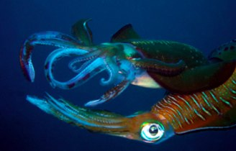
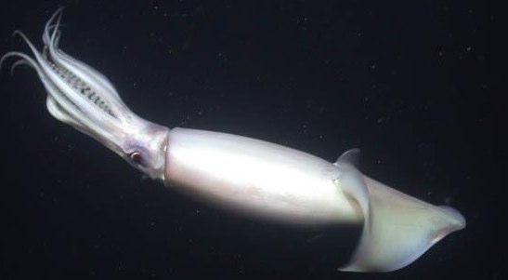
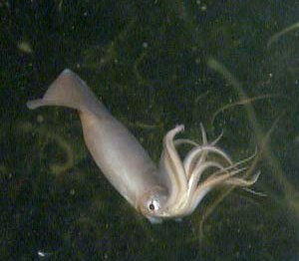
Humboldt squid migration
Squids moving north in response to overfishing and climate change
Ocean acidification changing their metabolism, driving them to shallower water
Notes:
Driving them to shallower water- why? allows for greater oxygen uptake

Slide 28
Awesome Videos!
Octopus camouflage: http://www.youtube.com/watch?v=PmDTtkZlMwM
Cuttlefish camouflage: http://www.youtube.com/watch?v=__XA6B41SQQ
Vampire squid: http://www.youtube.com/watch?v=IWAnliNc6wk

