Slide 1
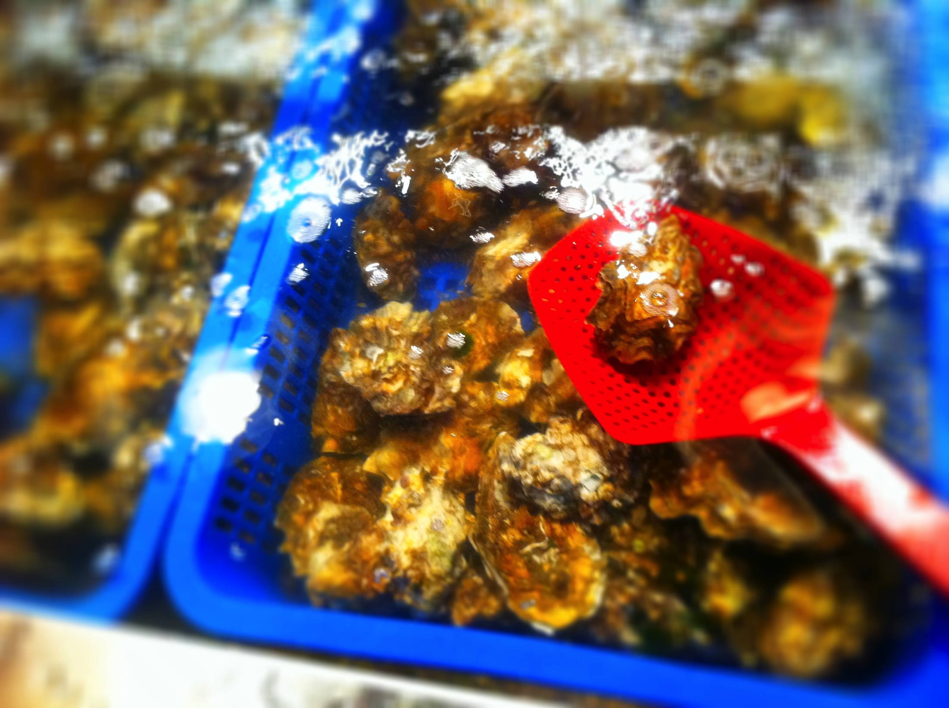
Characterizing epigenetic variation in the Pacific oyster (Crassostrea gigas)
Claire Olson
School of Aquatic and Fishery Sciences
University of Washington
Committee Meeting April 24th 2014
Notes:
Intent of this meeting for me to show my progress to date, discuss future research, proposed timeline for my degree, and approval on my Master’s proposal form

Slide 2
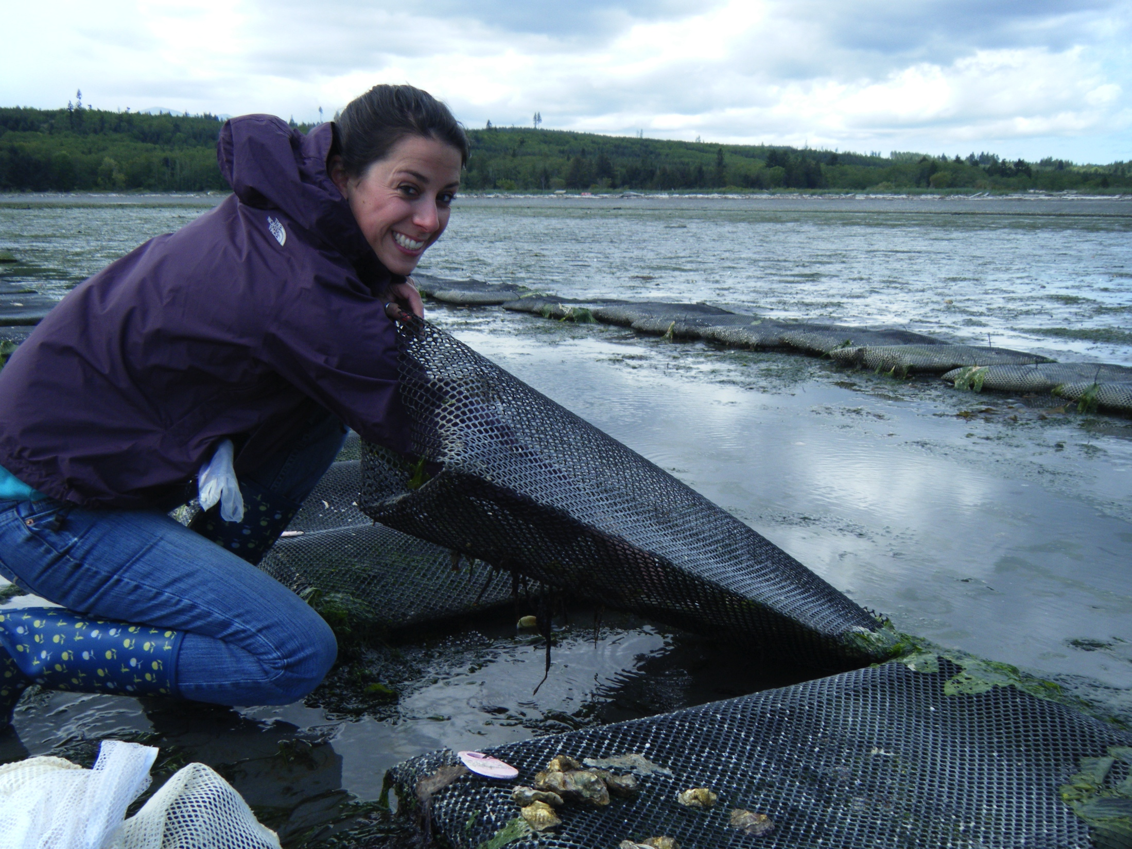
Committee Meeting Outline
Overview of Master’s thesis chapters
Research Update
Future steps
Timeline and progress

Slide 3
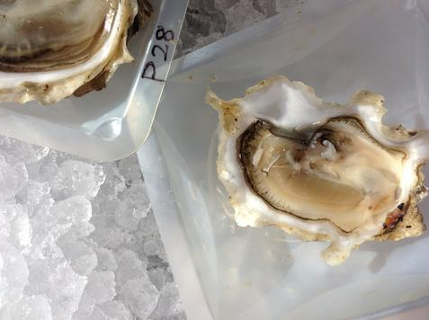
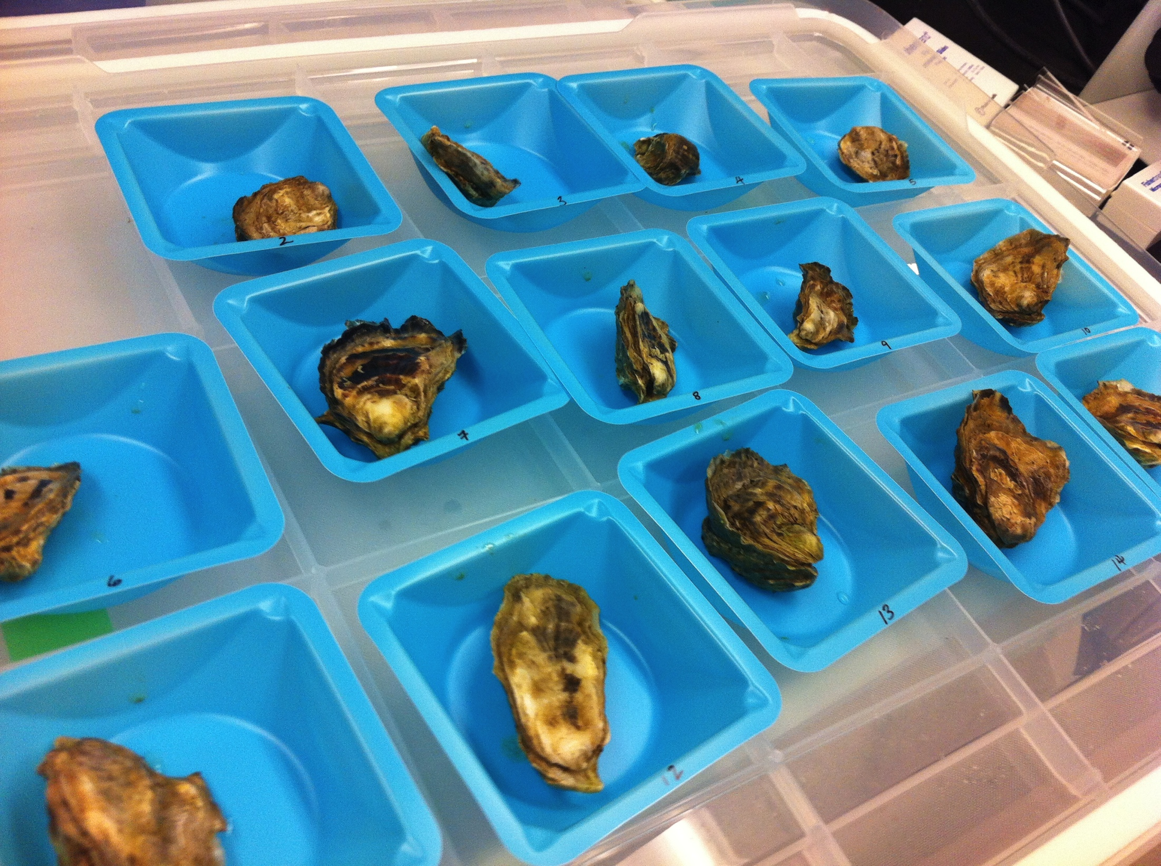
Goals
Characterize distribution of DNA methylation
Identify potential functions of DNA methylation
Notes:
Oysters are sessile marine animals, most cope and adapt to extreme environmental conditions that are associated with the intertidal zone. Oysters exposed to constant fluctuations in temperature and salinity and therefore must implement mechanisms to cope with these stressors, and epigenetic mechanisms such as DNA methylation may explain how these organisms are able to adapt.
Goals of this research is to use the Pacific oyster as a model organism to characterize DNA methylation patterns on a genome-wise level and determine putative role of methylation
Pacific oyster an excellent model for studying epigenetic modification because genomic resources for this species have recently become available (oyster genome) and its economic importance.

Slide 4
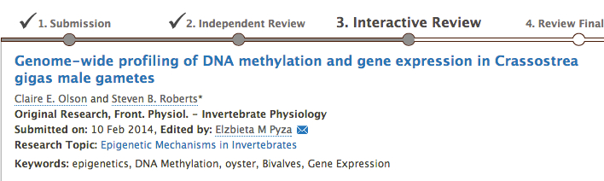
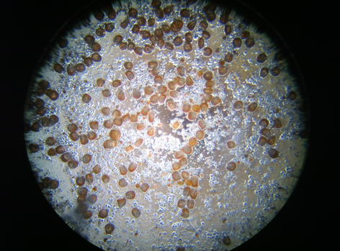
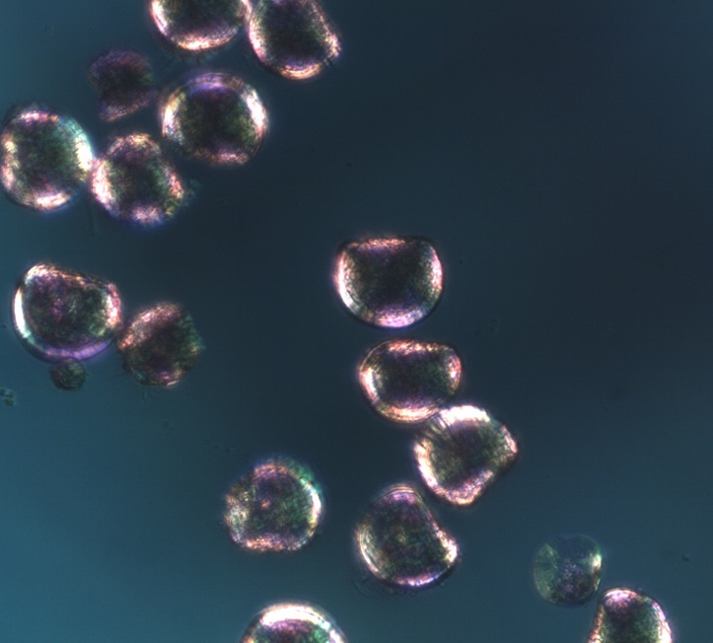
Understanding epigenetic variation in the oyster
Chapter 1: Characterizing genome-wide DNA methylation patterns in a single cell type
  Correlation with gene expression patterns
Chapter 2: DNA methylation during oyster early development
  Heritability vs. Individual variability
Notes:
Chapter 1: Characterized genome-wide DNA methylation profile in male gamete cells using whole-genome bisulfite sequencing. And RNAseq for meth vs expression
While we’re starting to understand DNA methylation in this species, still had some questions esp the relationship between methylation and gene expression, nor DNA methylation patterns in a single cell type. Examining a single cell type is important as methylation levels and patterns vary across cell types and life history stages.. Spermatozoa ideal for a single cell type.

Slide 5
Chapter 1: Genome-wide methylation
Determine genome-wide methylation patterns
  Whole Genome Bisulfite Sequencing (WGBS)
    Male gonad tissue: genome wide scale, single base pair resolution
    Unmethylated C to U (sequenced as T)
    Differentiate between SNPs from bisulfite conversion
CH₃
CH₃
A
C
G
C
T
C
A
G
Bisulfite treatment + sequencing
CH₃
CH₃
A
C
G
T
T
C
A
G
Notes:
-Genome-wide high throughput bisulfite sequencing conducted on male gonad tissue to provide a comprehensive view and reveal methylation patterns
-Using this approach, characterized methylation in male gonad tissue on a genome-wide scale, which still obtaining coverage at a single base pair resolution.
Analysis reduced to differentiating between single nucleotide polymorphisms resulting from bisulfite converstion (cytosines and thymidine) .
Uses bisulfite treatment of DNA to determine it’s pattern of methylation. Treatment with bisulfite converts cytosine residues to uracil, but leaves 5-methylcytosine residues unaffected. Thus, bisulfite treatment introduces specific changes in the DNA sequence that depend on the methylation status of the individual cytosine residues, yielding single-nucleotide resolution information about the methylation status of DNA.

Slide 6
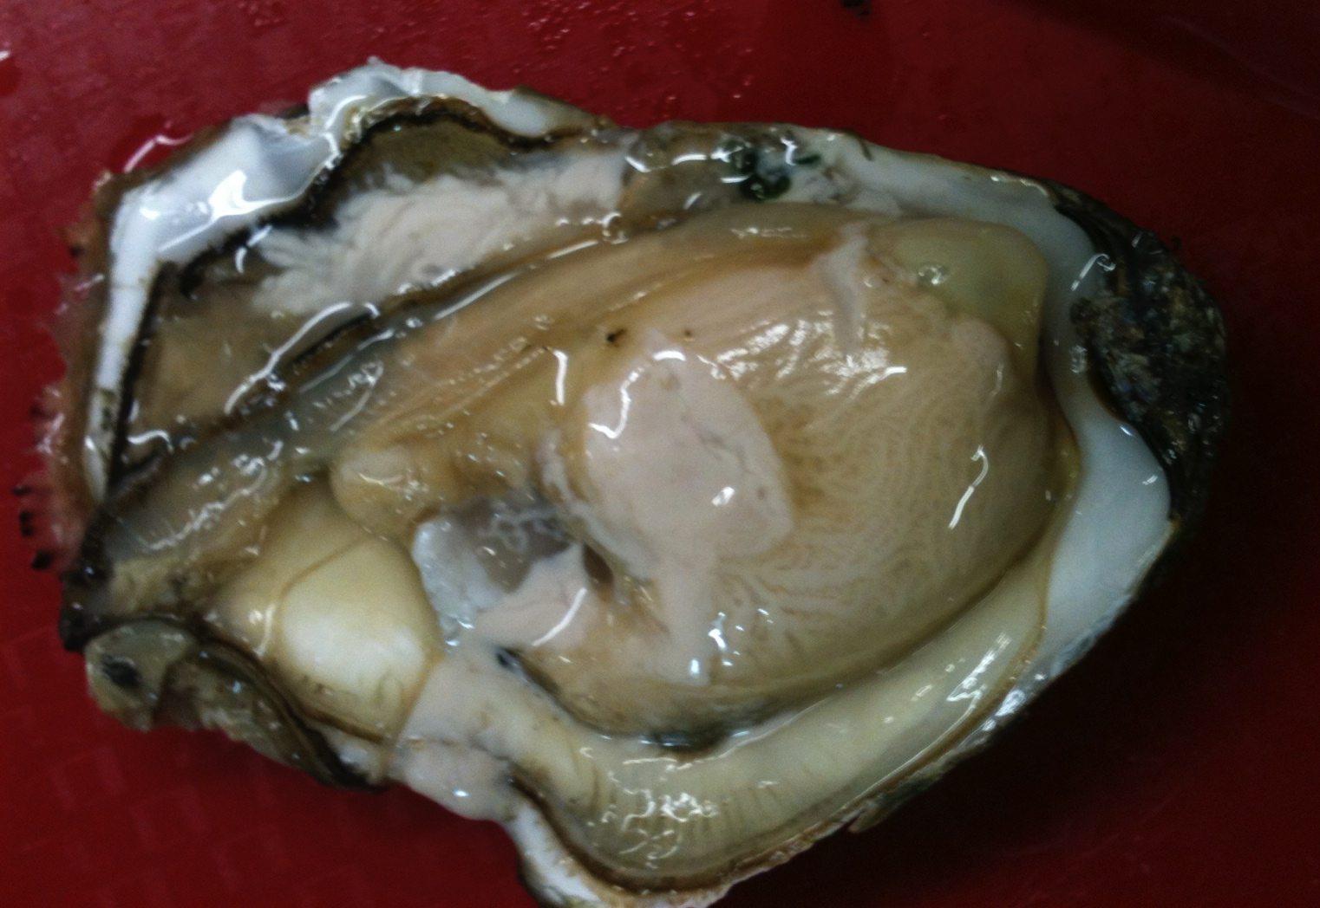

Chapter 1: Genome-wide methylation
Whole Transcriptome Shotgun Sequencing
Methylation vs expression patterns in a single cell type
Relationship between gene expression and promoter methylation
RNA extracted from gonad tissue
AAAAA
Enrich for mRNA
AAAAA
Create cDNA library
Sequence on Illumina
Gene expression data for 17,093 genes
Notes:
Potential function of DNA methylation- relationship between methylation and expression (or gene function). Snapshot of RNA presence and quantity from a genome at a given moment in time. Look at relationships between epigenetic and genetic variations. Particularly interested in relationship between gene expression and promoter methylation, as primary function of DNA methylation in mammals is to suppress gene expression through increased promoter methylation

Slide 7
Chapter 1: Genome-wide methylation
Coverage for 7.64 million CpGs
Overall 15% genome methylation
Methylation primarily in intragenic regions
No methylation in mitochondrial genome
Positive association between methylation status and expression
  Methylation involved in gene regulatory activity
Notes:
Using oyster reference genome for mapping
5x coverage threshold (need at least five reads in that region in order quantitatively call methylation), information for 7.64 million CpGs
Overall 15% of the CpG dinucleotides determined to be methylated- comparable with other invertebrate sp’s
Majority of methylated regions occurring among intragenic regions (exons and introns)
Mitochondrial genome lacked DNA methylation (consistent with other studies)
Positive association of meth vs expression (both in gene bodies and promoter regions)
Analysis of DNA methylation and gene expression data revealed a positive association between methylation status, both within gene bodies and promoter regions, and expression- DNA methylation is likely involved in gene regulatory activity.

Slide 8
Chapter 1: Genome-wide methylation
Distribution of methylation ratios
DNA methylation is dispersed throughout the oyster genome
Notes:
Frequency of methylation - 7.64 million CpG dinucleotides were examined for the distribution of methylation.
Extreme methylation levels- with DNA being primarily either methylated or unmethylated in the genome.

Slide 9

Chapter 1: Genome-wide methylation
Methylated CpGs
Non-methylated CpGs
mRNA
Exons
Introns
Notes:
Genomic visualization tools
Visualize patterns of methylated and non-methylated regions of oyster genome, as they relate to various genomic areas.
Showing a scaffold of the oyster genome, each dot represents a single CpG dinucleotide.
Vizualize what areas of the oyster genome the methylated and nonmethylated areas correspond to.

Slide 10
Distribution of methylation within genomic regions
Methylation occurring predominantly in intragenic regions (expressed portions and introns)
Exons
Introns
Methylated CpGs
All CpGs
Other

Slide 11
Distribution of methylation within genomic regions
Notes:
Where methylation is with respect to genomic regions. Proportion of meth regions shown as percentage contributions to specific oyster genomic regions. Genomic regions are also scaled according to their contribution to the entire oyster genome.
Methylation occurs primarily in exons and introns (dark blue comparatively larger).
Methylated (ratio >0.5), sparsely methylated (ration between 0->.5) unmethylated (ratio =0) or uncovered regions of CpG dinucleotides

Slide 12
Chapter 1: methylation vs expression
Notes:
Found that a positive correlation exists between DNA methylation and gene expression in which genes with high expression levels had high methylation levels. Interesting because previous research indicate the opposite- Riviere reported a negative correlation between DNA meth and gene expression of oyster developmental genes
Likely that relationship between methylation and gene expression is complex- and methylation pattern has been shown to be dependent on gene function. Different findings may be attributable to differences in cell type or differing role of methylation throughout oyster life history stages. Also, Riviere specifically looked at homeobox orthologs and we examined the entire transcriptome.
Promoter methylation has been associated with transcriptional silencing, however we found a significant difference in promoter methylation in high versus low expression.

Slide 13
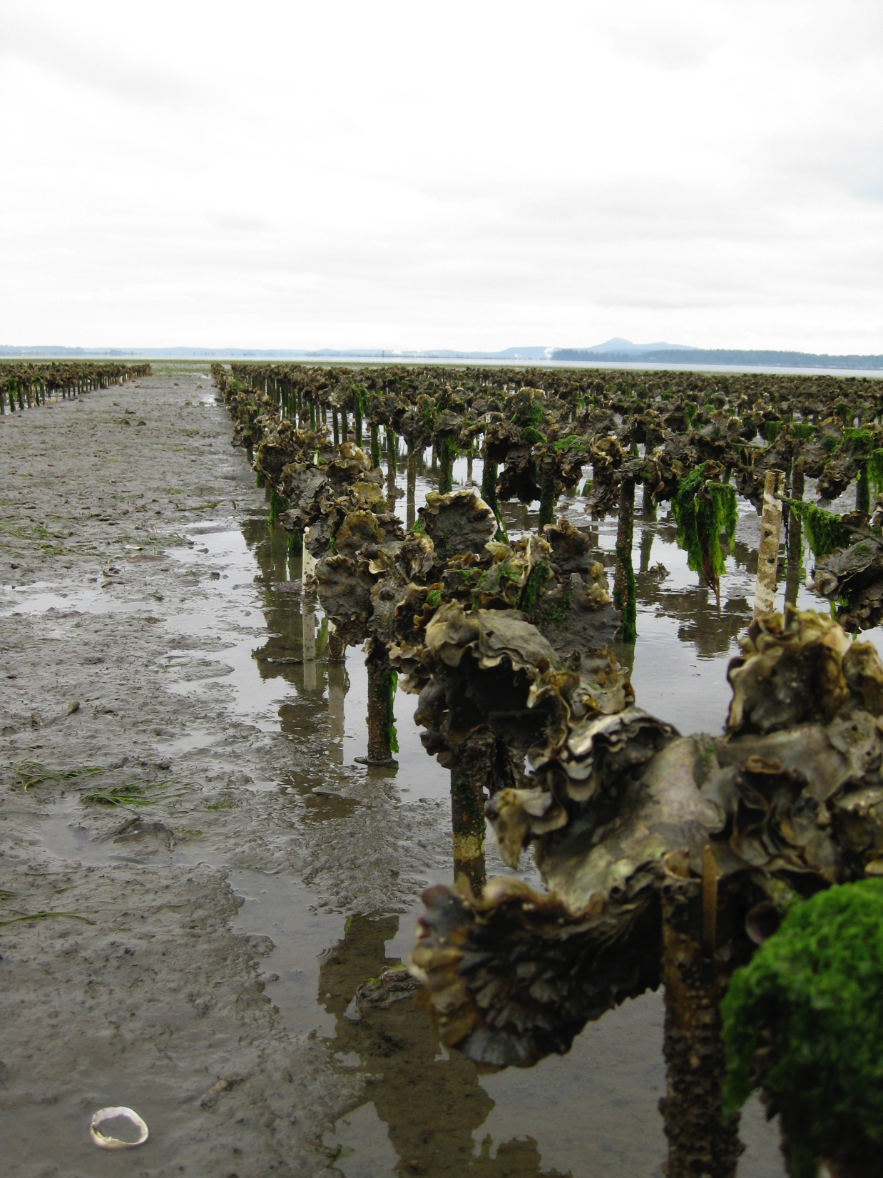
Chapter 1: Summary
Characterization of methylation in a single cell type
Methylation only observed in CpG motifs
Lack of methylation in oyster mtDNA
15% overall genome methylation
  Intermediate level
  Methylation not variable between tissue types
DNA methylation predominantly in exons and introns
Likely association between methylation status and gene expression
Notes:
Study of interest because most studies concern mammals or model species we provided info on non-model invert.
Methylation only observed in CpG motifs- Drosophila has low methylation levels and mostly in CpT dinucleotide context
This was the first characterization of DNA methylation in bivalve mitochondrial DNA. Lack of meth is consistent with previous invert research (unmethylated in honey bee brain tissue and in sea squirt). Mammalian system also confirms lack of methylation among CpGs in human mtDNA.
Overall 15% of CpGs methylated in oyster male gamete genome. Oyster is at an intermediate level (Ciona/sea squirt 23%, scallop 21%, freshwater snail 2%) and methylation does not significantly vary among tissue type.
Distribution of DNA methylation in invertebrate genomes is diverse and most genomes exhibit interspersed regions of methylated and unmethylated DNA.
No definitive evidence of a link between DNA meth and function, however based on RNA-seq data there’s likely an association between methylation status and gene expression. Regulation likely context dependent whether you find it in gene bodies or promoter regions.
In mammals, primary function of DNA methylation is to suppress gene expression through increased promoter DNA methylation, however function of methylation in invertebrates ins variable and likely differs among taxa. Roles include regulating transcriptional activity, alternatively exon splicing, and developmental activity.
Limited methylation in select genes may contribute to increased phenotypic plasticity in highly fluctuating environments (roberts and gavery 2012).

Slide 14
Chapter 2: DNA methylation and oyster development
Characterize methylation landscape
ID potential functions of DNA methylation throughout various stages of oyster development
  Sperm, eggs and Larvae
Notes:
Characterization of DNA methylation during oyster larval development. Previously examined (Riviere) revealing that DNA methylation varies through early development and treatment with a DNA methyltransferase inhibitor leads to developmental alterations. This study also found an inverse correlation between methylation and gene expression.
We want to examine this at a more in-depth level and genome-wide scale

Slide 15
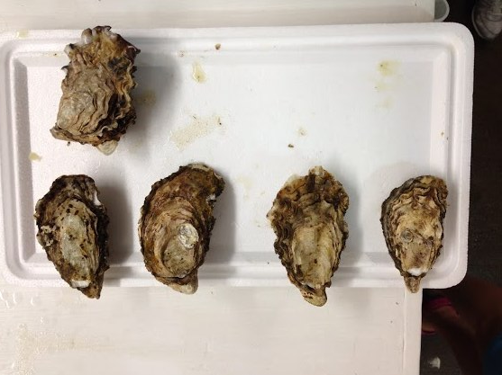
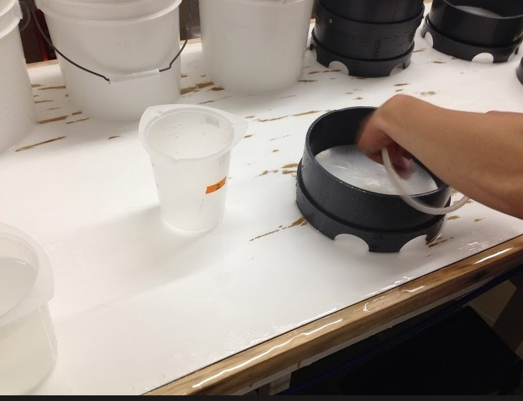
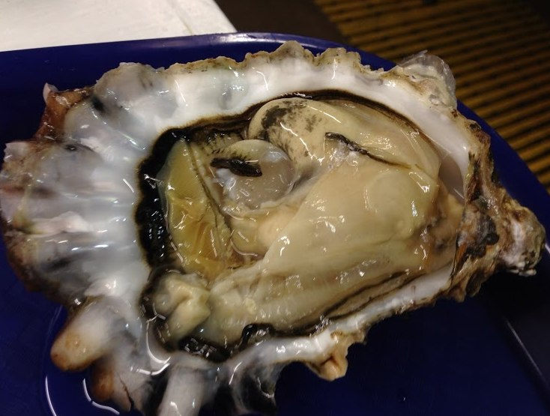
Chapter 2: Developmental methylation
Sperm and larvae methylome
  2 males strip spawned, fertilized eggs from one female
  Sperm & eggs frozen
  Larvae collected 3 days and 5 days post-fertilization
Notes:
2 males strip spawned, sperm fertilized eggs from one female

Slide 16
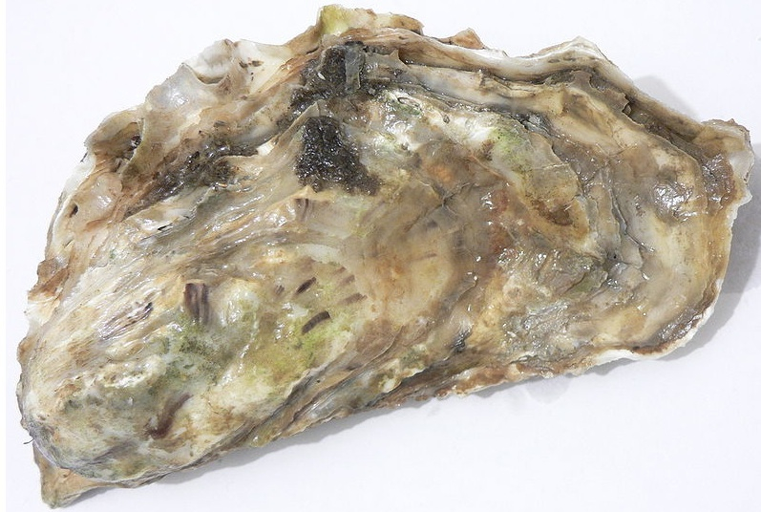




Chapter 2: Developmental methylation
Male 1
Male 3
Sperm
(+ Eggs)
Tank 1
Day 3
Day 5
Tank 3
Notes:
Schematic

Slide 17
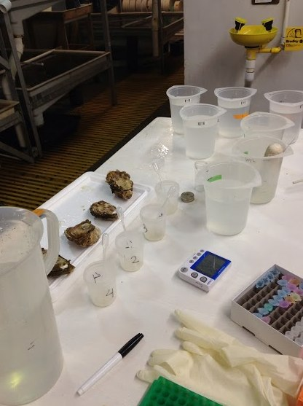
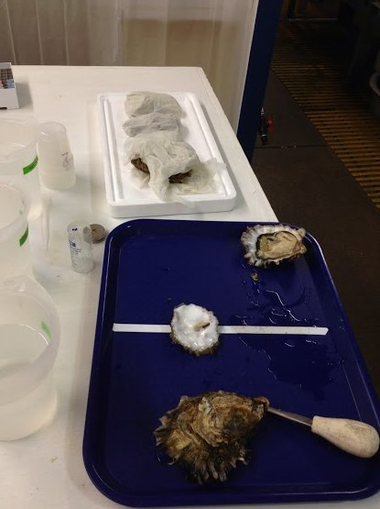
Chapter 2: Developmental methylation
Sperm: single cell type (removes bias of cell-specific methylation)
Larvae: significant changes in tissue-specific gene expression occurring
Notes:
Sperm sample offers a single cell type, which will allow us to remove any potential bias of cell type specific methylation patterns.
The larvae sample was selected for 5 days post fertilization because there are significant changes in tissue specific gene expression occurring.
Sampling multiple individuals will provide insight into the degree of natural epigenetic variation.
Heritabiity vs. Individual variability

Slide 18
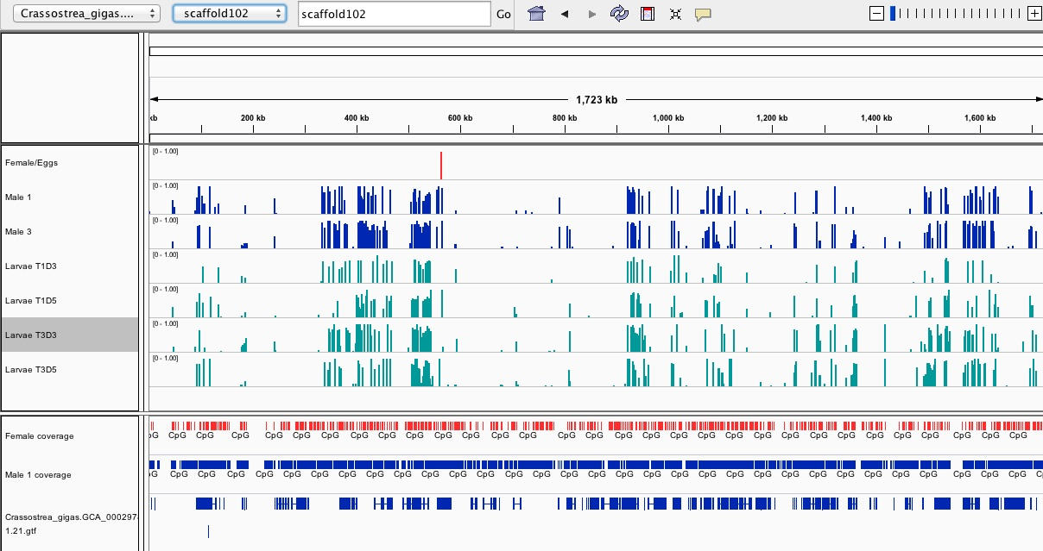
Chapter 2: Developmental methylation
Female
Male 1
Male 3
Larv1 Day 3
Larv1 Day 5
Larv3 Day 3
Larv3 Day 5
Female coverage
Male 1 coverage
Genes
Notes:
Using genome visualization tools- Integrative genomics viewer. Shows a single scaffold of the genome. Each bar represents percent methylation for an individual CG loci.

Slide 19
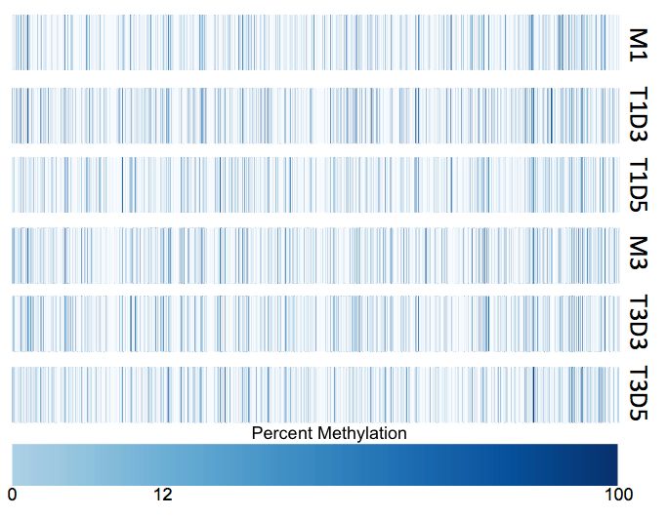
Chapter 2: Developmental methylation
Male 1
Methylation profiles among sperm and larvae
40,654 common loci
Larv1
Day 3
Larv1
Day 5
Male 3
Larv3
Day 3
Larv3
Day 5
Notes:
Visualize genome-wide methylation distribution for all common loci between sperm and larvae. Mean methylation level 12% for all 6 samples. A total of 40,654 loci per sample are represented in these plots

Slide 20
Chapter 2: Developmental methylation
Larv3 Day 3
Male 3
Larv3 Day 5
Larv1 Day 3
Male 1
Larv1 Day 5
Notes:
Dendograms/Hierarchical clustering of the six sperm and larvae methylation profiles using Pearson’s correlation distance.
Expected males to have more similar methylation profiles and cluster together, however males are clustering with their respective larvae.
Male 3 and larvae + male 1 and larvae

Slide 21
Chapter 2: Developmental methylation
Larv1 Day 3
Larv3 Day 3
Larv3 Day 5
Larv1 Day 5
Male 3
Male 1
Notes:
Principal component analysis (PCA) of six sperm and larvae methylation profiles, plot shows principal component 1 and principal component 2 for each sample. Samples closer to each other in principal component space are similar in their methylation profiles.

Slide 22
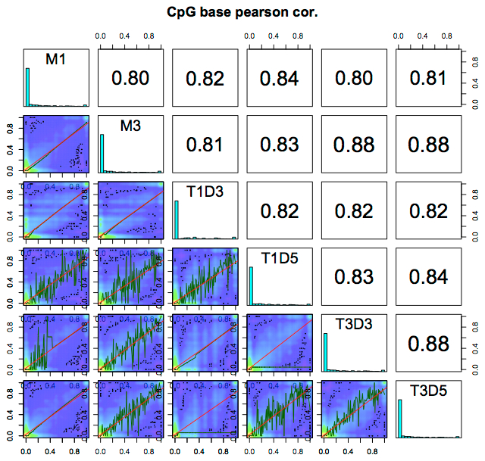
Chapter 2: Developmental methylation
Male 1
Male 3
Larv1Day3
Larv1Day5
Larv3Day3
Larv3Day5
Notes:
Scatter plots of % methylation values for each pair in six oyster samples. Numbers on the upper right corner denote pair-wise Pearson’s correlation scores. The histograms on the diagonal are %methylation histograms (% methylation per cytosine)

Slide 23
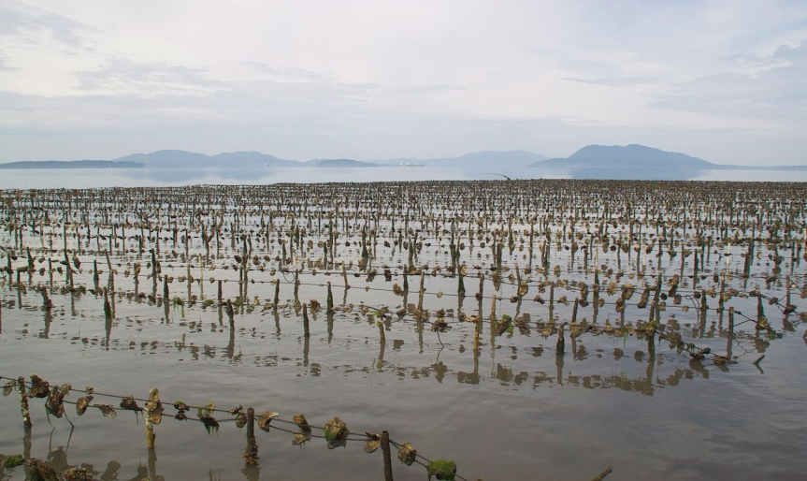
Chapter 2: Summary
Overall methylation levels similar for sperm and larvae samples
  ~ 12%-17% genome methylation
Similar spermatozoa and larvae methylation profiles
Notes:
Males had more similar methylation profiles with their offspring than to each other. Different than what we expected- as spermatozoa samples were a single cell type and larvae samples were mixed tissues.

Slide 24
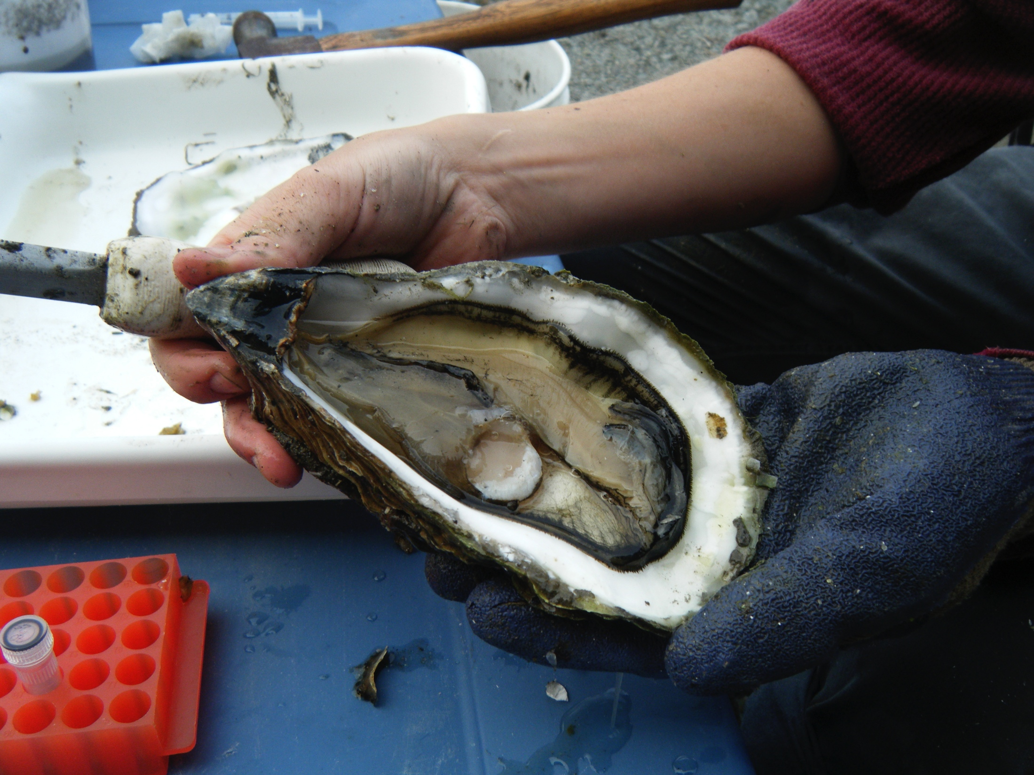
Future steps
Examine hypo/hyper methylated regions from sperm and larvae samples
Identification of DMRs
Notes:
Looking at aberrant DNA methylation patterns (Hyper-high, hypo-low)
DMRs- genomic regions with different methylation statuses among samples. Viewed as possible regions involved in gene transcriptional regulation
Genes with housekeeping functions=hypermethylated

Slide 25
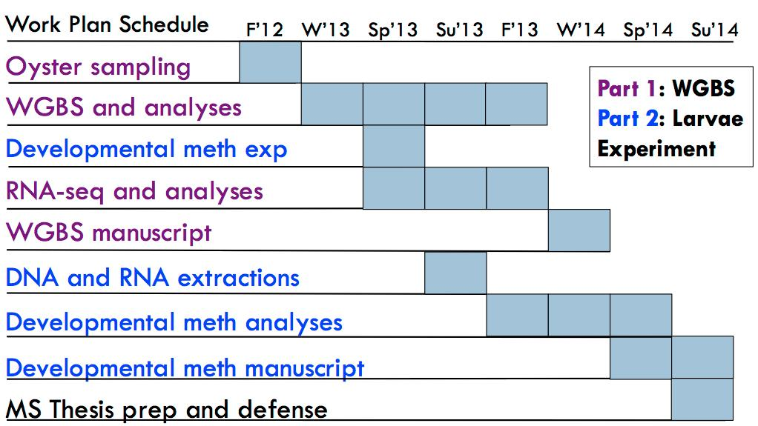
MS Timeline

Slide 26
Courses to date
QSCI 482: Statistical Inference (Fall 2012)
FISH 510: Topics: Local Adaptation (Spring 2013)
FISH 521: Research Proposal Writing (Winter 2013)
FISH 522: Hot Topics (Fall 2012)
FISH 510: Topics: Endangered Species Act (Spring 2014)
Additional coursework:
  FISH 541: Environmental Physiology (Fall 2012)
  FISH 546: Bioinformatics (Winter 2013)
  FISH 552: R Programming (Fall 2013)
  FISH 554: Beautiful Graphics in R (Winter 2014)
TA experience
  FISH 310: Biology of Shellfish (Spring 2013 and 2014)
  FISH 546: Environmental Physiology (Fall 2013)
Notes:
Master’s proposal form
Courses that not be completed towards my MS degree- Course removal request form to fill out

Slide 27
Understanding epigenetic variation in the oyster
Chapter 1: Characterizing genome-wide DNA methylation patterns in a single cell type
  Correlation with gene expression patterns
Chapter 2: DNA methylation during oyster early development
  Heritability vs. Individual variability
Notes:
Chapter 1: Characterized genome-wide DNA methylation profile in male gamete cells using whole-genome bisulfite sequencing.
RNAseq used to examine relationship between DNA methylation and transcript expression
While we’re starting to understand DNA methylation in this species, there are still several questions that remain. Importantly we do not fully understand the relationship between methylation and gene expression, nor DNA methylation patterns in a single cell type. Examining a single cell type is important as methylation levels and patterns may different between multiple cell types and life history stages, and our research attempted to limit this potential variability. Spermatozoa an ideal resource for studying a single cell type and also provides the secondary benefit of understanding more about oyster spermatogenesis.

