Slide 1
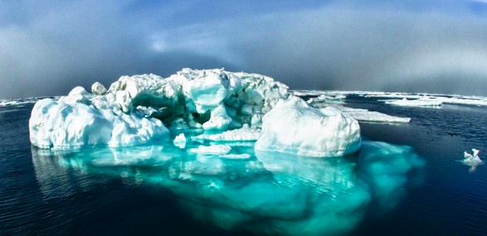
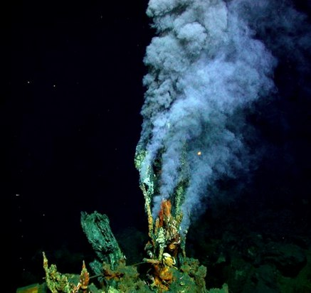
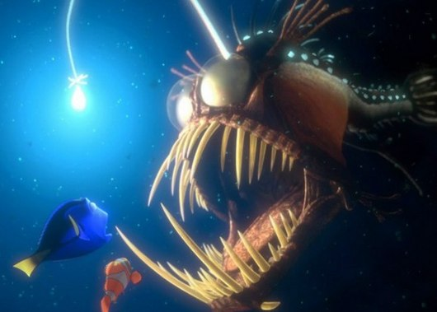
Life in Extreme Environments OR some things you wanted to learn about!
Lecture 22
FISH 310 June 3rd, 2013

Slide 2
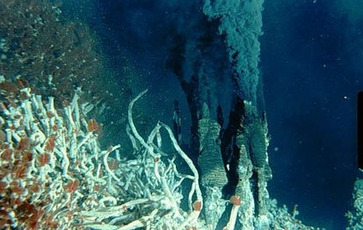
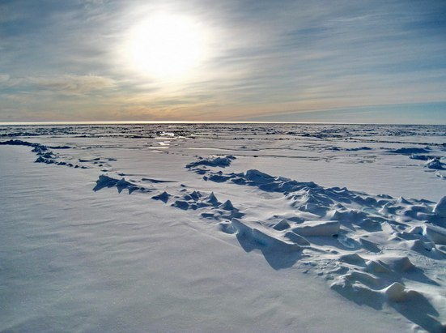
An overview
Aquatic animals inhabit almost every area of water, every depth of the ocean
Some examples and some adaptations to living in (sometimes) extreme environments
Physiological and molecular mechanisms enabling invertebrates to survive in extreme conditions

Slide 3
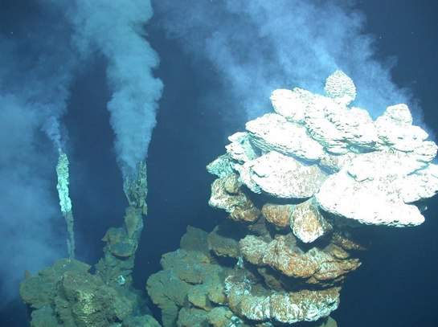
Deep sea invertebrate ecology: Overview
Life typically driven by energy from sun
  Deep sea organisms must depend on nutrients found in chemical deposits and hydrothermal fluids
Notes:
Life is typically driven by energy from the sun, but deep-sea organisms have no access to sunlight, so they must depend on nutrients found in the chemical deposits and hydrothermal fluids in which they live.

Slide 4
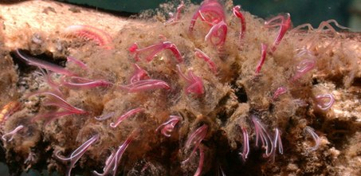
Deep sea invertebrates: whale worm
Osedax- bone devourer
Unique tubeworms that feed on the bones of dead whales
Unique feeding strategy
  Red feathery plumes extend in water and act as gills
  Large egg sac
  in whale bone
  Roots filled
  with symbiotic
  bacteria
Notes:
Discovered by MBARI in 2004, 2 new species of unique tubeworms that feed on the bones of dead whales. Osedax= latin for bone devourer.
Bodies have no eyes, legs, mouths or stomachs, but have feathery plumes and “roots”. Plumes as gills, and connect to muscular trunk, which can be withdrawn into transparent tube when disturbedGreen . Hidden inside whale bone is large egg sac. roots branch off from egg sac, grow into whale bone like a garden plants roots into ground. Roots filled with symbiotic bacteria that break down fats and oils inside bone, providing food for worms.
Whale carcasses or whale falls represent a massive input of food into the generally food-limited environment of the deep sea. One whale fall can provide as much organic material as thousands of years of marine snow (the organic debris that drifts down from surface waters to sustain life in the deep).

Slide 5
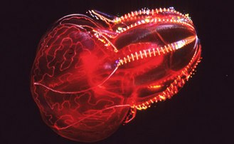
Deep sea invertebrates: Bloodybelly comb jelly
Lampoctena- “brilliant comb”
Always contain a blood-red stomach, sparkling display from light diffracting from cilia
In darkness of deep sea, red colors appear as black- purpose of red pigmented stomach?
Notes:
Brilliant comb in Greek, referring to the bright iridenscence diffraced from the animal’s comb rows. Bloodybelly comb jelly comes in different shades of red but always have a blood-red stomach. Sparkling display on outside comes from light diffracting from tiny transparent, hair-like cilia. Beating continuously propelling jelly through the water.
Ironically at depths where they live, it’s nearly invisible to predators.
Scientists believe the bloodybelly’s red belly helps mask bioluminescent light from the prey it swallows.

Slide 6
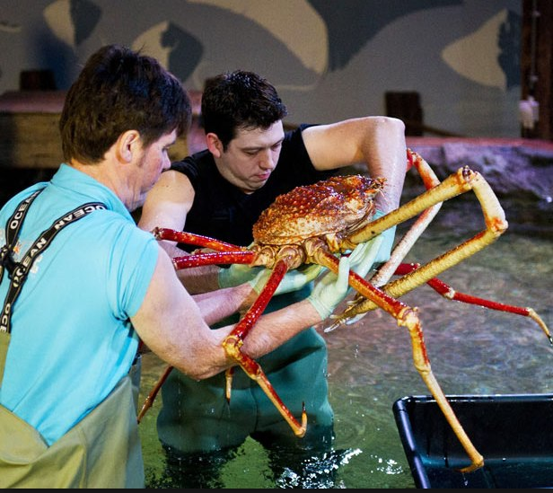
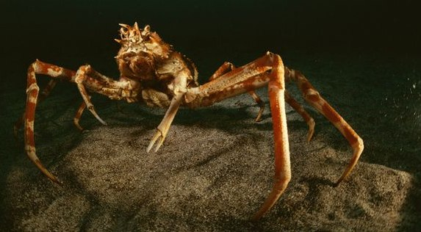
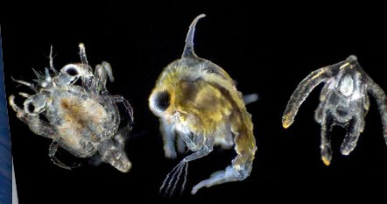
Giant or Japanese spider crab
Infraorder Brachyura, Macrocheira kaempferi
Greatest leg span of any arthropod, up to 12 ft
Differs from other crustaceans: first pleopods of males twisted and primitive larvae
Ecological importance for local fisheries
Notes:
Brachyura=true crabs
Largest leg span of any arthropod- can measure up to 12 feet from claw tip to claw tip and can weigh up to 41 lbs.
Resides in the waters around Japan.
Larvae- crab megalop larvae, spider crab larva, starfish larva.
Occasionally collected for food, populations have decreased in numbers forcing fishermen to explore deeper waters to catch them.

Slide 7
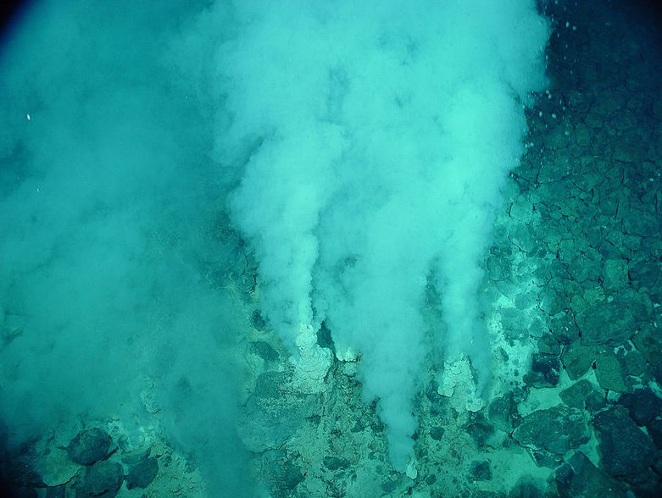
Deep sea hydrothermal vents
Volcanic activity-fissure that spews geothermally heated water
Superheated water saturated with toxic chemicals
Complex communities fueled by chemicals dissolved in vents
Notes:
Usually near volcanically active places, areas where tectonic plates moving apart. Spew superheated water saturated with toxic chemicals. Contain sulfides of copper, iron, zinc, precipitate in chimney gaps. Areas around submarine hydrothermal vents are biologically more productive that the majority of the deep sea, often hosting complex communities fueled by chemicals dissolved in the vent fluids.
Chemosynthetic bacteria and archaea form the base of the food chain, supporting diverse organisms including the giant tube worms, clams, limpets and shrimp.
Pic=smokers emitting liquid carbon dioxide, low pHs sometime such as 2.8, temperatures up to 460 degrees

Slide 8
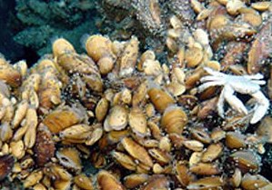
Deep sea hydrothermal vent ecology
Communities able to sustain vast amounts of life due to chemosynthetic bacteria
  Water rich in dissolved minerals
  Chemoautotrophic bacteria- sulfur compounds
Instead of sunlight, rely on hydrogen sulfide
Notes:
Hydrothermal vent communities able to sustain such vast amounts of life b/c vent organisms depend on chemosynthetic bacteria for food.
Water is rich in dissolved minerals and supports a large population of chemoautotrophic bacteria. Bacteria use sulfur compounds, mainly hydrogen sulfide (a chemical highly toxic to most known organisms) to produce organic material through chemosynthesis.
Picture- Crab and mussels living on hydrothermal vent in Atlantic ocean

Slide 9
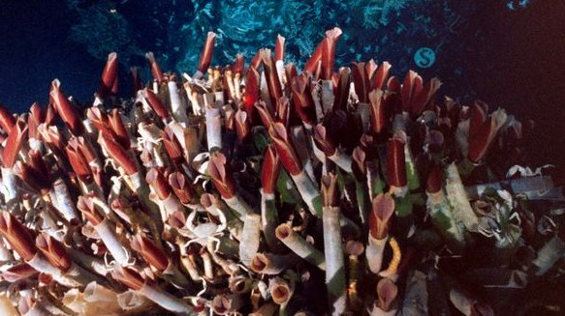
Giant tube worms
2 species Tevnia jerichonana and Riftia pachyptila
Withstand pressure, freezing temps, lack of sunlight, and hydrothermal vents
Can grow to be over 2 ft tall!
Red plumes contain hemoglobin
  Hydrogen sulfide transferred to bacteria inside worm
  Bacteria nourish worm with carbon compounds
Notes:
Red plumes contain hemoglobin- combines with hydrogen sulfide and transfers it to the bacteria living inside the worm. In return, bacteria nourish worm with carbon compounds.

Slide 10
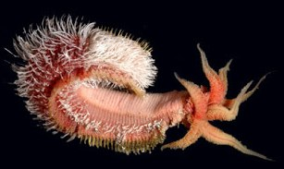
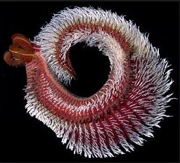
Pompeii worm
Hottest animal on earth!
Alvinella pompejana deep sea polychaete worm
Adaptive traits
  “Hairy” backs with colonies of bacteria and potentially insulation
  Glands secrete a mucus that bacteria feed
  Aggregate colonies enclosed in delicate tubes
  Plume of tentacle structures=gills
Notes:
Hottest animal on earth- most heat tolerant animal. Can survive temps up to 176 degrees F.
“hairy” backs are actually colonies of bacteria which are thought to afford the worm some degree of insulation (protect from heat). Glands on the worm’s back secrete a mucous (sugar rich in eurythermal enzymes) on which the bacteria feed, a form of symbiosis. This acts as a form of protection from the wide range of temperatures it lives in. The worm forms large, aggregate colonies enclosed in delicate paper-thin tubes (heat resistant)

Slide 11
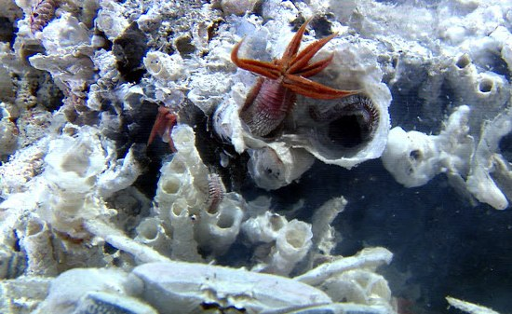
Pompeii worm heat tolerance
Heat tolerance- how does it work?
Hold it’s body in two different gradients of heat
  Tail resist high temps
  Feather heads stick out of tubes into waters of cooler temps (feeding and breathing)
Notes:
Fascinating behavior of holding the body in two different gradients of heat. The tail can resist temperatures as high as 80 degrees C, whereas feather like heads stick out of tubes into waters of much cooler temps of around 22 degrees C. Here is where it feeds and breathes

Slide 12
Deep sea ecological importance
Less than 5% of the deep ocean has been explored
Adaptations of deep sea organisms
  Understanding of biochemistry could lead to biochemical and medical advances
Conservation: overfishing depletion of many epipelagic and coastal fisheries
  Up to 40% of fishing grounds deeper than 200m
Notes:
The deep sea may seem remote, but what we send down eventually cycles back up into our lives. Deep sea animals part of a thriving ecosystem so trash and chemicals may harm them if we are careless with our waste.
Intrinsic value- expeditions to the depths result in new species being found, sometimes even entire ecosystems such as hydrothermal vents and cold seeps.
Scientific value- specialized adaptations of deep sea organisms and an understanding of biochemistry could lead to biochemical, medical and other advances.
Conservation- deep sea increasingly being targeted by commercial fisheries. Overfishing having depleted many epipelagic and coastal fisheries, as many as 40% of the worlds fishing grounds are now in waters deeper than 200m.

Slide 13
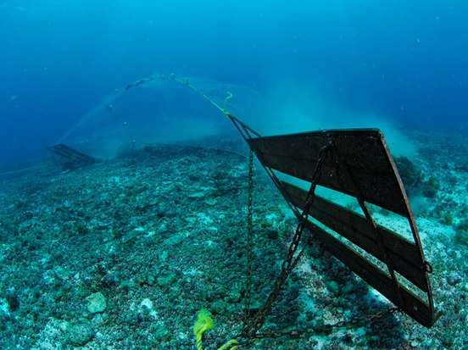
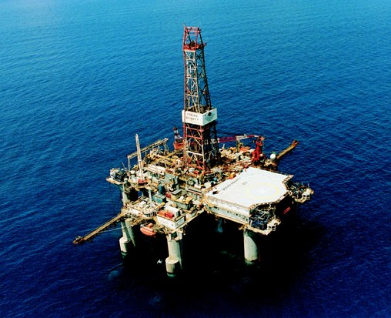
Deep sea conservation
Bottom trawling
  55% of AK corals didn’t recover a year later
  Heavily fished areas of Australia 90% of surfaces once coral now bare rock
  Bycatch
Species slow growing, long to reach sexual maturity
Oil, gas, and mineral exploration
  Eventually explore down to 3000m
Notes:
Bottom trawling currently the greatest threat to deep sea biodiversity. Bottom trawling possible on nearly all ocean floor down to depth of 2000m, and trawls crush everything in their path. In an experiment off Alaksa, 55% of cold water corals damaged by one pass of a trawl didn’t recover a year later. In heavily fished areas in southern Australia, 90% of surfaces where coral used to grow are now bare rock. Deep sea trawlers also kill a large amount of unwanted deep sea life as bycatch.
Deep sea species are generally slow growing and don’t reach sexual maturity for many years. These factors make species extremely vulnerable to overfishing.
Presently, most oceanic reserves of oil, gas and minerals extracted from continental shelf under shallow waters. Valuable reserves are also located in deep ocean floor. Oil and mining industries expected to venture further and explore down to 3000m. This activity would have devastating effects on fragile, slow growing deep-sea communities.

Slide 14
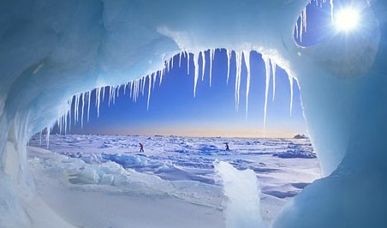
Switching directions to a cool location…

Slide 15
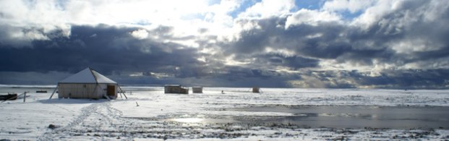
Invertebrates and the Arctic
Most common and diverse animals in the arctic ecosystem
Long cold winters coupled with short cool summers
Winter almost 10 months of the year
  Ground freeze in September-> thaw in June
Mammals: insulated fat and fur for elevated core body temp
Invertebrates: body temp similar to environment
  Desiccation and anoxia
Notes:
Some of the most characteristic features of the Arctic are long cold winters coupled to short cool summers. Both of these present challenges to arctic invertebrates.
For most winters, the ground begins to freeze in september and does not thaw until june the following year.
Mammals maintain elevated core body temp using a thick insulative layer of fat and fur to insulate against the loss of heat from metabolism. However, invertebrates have a body temp similar to the environment. Means they must deal with being frozen, desiccation and anoxia.

Slide 16
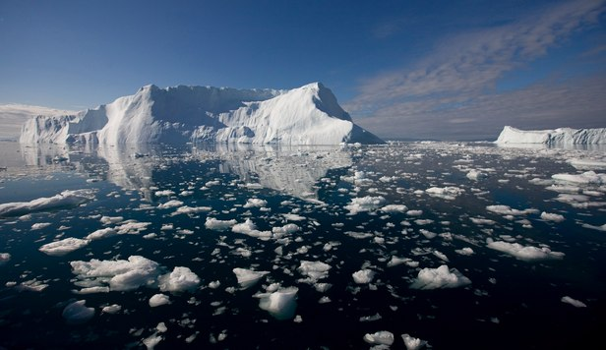
Cold tolerance problems
Animals in arctic have adapted to persist in harsh winter conditions
  Low availability of liquid water in winter
  Temperatures below melting point of body fluids
Notes:
Freezing of free water in the body- such ice is dangerous and may kill the animal.

Slide 17
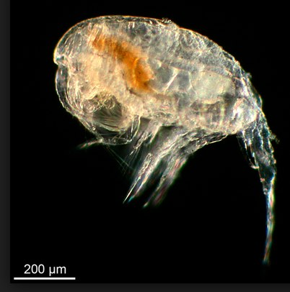
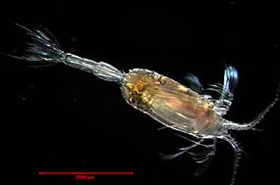
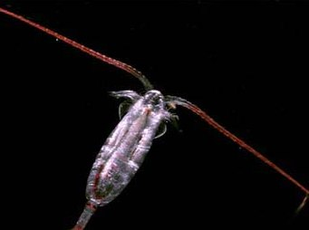
Cold tolerance strategies: Copepods
  Copepods: very efficient synthesis, storage and utilization of lipids
  Store energy from food as oil droplets while feeding in spring and summer plankton blooms
Notes:
Surviving the cold.
Droplets can take up over half of the volume of the body in polar species

Slide 18
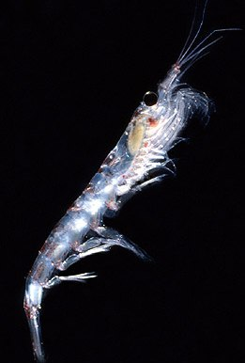
Cold tolerance strategies: Krill
  Krill: use up own body’s reserves and shrink
  Can withstand long periods of starvation by using their muscle as a reserve
Notes:
Can withstand long periods of starvation (up to 200 days) by using their muscle as a reserve. Will shrink in the process, and happens over winter months when krill under seasonal ice and there is little or no photosynthesis

Slide 19
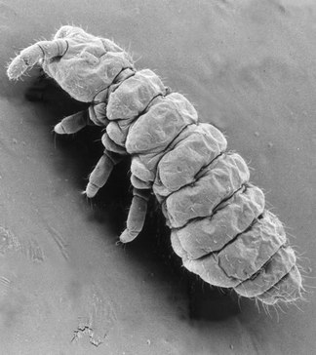
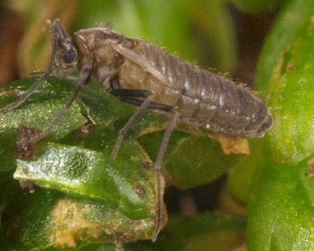
Cold tolerance strategies: Insects
  Insects: freeze tolerance, freeze avoidance and dehydration or by sporting darker or hairier bodies

Slide 20
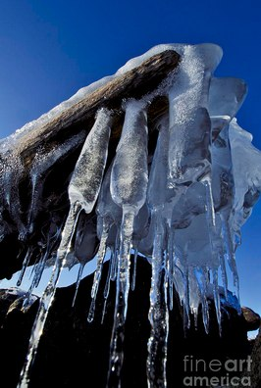
Surviving ice formation
Survive formation of ice within body (Freeze Tolerance)
Prevent water in the body from freezing (Freeze Avoidance)
Remove water from the body (Dehydration)
Notes:
Most living things made up of 70% water, when water freezes it expands and forms ice crystals. Repeated freezing and thawing can destroy living tissue.
During the process of freezing, body tissues are subjected to…? cell dehydration and cell membrane damage, damage of vessels, and buildup of lactate and alanine in conjuction with a loss of ATP

Slide 21
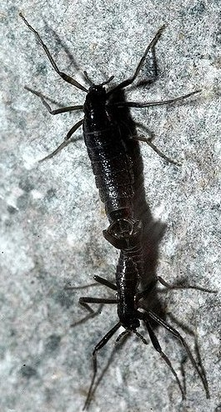
Freeze Tolerance
Survive ice formation within tissues
  Colligative cryoprotection
  Ice nucleating proteins in hemolymph
Produce chemicals that lower the freezing temperature of cell fluids
e.g. Belgica antarctica the flightless midge
  Thermal buffering
  Accumulate trehalose, glucose and erythritol
  Heat shock proteins
Notes:
Survive periods of extracellular ice formation, primarily by the mechanism of colligative cryoprotection (cryoprotection chemicals).
Synthesize specialist ice nucleating proteins in their hemolymph to ensure freezing is initiated in this tissue. OR can have gradual ice crystallization in their tissues. Freeze tolerance widespread in invertebrates, particularly overwintering insects.
Thermal buffering: burrowing where temperature more stable. Ice and snow cover help keep the temperature stable. Also accumulates trehalose, glucose and erythritol. These compounds help the insect survive freezing reducing the amount of ice that forms within the body. They also stablilize proteins and membranes, binding them to hydrogen bonds. Heat shock proteins also help the tolerance to both high and low temps.
Interesting: Can survive freezing, but larvae exposed to mild temperatures can get killed in a week.

Slide 22
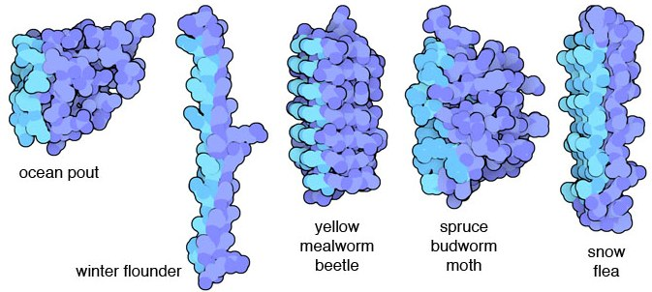
Freeze Avoidance
Susceptibility- depress their freezing temp (SCP)
Cryoprotectants
  Polyhydroxy alcohols (glycerol or trehalose)
  Breakdown rate of glycogen to glycerol 5x higher than FT species
AFPs
  Thermal Hysteresis Proteins
  Bind to ice crystals, prevent further growth
Notes:
Coping with temps lower than the freezing point of body fluids in animals is based on preventing the freezing of body fluids, keeping body fluids at a liquid state. Those that would die if they begin to freeze. These inverts depress their freezing temp, the supercooling point (SCP).
Majority produce cryoprotectants -accumulate, often polyhydroxy alcohols such as glycerol or trehalose. FA species exhibit a breakdown rate of glycogen to glycerol that is about 5x higher than that of FT species.
Others produce antifreeze proteins which bind to ice crystals (Thermal Hysteresis Proteins) which stabilize the supercooled state by binding to incipient ice crystals and preventing further growth.

Slide 23
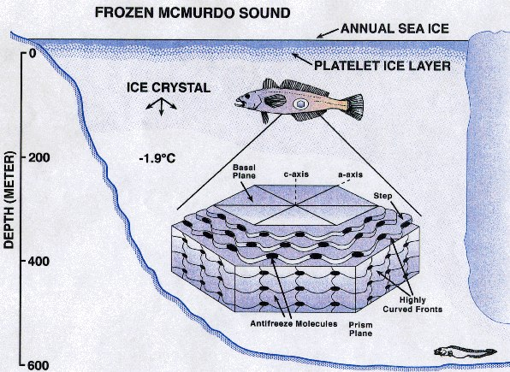
Antifreeze Proteins
Antifreeze glycopeptides and peptides
Amphipathic molecules- one side of rod hydrophopic, other side hydrophilic
  Hydrophilic side
  has repeating
  threonine and
  aspartate residues
  that bind protein
  to ice lattice
Notes:
In fish, frogs, and some insects. Antifreeze molecules allow them to live in subfreezing water by plugging gaps in existing small ice crystals and preventing the attachment of more ice molecules. Ice crystal growth is thus effectively stopped.
Antifreeze chemicals lower the temperature at which their bodies freeze, so they can experience very low temps.

Slide 24
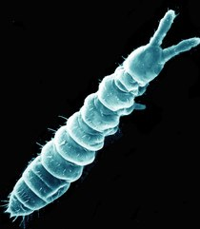
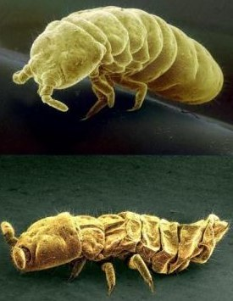
Dehydration/Dessication
Vapor pressure of liquid water greater than ice-net movement of water vapor from animal to surrounding ice
Animal will dessicate until vapor pressure of body fluids=atmosphere
SCP of tissues decreases, animal won’t freeze
e.g. Onychiurus arcticus Springtail
  Protective dehydration
Notes:
Vapor pressure of liquid water greater than ice, so there will be a net movement of water vapor from the animal to the surrounding ice and the animal will desicate until the vapor pressure of the body fluids equals that of the atmosphere.
The SCP (supercooling point) of dessicated tissues thus decreases and the animal will not freeze.
Tiny humpbacked arthropod-Springtail. Scientists have discovered that it loses water and shrivels up in a process known as protective dehydration. Water is lost from the body across a diffusion gradient between the animals’ super-cooled body fluids and ice in the environment. During this process body loses all its water and you end up with a normal looking head, and a body that looks crumpled when its fully dehydrated. When water added, goes back to normal.

Slide 25
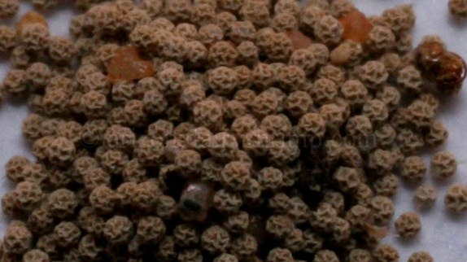
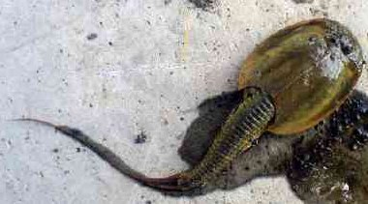
Life cycles in Arctic regions
Long cold winters and short cool summers
1. Extended life histories, grow a little each summer until adults
2. Short life cycle, overwinter as an egg
  e.g. Tadpole shrimp Lepidurus arcticus
    Overwinter as an egg and develop into adult
Notes:
Must grow and reproduce during short cool summers. Many species have extended life histories where they grow a little during each summer until finally an adult. OR they can have short life cycle and can only overwinter as an egg. Overwintering protects individuals from lethal abrasion by wind-blown ice crystals, so overwinter in protected areas usually.
Tadpole shrimp- Crustacea, Class Branchipoda Order Notostraca

Slide 26
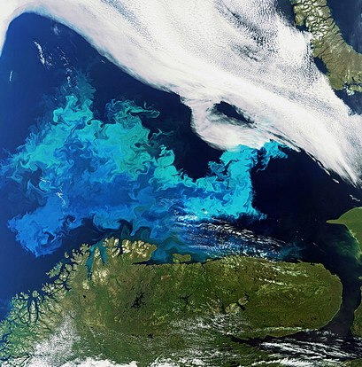
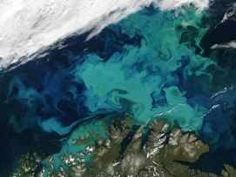
Arctic algal blooms
2012- Massive blooms under Arctic pack ice
Potential indicator of global warming’s effects
  Changing ice conditions now allow light to penetrate
  Thick “multi-year” ice is declining
  Melt pools commonly form on sea ice, decreasing pack’s ability to reflect light
Notes:
Permanent ice cover severely limit biological production.
Changing ice conditions now allow light to penetrate large swaths of Arctic sea ice. Thick “multi-year” ice, which requires several seasons to accumulate, is on the decline, while warming temperatures favor thinner “first-year ice”. Additionally, the melt pools that now commonly form on top of Arctic sea ice decrease the ice pack’s ability to reflect light.

Slide 27
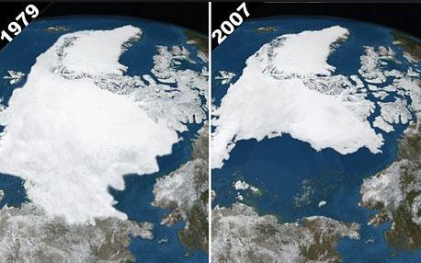
Consequences of climate changes and pollution in arctic for the performance of invertebrates
Impacts of climate change will strongly effect the arctic
Notes:
Melting ice pack- why bad?
Changes in vegetation
Disappearance of sea ice threat for land animals- polar bears, seals, walrus- all animals that depend on ice for habitat and food. Also will affect everything in the marine food chain.
Loss of permafrost- melting permafrost, ground water will seep into underlying strata and reduce the level of moisture.

Slide 28
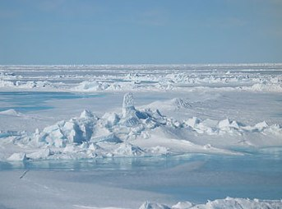
Issues
Poorly studied
  1989 report calling for action in researching arctic invertebrates
  Logistical challenges imposed by its multiyear ice
  Severe weather
Lack of funding
Lack of public
support
Notes:
Action required for arctic invertebrate biological survey- series of international cooperative research ventures should be established, establish a series of workshops, and initiatives should form part of a plan for long-term and coordinated studies of arctic invertebrates.
Knowledge is limited due to logistical challenges of multiyear ice and inhospitable climate

Slide 29
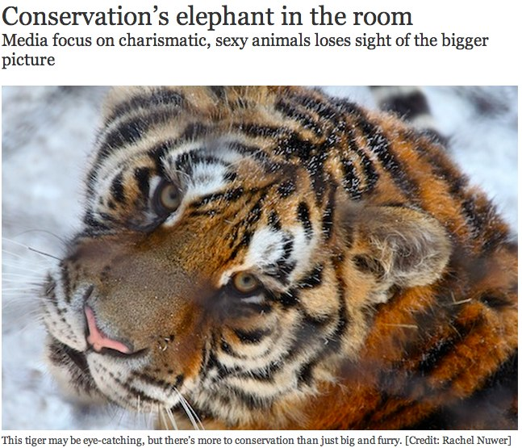
Conservation issues
Notes:
Doing a search for endangered species- polar bears, wolves, and sea lions crowd the top headlines. These so-called charismatic animals dominate the media scene, and sometimes their place in the spotlight obscures those of other species, and maybe even the point of conservation. Main blame for this is the media.
Of course people are interested in things they find enjoyable and beautiful. But problem is that many large charismatic animals are not keystone species (if removed from their environment, the ecosystem wouldn’t collapse)

Slide 30
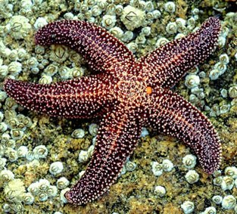
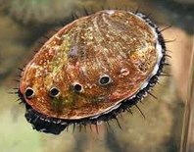
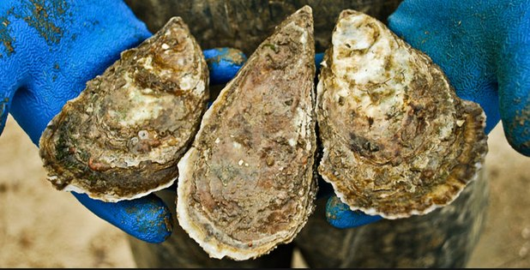
Discussion
How do we encourage public support, funding and research for non-charismatic species?
Notes:
e.g. sea stars pay a keystone role in WA, without them populations of mussels would explode and wreak havoc on the entire ecosystem
-Scientists can present their work in an interesting way
-For media interest, can tailor stories of organisms for different audiences (e.g. farmer, aquaculture, general public)

