Slide 1


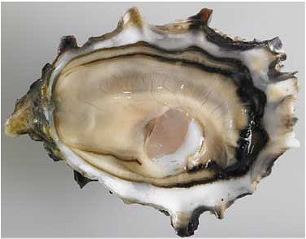
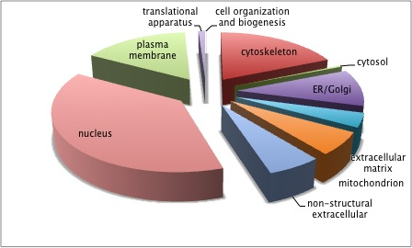
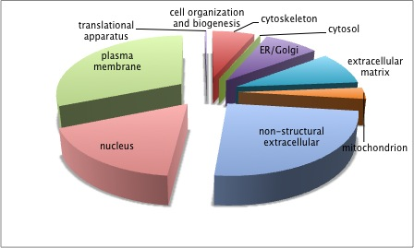
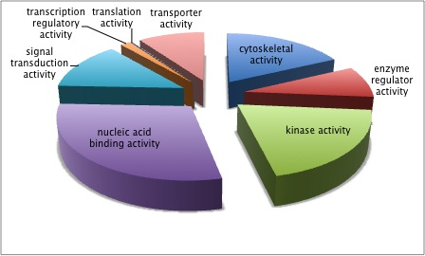
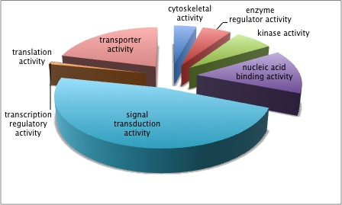
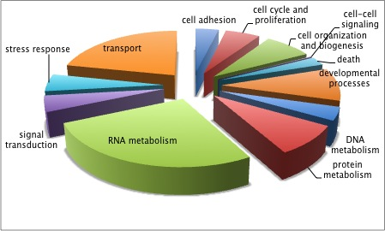
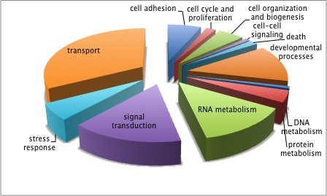

Epigenetic Modifications in Crassostrea gigas
Claire H. Ellis and Steven B. Roberts
School of Aquatic and Fishery Sciences, University of Washington, Seattle, WA
Crassostrea gigas is a key bioindicator species.
C. gigas gene ontology analyses reveal differences between methylated and non-methylated areas.
The Pacific oyster Crassostrea gigas is the principal commercial oyster species of the West coast
C. gigas is exposed to environmental variations including changes in temperature, pH, and oxygen levels
Lives at a range of tidal heights and routinely encounters large seasonal fluctuations in temperatures
Excellent model to study environmental effects on genetic modifications- genomic resources for this species are available and epigenetic modifications by DNA methylation have been described.
Methylated Areas
Non-methylated Areas
The objective of this study is to use C. gigas as a model organism to characterize the relationship between DNA methylation and environmental fluctuations.
Cellular Components
Anatomy of the Pacific oyster (C. gigas)
Source: http://www.sea-ex.com/fishphotos/oyster-pacific.htm
DNA methylation as as mechanism to increase adaptive potential in invertebrates.
Molecular Functions
Epigenetics describes DNA modifications that change gene expression without altering the underlying nucleotide sequence
DNA methylation is the most commonly studied epigenetic mechanism and involves the addition of a methyl group to a cytosine or adenine ring. These methyl groups project into the major groove of DNA, effectively inhibiting
transcription.
A combination of high-throughput sequencing and DNA tiling array analysis will be coupled with methylation enrichment to determine genome wide methylation distribution and assess how specific DNA methylation patterns influence transcriptional activity.
The amount and location of methylation in organisms is extremely diverse and variable among species and can change genome function under external influences.
Biological Processes
*Our goal is to evaluate the relationship between methylation, alternative splicing, and sequence mutations.
DNA methylation patterns will be determined using bisulfite sequencing and RNA-seq
Methylation patterns in the C. gigas genome
Visualization of the C. gigas gamete methylation landscape.
Cellular Components
Methylated areas had higher incidences of genes located in the nucleus, translational apparatus, cell organization and biogenesis, cytoskeleton, and cytosol.
Molecular Function
Methylated areas had higher incidences of genes involved in cytoskeletal activity and translation activity.
Non-methylated areas had significantly higher incidences of genes involved in nucleic acid binding and signal transduction activity.
Biological Processes
Methylated areas had higher incidences of genes involved in cell cycle and proliferation, and DNA metabolism.
Non-methylated areas had higher incidences of genes involved in transport and signal transduction.
Characterization of the C. gigas DNA methylation landscape reveals patterns in gamete tissue
DNA methylation occurs predominantly on ubiquitously expressed genes and coding exons.
Scaffold 433 0-1,285,080 base pairs
Methylated CG
Non-methylated CG
Conclusions
Bisulfite sequencing was used to examine unbiased genome-wide analysis of DNA methylation, enabling methylome analysis at a single base pair resolution.
A majority of the methylated areas of the Pacific Oyster genome are associated with exons, or expressed regions (22.46%) and introns (37.2%).
Most of the methylated areas of the Pacific Oyster genome are associated with genes involved in molecular functions such as cytoskeletal and translation activity as well as biological processes such as DNA metabolism and cell cycle and proliferation.
Future work will characterize the relationship between DNA methylation and environmental fluctuations in C. gigas, determining whether development of stress resistance and certain epigenetic mechanisms may play a role in the survival of oysters under environmental variations.
mRNA
Coding Sequences (CDS)/Exons
Non-coding Sequences /Introns
Repeat Regions
0 bp
1,000,000 bp
Feature tracks used in characterizing C. gigas DNA methylation
Acknowledgements
We would like to acknowledge the members of Taylor Shellfish Farms for graciously providing oyster samples for our research. We would also like to thank the University of Washington School of Aquatic and Fishery for supporting this research. Finally, we would like to thank our funding agency the National Science Foundation.
Acknowledgements
I would like to thank Kate Hubbard for her help and mentorship and Dr. Virginia Armbrust for all her support. NEED TO ADD GRANTS

