Slide 1
DNA methylation variation in gametes and larvae of the Pacific oyster,
Crassostrea gigas
Claire Olson
University of Washington
School of Aquatic and Fishery Sciences
Final Examination
November 19th, 2014
Notes:
Today I’m going to talk about MS thesis research, examining….

Slide 2
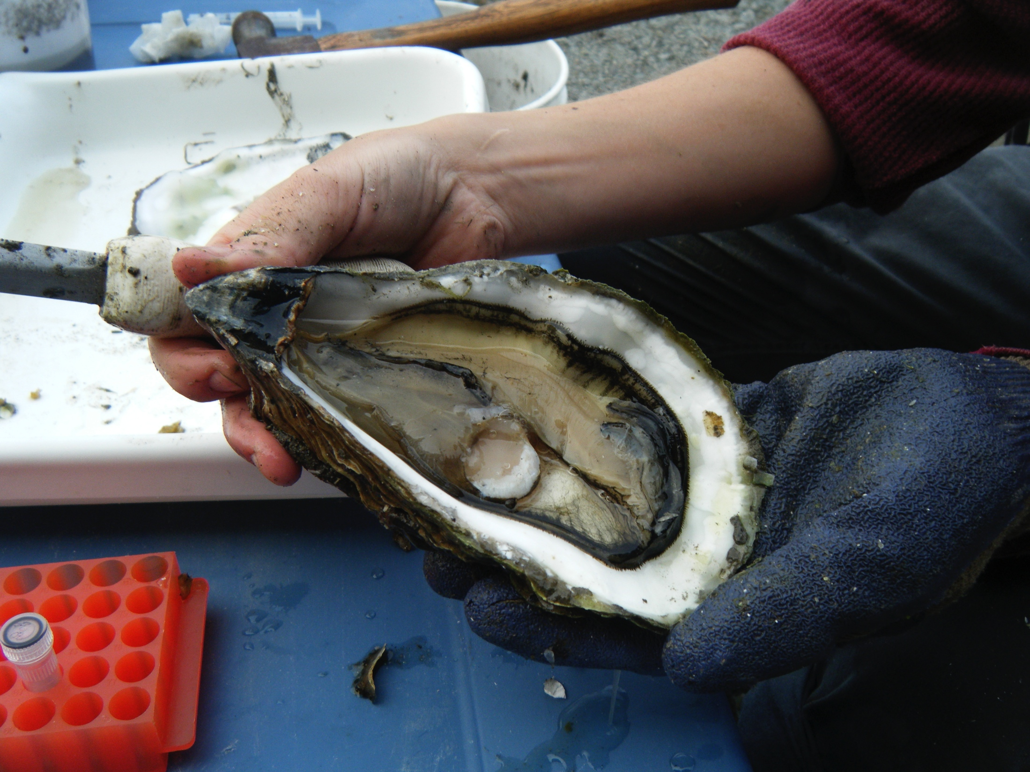
Outline
Background
  Epigenetics and DNA methylation
DNA methylation in oysters
Characterization of DNA methylation and gene expression
Developmental patterns of DNA methylation : variability and heritability
Notes:
I’ll start by giving some background information about epigenetics specifically focusing on DNA methylation
Then I’ll present some information about what is already known about DNA methylation patterns and functions in various species.
Then I’ll talk about the results of my thesis which has two parts-
The first part characterizes DNA methylation on a genome-wide scale in oysters to understand the functional role of methylation. This included examining where methylation was located in the genome, and the relationship between DNA methylation and gene expression in this species.
The second part characterized DNA methylation patterns during oyster development, and we looked at 2 different lineages examining the degree of DNA methylation heritability and 3 developmental stages to examine variability of these marks.

Slide 3
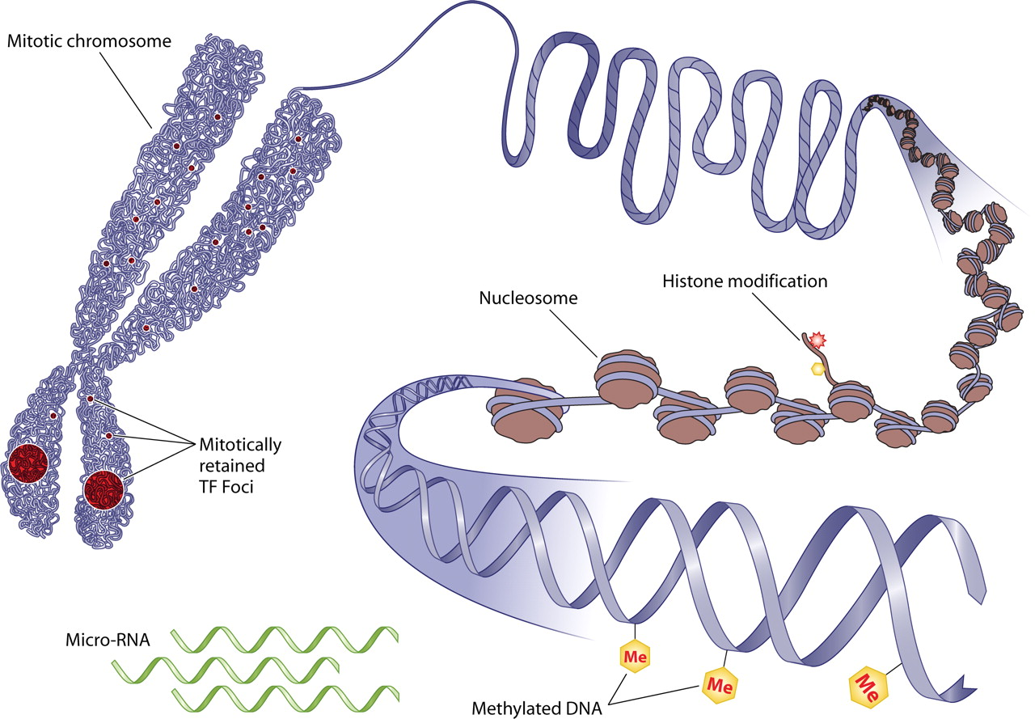
Epigenetics
Epi = “at, upon”
Epigenetics describes modifications to our genetic material that changes genome functions
Source: http://episona.com/short-introduction-epigenetics/
Notes:
The prefix “Epi” means at or upon. Therefore,
Epigenetics describes DNA modifications that change genome activity without altering the underlying nucleotide sequence.
Involves mechanisms other than mutations to the DNA sequence, and epigenetic changes can switch genes on or off.

Slide 4
Epigenetics
Histone modifications
  Acetylation
  Methylation
  Phosphorylation
DNA methylation
Source: http://episona.com/short-introduction-epigenetics/
Notes:
Examples of such epigenetic modifications are histone modifications. Histones are the proteins that package DNA into nucleosomes for compact cellular organization, and these proteins can be modified by…
DNA methylation is another epigenetic mechanism. Both of these mechanisms serve to regulate gene expression without altering the underlying nucleotides, or DNA sequence.

Slide 5
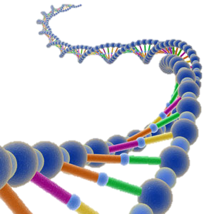
DNA methylation
DNA methylation in organisms is diverse, variable among species, and can change genome function under external influences
G
C
G
C
CH₃
Notes:
DNA methylation is the most well understood epigenetic mechanism.
It involves the addition of a methyl group to DNA. It is highly specific and typically happens in a region in which a cytosine nucleotide is located next to a gunanine nucleotide linked by a phosphate, and this is called a CpG site or dinucleotide.
Insertion of this methyl group changes both the appearance and structure of DNA, modifying a genes interaction with a cell’s nucleus, which is needed for transcription.
And interestingly, ..…

Slide 6
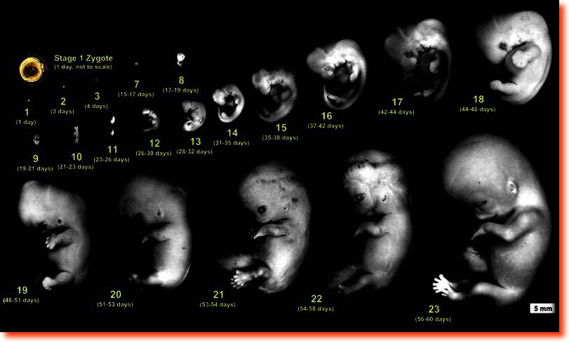
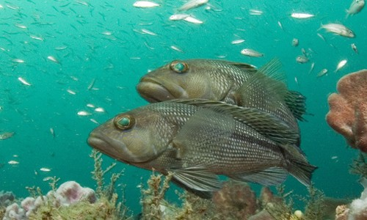
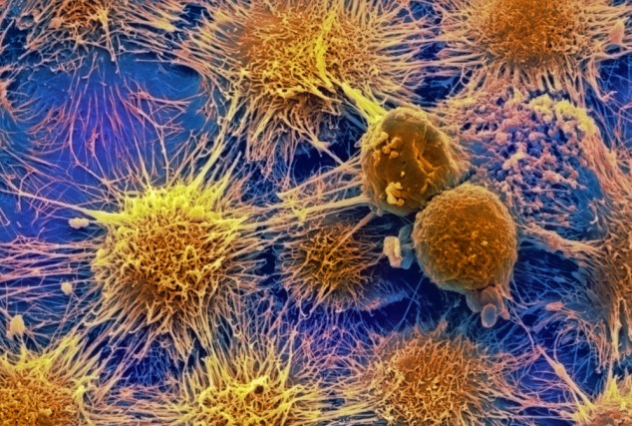
DNA methylation
DNA methylation regulates gene expression
  Embryonic development (Monk et al. 1987)
  Genomic imprinting (Li et al. 1993)
  Sex Ratios (Navarro-Martin et al. 2011)
  Human diseases (Jones and Laird, 1999)
Notes:
DNA methylation has many important regulatory functions in gene expression in a variety of organisms. To name a few..
-Embryonic development: important regulating developmental processes
-Genomic imprinting: phenomenon in which genes expressed in a parent-of-origin-specific manner.
-Sex ratios: In European sea bass, methylation of the gonadal aromatase promoter is involved in temperature-dependent sex determination
-Disease: aberrant DNA methylation is a feature of a number of human diseases, including cancer

Slide 7
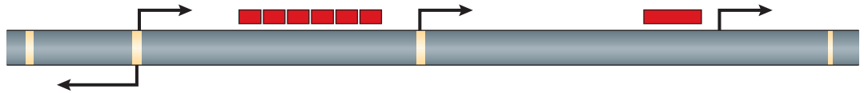
DNA methylation patterns
Vertebrates: global methylation
  70-80% genome methylation
Notes:
There’s also a wide range of DNA methylation patterns:
-Vertebrate species like humans exhibit what’s called global methylation (genomes are 70-80% methylated). This figure is depicting a vertebrate genome that would exhibit a global DNA methylation landscape. Grey regions indicate constantly methylated domains and yellow indicates domains that can be methylated or unmethylated and these are promoter regions. Only small regions of the genome can be unmethylated or transcriptionally active.
Yellow=promoter regions

Slide 8
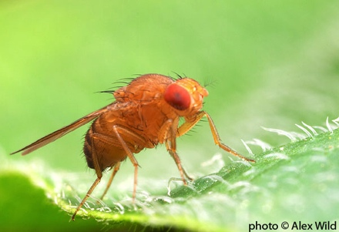
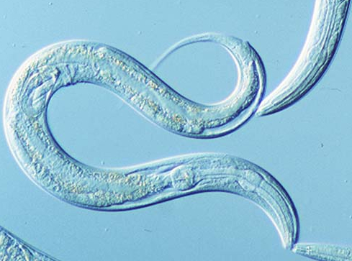
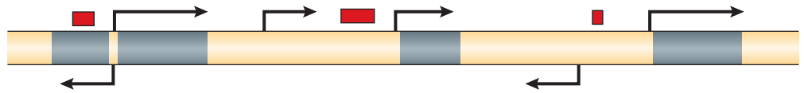
DNA methylation patterns
Invertebrates: limited to no methylation
  No methylation:
  D. melanogaster and C. elegans
  Mosaic methylation: Oysters and sea squirts
  Distribution and function is uncertain
Notes:
However, invertebrate species display limited or no methylation in their genomes. Model invertebrates lack meth (Drosophila and C elegans). Invertebrates such as oysters contain mosaic pattern.
Figure is depicting mosaic DNA methylation characteristic of most invertebrates, in which heavily methylated (or grey) areas are dispersed within domains that are methylation free (yellow regions).
Differences in methylation illustrates the diversity of DNA methylation patterns and highlights gaps in understanding the evolutionary and functional significance.

Slide 9
DNA methylation functions
In vertebrates, methylation is associated with transcriptional silencing
Expressed
TF
M
M
M
Promoter
Gene
Notes:
Not only are DNA methylation amounts different across taxa, but the function of methylation differs as well..
In vertebrates, DNA methylation is one mechanism for suppressing or silencing gene transcription, thereby preventing gene expression.

Slide 10
DNA methylation functions
In vertebrates, methylation is associated with transcriptional silencing
Expressed
TF
M
M
M
Promoter
Gene
TF
Decreased Expression
M
M
M
M
M
M
Promoter
Gene
Notes:
Methylation is found throughout the genome, so in both genes and promoter regions (or regions of DNA that initiate transcription of a particular gene), and methylation among promoter regions blocks the areas transcription factors would bind.

Slide 11
DNA methylation functions
In vertebrates, methylation is associated with transcriptional silencing
In invertebrates, methylation is predominant in gene bodies
TF
Decreased Expression
M
M
M
M
M
M
Vertebrate
Gene
M
M
M
Invertebrate
Gene
Notes:
However, like I previously said, most of what is known about methy is from mammals and plants, less in invertebrates.
Most invertebrate genomes contain DNA methylation located within genes…

Slide 12
DNA methylation functions
In vertebrates, methylation is associated with transcriptional silencing
In invertebrates, methylation is predominant in gene bodies
TF
Decreased Expression
M
M
M
M
M
M
Vertebrate
Gene
? ? ?
M
M
M
Invertebrate
Gene
Notes:
….but the function remains unclear.

Slide 13
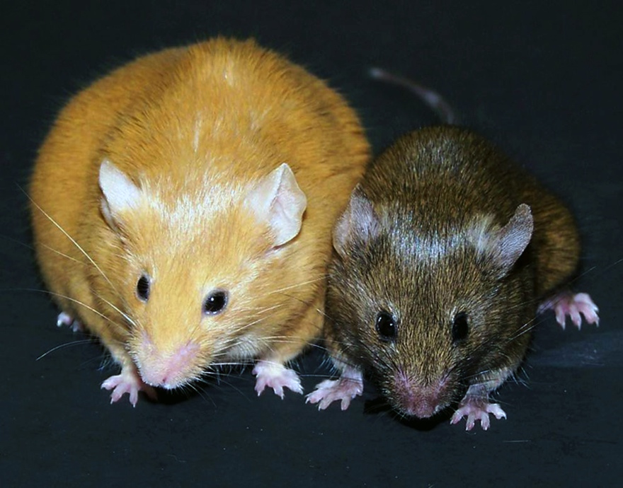
Epigenetics and gene regulation
DNA methylation affects gene expression
Genetically identical mice
Agouti gene is differentially methylated
Source: Waterland and Jirtle 2003
Notes:
Most of what is known about methy is from research on mammals, less in invertebrates.
And we see dramatic affects of methylation on mammals, and in mice it has been shown that the epigenetics can affect gene expression.
-Visual example of this can be seen in the agouti mice. These are two female mice that are genetically identical but have different DNA methy patterns in their agouti gene, which affects gene expression, and gives rise to these 2 very different phenotypes.
-Specifically, in the small brown phenotype, the agouti gene promoter regions are methylated, and are therefore turned off, preventing transcription. However, in the yellow obese mice, the promoter region of agouti genes are not methylated, and these genes are expressed or turned on. When these agouti genes are expressed, the mouse is more prone to cancer and diabetes.
-Research in the Waterland and Jirtle lab found found that activation a single gene due to a lack of methylation caused dramatic changes in phenotype. They therefore confirmed that DNA methylation plays a role in regulating gene expression.

Slide 14
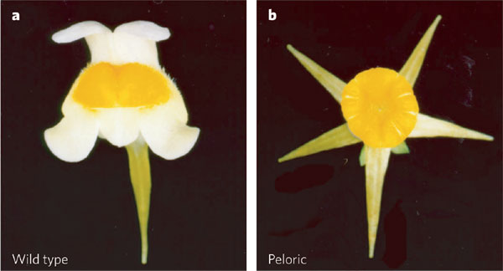
Epigenetic inheritance
Genetically identical plants with different methylation patterns
DNA methylation patterns heritable and passed to offspring
Linaria vulgaris
Source: Cubas et al. 1999
Notes:
DNA methylation have also been shown to be heritable and can be maintained and passed on to offspring. An example of this was demonstrated under natural conditions in the plant toadflax, Linaria vulgaris. Specifically, wild-type and peloric toadflax plants are genetically identical, but have different shape of their flowers which is thought to be beneficial for different pollination strategies. These two flower variants have different methylation patterns in a single gene, which is heavily methylated, or inactive in the peloric variant. And peloric toadflax can pass on this heavy methylation status to its offspring, so an abnormal flower structure will continue to the next generation. This is an example of methylation patterns being inherited. This type of transgenerational epigenetics has been well documented in plants, but is more difficult to demonstrate in other organisms.

Slide 15
DNA methylation in oysters
Notes:
The background I just provided summarizes what we already know about DNA methylation. And I mentioned a majority of this information comes from studies done on mammals and plants, and much less is known about methylation in invertebrate species, like oysters.

Slide 16
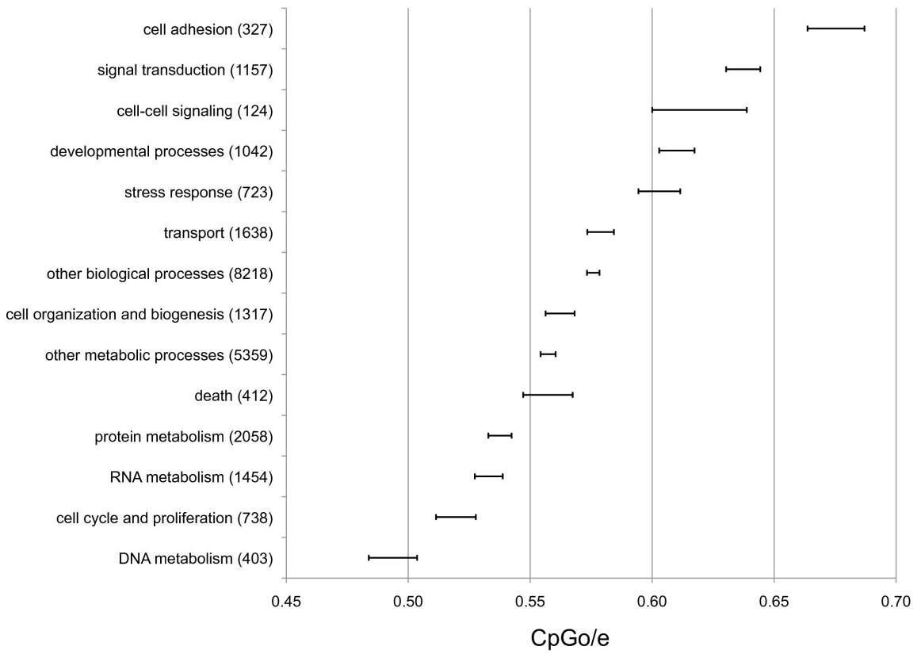
DNA methylation in oysters
Genes with different regulatory requirements have different levels of methylation
Source: Gavery and Roberts, 2010
Notes:
But some previous work in our lab has examined DNA methylation in oysters, research done by Mac in our lab.
To summarize what we know about methylation in oysters….Using an in silico and experimental analysis to show that methylation is in fact present in genes, and that methylation levels change with gene function.
However, this work was strictly predicting methylation status from oyster transcriptome (or the set of all RNA molecules),
and with the release of the oyster genome in 2012, this greatly facilitated my research, and I was able to quantitatively examine DNA methylation at a genome-wide scale.

Slide 17
Research Objectives
Characterizing and understanding DNA methylation in oysters
Notes:
My research aimed at characterizing and understanding this epigenetic mark in oysters. This was important as limited studies have focused on invertebrates. Currently there is not a complete understanding of how DNA methylation regulates genome activity in invertebrates, though it does appear to be different from mechanisms observed in mammals and is likely variable across species.

Slide 18
Research Objectives
Characterizing and understanding DNA methylation in oysters
Genome-wide DNA methylation patterns in a single cell type
  -Correlation with gene expression patterns
DNA methylation during oyster early development
  -Heritability and differences in methylation
Notes:
My approach was split into two parts:
1st part: Characterized genome-wide DNA methylation profile in male gamete cells using whole-genome bisulfite sequencing. We were particularly interested in the relationship between methylation and gene expression.
2nd part: Examining DNA methylation during oyster development. While we know that methylation has impt regulatory functions in mammalian development, we still didn’t understand the roles of methylation during invertebrate development. A major component of this is understanding if DNA methylation is inherited between organisms, and to what extent DNA methylation patterns vary between developmental stages.

Slide 19
Approach
Whole-genome bisulfite sequencing
T
C
T
C
G
bisulfite
T
U
T
C
G
PCR
T
T
T
C
G
Notes:
The approach I used for my research was to use what is considered the gold standard for examining DNA methylation, called whole genome bisulfite sequencing.
This involves genomic sequencing of bisulfite treated DNA. For this method, DNA is treated with sodium bisulfite, which converts cytosine residues to uracil, but leaves methylated cytosine nucleotides unaffected. Therefore, this bisulfite treatment introduces specific changes in the DNA sequence that depends on the methylation status of individual cytosines.

Slide 20
Approach
Whole-genome bisulfite sequencing
T
C
T
C
G
bisulfite
T
U
T
C
G
PCR
T
T
T
C
G
Notes:
After sequencing, I map the results back to the oyster genome, and I can conclude that any cytosines remaining are methylated. Using this approach I can characterize methylation on a genome-wide scale while still obtaining coverage at a single base pair resolution. Analysis reduced to distinguishing cytosines resulting from bisulfite conversion. But we can differentiate these marks from single nucleotide polymorphisms by using information from the complementary DNA strand.

Slide 21
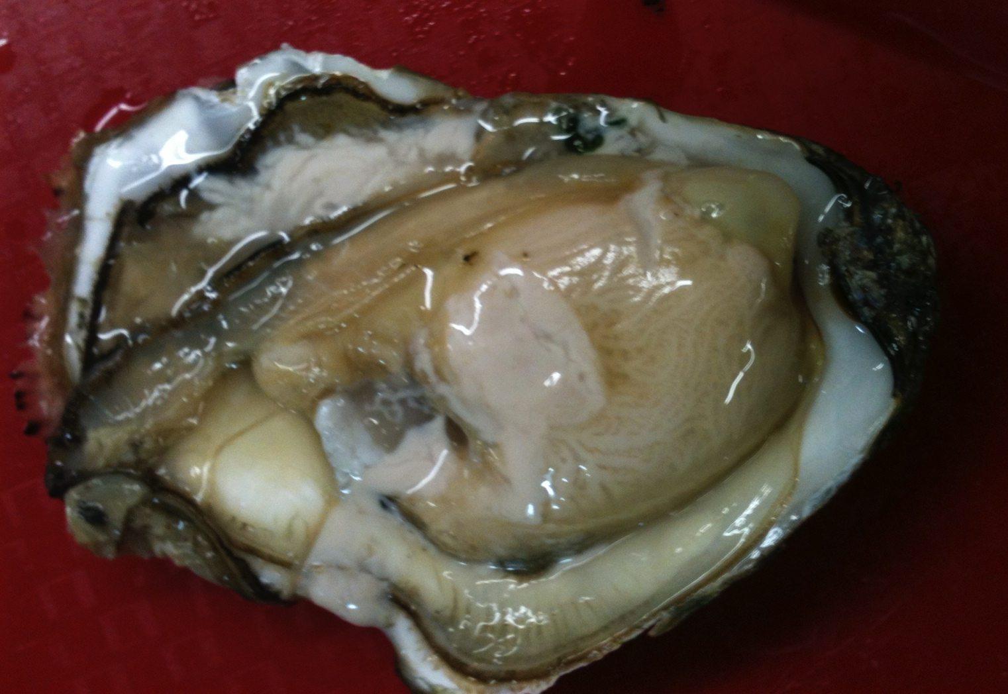

I. Genome-wide methylation
Whole Genome Bisulfite Sequencing (WGBS)
  Genome-wide methylation patterns in a single cell type
Whole Transcriptome Shotgun Sequencing
  Relationship between methylation and gene expression
M
M
M
genomic DNA
Notes:
-The first part of my research was completely novel as it was the first time genome-wide methylation was examined in oysters, which allowed us to see how methylation was distributed in the genome, and to look closely at the relationships between DNA methylation and gene expression patterns.
-For this research, I performed high throughput WGBS on oyster male gamete tissue to provide a comprehensive view and reveal methylation patterns
-To understand potential functions of DNA methylation I examined the relationship between methylation and gene expression. To examine this relationship used an approach called RNAseq (whole transcriptome shotgun sequencing). Basically, this involves taking a snapshot of RNA presence and quantity from the oyster genome at a given moment in time so we can look at relationships between epigenetic and genetic variations.

Slide 22
I. Genome-wide methylation
Male gamete tissue ~ 7.64 million CpGs
Notes:
Using oyster reference genome for mapping, information for 7.64 million CpGs
Showing histogram- Looking at the distribution of methylation, and a single CpG loci can have a methylation ratio between 0-100% because you have multiple reads from a sequencing run, and the status of some Cytosines for that region may be methylated, while other cytosines may be unmethylated. So the percentage is based on the methylation status and coverage of that particular loci.
We see a bimodal distribution, and that a majority of the oyster genome unmethylated.
But we can also see that it does in fact contain SOME methylation, so we wanted to describe where this was occurring.

Slide 23
I. Distribution of methylation
19%
14%
35%
15%
28%
Source: Olson and Roberts 2014
Notes:
So to summarize where exactly methylated cytosines were distributed in oyster genome. These are pie charts showing the genome-wide distribution of methylation within genomic regions. This figure is showing the proportion of methylated or unmethylated regions as percentage contributions to specific oyster genomic regions. Specifically, we have classified a CG loci as being either heavily or sparsely methylated (defined as having a methylation ratio > 0) or unmethylated regions (having a ratio =0). Genomic regions are also scaled according to their contribution to the entire oyster genome. So a larger pie is representative of a large region in the oyster genome.
Methylation occurs primarily within genes in exons and introns (dark blue slices are comparatively larger than that among other regions of the genome).
Exons and introns were 35 and 28% methylated, compared with other genomic regions were only contained about 15% methylation.

Slide 24
I. Genome-wide methylation
Overall 15% genome methylation
Methylation primarily in genes
Notes:
We were able to determine that overall 15% of the CpG dinucleotides are methylated in the oyster genome- this dramatically lower than what we see among vertebrate species, in which their genomes are heavily methylated between 70-80%, but it is comparable with other invertebrate sp’s
From the pies I showed on the previous slide, we found a majority of methylated regions occurring among genes, or both exons and introns
exons- expressed portions of genes that will code for proteins
Introns- portions of the genes that don’t code for proteins and will be removed during transcription

Slide 25
I. Methylation and expression
Notes:
We were also interested in using this data to identify any relationships between methylation and gene expression.

Slide 26
I. Methylation and expression
Source: Olson and Roberts 2014
Notes:
Analysis of DNA methylation and RNAseq data revealed a positive association between methylation status, within promoter regions and expression.
Figure is showing the proportion of methylation on a per gene basis for promoter regions (or regions of DNA that initiate transcription of a particular gene). I have divided our RNAseq data into high and low expression categories, based on expression values. Then we calculated average percent methylation for promoters within these categories.
And we see a positive relationship- promoter regions of genes with high expression levels, had high methylation levels.
Interesting because previous research indicate the opposite- in which a negative correlation exists between DNA meth and expression levels

Slide 27
I. Methylation and expression
TF
Decreased Expression
M
M
M
Vertebrate
Gene
Notes:
If we go back to our introductory diagrams, previous research in mammals has shown that the primary function of DNA methylation is to suppress gene expression through increased promoter DNA methylation. So methylation found in promoter regions blocks the areas transcription factors would bind, therefore being associated with a decrease in gene expression or transcriptional silencing.

Slide 28
I. Methylation and expression
TF
Decreased Expression
M
M
M
Vertebrate
Gene
TF
M
M
M
Invertebrate
Gene
Notes:
However, this doesn’t seem to be the case in oysters, as we found that methylation in promoter regions is associated with transcriptional activity, or gene expression.

Slide 29
I. Methylation and expression
Source: Olson and Roberts 2014
Notes:
And based on our findings that methylation is primarily located among genes, and if methylation is regulating the oyster genome, we would also expect to see a relationship between methylation and gene expression.
And we do see a positive correlation between DNA methylation and gene expression, in which genes with high expression levels had significantly more methylation.

Slide 30
I. Methylation and expression
? ? ?
M
M
M
Invertebrate
Gene
Notes:
From what I previously said, we know that methylation in invertebrates is primarily located in genes, but the function remains unclear.

Slide 31
I. Methylation and expression
? ? ?
M
M
M
Invertebrate
Gene
M
M
M
M
Expression
Invertebrate
Gene
Notes:
And using the oyster as an invertebrate model, we saw that methylation among genes is associated with transcriptional activity, or gene expression.
And to explore some potential roles for this…

Slide 32
I. Methylation and noise
Heavy methylation:
M
M
M
M
M
M
M
M
M
M
M
M
M
M
M
M
M
M
M
M
M
M
Sparse methylation:
Multiple transcriptional outcomes
M
M
M
M
M
M
M
M
M
M
M
M
Notes:
I believe that methylation is keeping promoter complexes from laying down in various places within genes. So heavy methylation among genes in the oyster genome would result in consistent transcriptional outcomes, while sparse methylation present among genes would allow for multiple transcriptional opportunities. DNA methylation may therefore help reduce any unwanted/unnecessary transcriptional noise in the oyster genome.
Therefore, methylation may not necessarily be controlling gene expression directly but is rather controlling the amount of transcriptional noise that is present in the oyster genome.

Slide 33
I. Methylation and expression
Source: Olson and Roberts 2014
Notes:
If we return to our figure, we found that genes with high methylation are those that exhibit high expression levels. These are likely genes that are involved in maintaining essential cellular functions and require stability. These genes will therefore be highly expressed in the oyster genome to allow for efficient regulation of genes necessary for survival. So I believe that methylation among genes is controlling the amount of transcriptional noise that is present in the oyster genome.

Slide 34
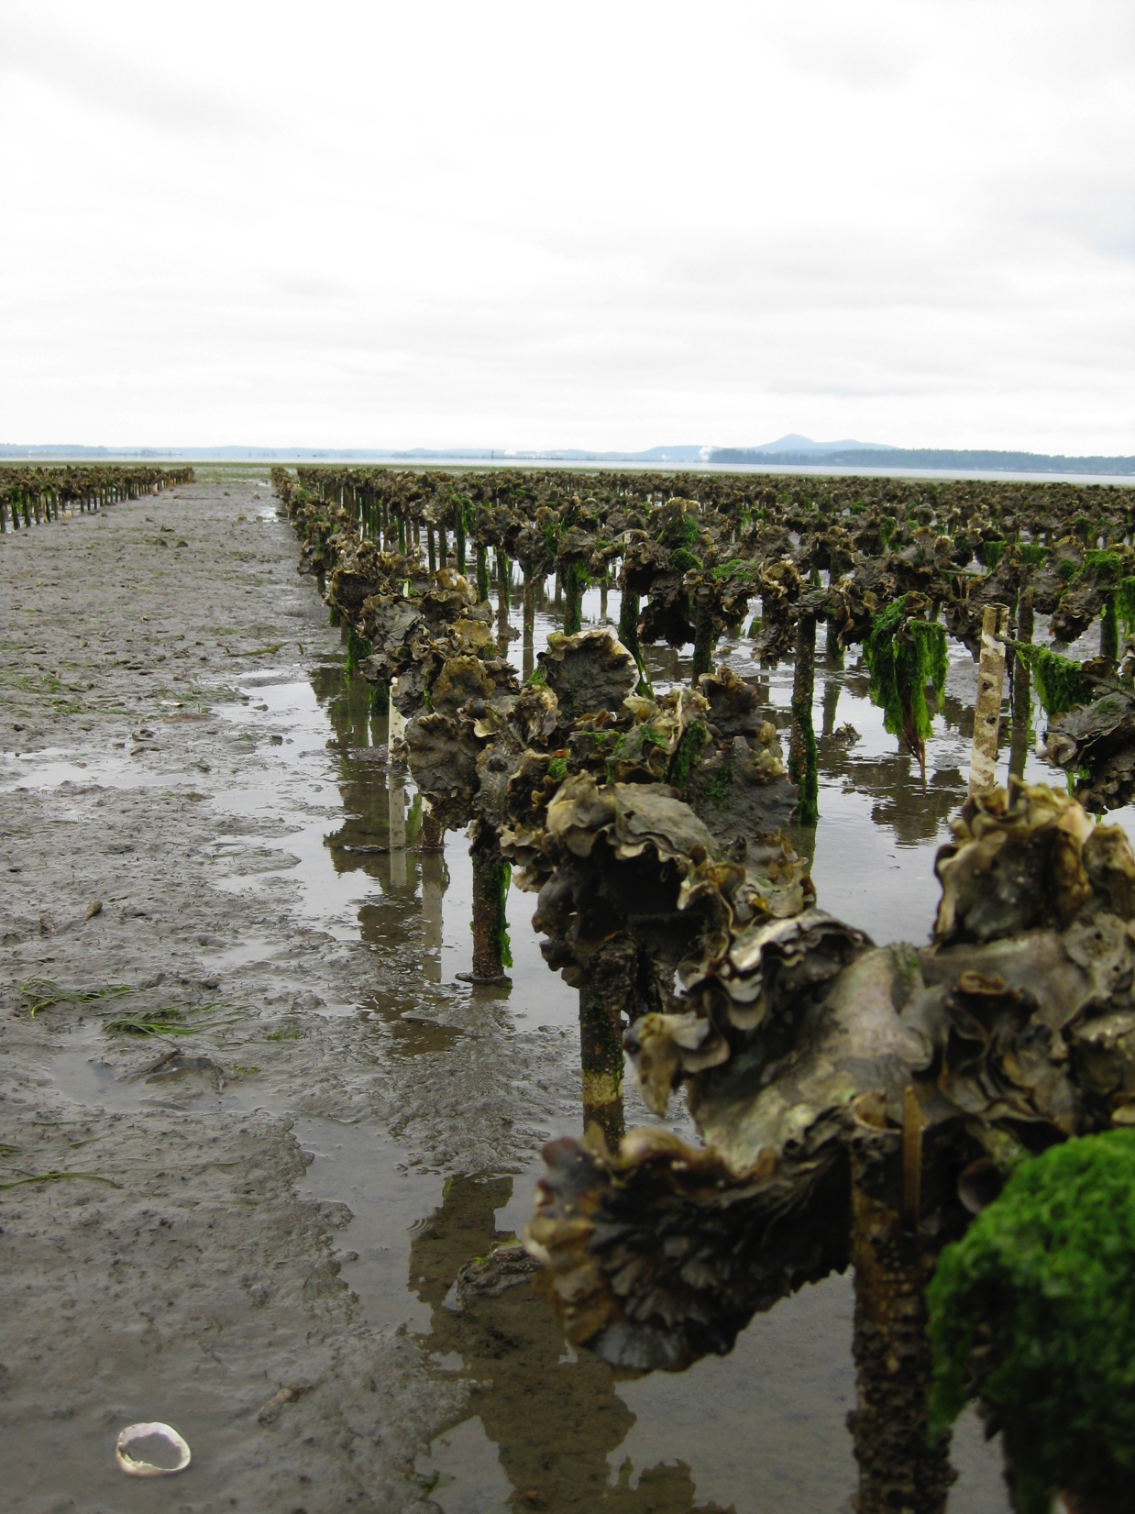
I. Summary
Genome-wide characterization of methylation
Source: Olson and Roberts 2014
Notes:
This study of interest because most previous research has concerned mammals and we provided a comprehensive characterization of methylation in an invertebrate. This was the first high-resolution methylation map generated for a molluscan species, which allowed us to examine both the distribution and potential regulatory functions of methylation in the oyster genome.

Slide 35
I. Summary
Genome-wide characterization of methylation
15% overall genome methylation
Source: Olson and Roberts 2014
Notes:
To summarize the data from this study, we found that overall 15% of CpGs methylated in oyster male gamete genome. Again, this amount is much lower than what we see among vertebrate species with heavy genome methylation, but it is comparable with other invertebrate sp’s.

Slide 36
I. Summary
Genome-wide characterization of methylation
15% overall genome methylation
DNA methylation predominantly in exons and introns
Source: Olson and Roberts 2014
Notes:
We were also able to provide a comprehensive profile of where DNA methylation occurs across the oyster genome, with it being primarily located among genes, or exons and introns.

Slide 37
I. Summary
Genome-wide characterization of methylation
15% overall genome methylation
DNA methylation predominantly in exons and introns
Gene body methylation reduces transcriptional noise
Source: Olson and Roberts 2014
Notes:
And finally, based on our gene expression data we saw a positive relationship between methylation status and gene expression, in both promoter regions and genes. And I believe that methylation may not necessarily be controlling gene expression directly but is rather controlling the amount of transcriptional noise that is present in the oyster genome.
This research provided a comprehensive view of DNA methylation patterning in oysters as well as evidence for a relationship between methylation and gene expression

Slide 38
II. Methylation roles in development
To what degree are DNA methylation patterns:
  Heritable?
  Variable between individuals?
  Changes during development?
Notes:
However, there were still many things we didn’t know about methylation in oysters, including if these patterns are heritable.
Therefore, the objectives of our next project were to examine…

Slide 39
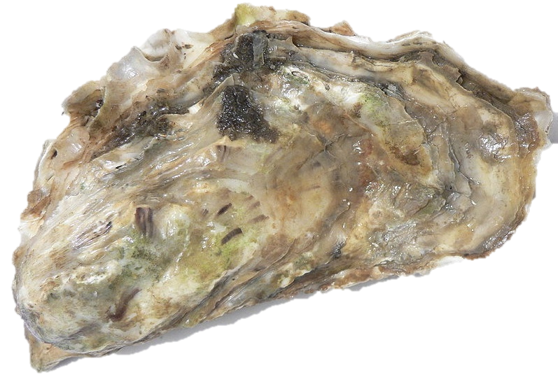



II. Experimental Design
Male 1
Male 2
Sperm
Sperm
Notes:
To examine degree of DNA methylation heritability in oysters, schematic showing experimental design
Fertilized eggs from a single female with the sperm from two males
-2 males were fraternal (full siblings- genetic variation was likely minimized)
-Also used a single female to reduce any potential variability

Slide 40

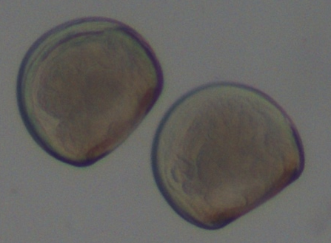
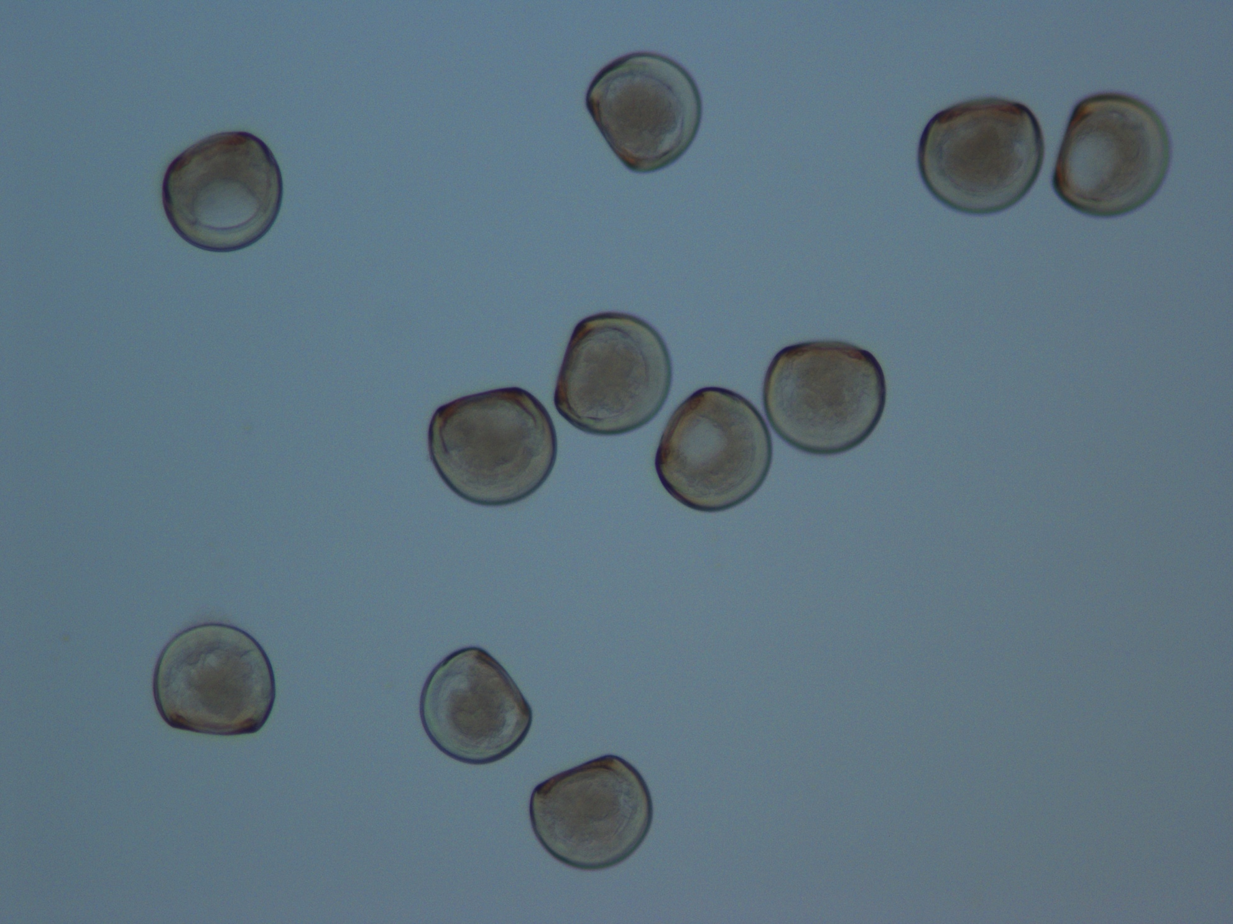
II. Experimental Design
Male 1
Male 2
Sperm
Sperm
Male 1
72hpf
120hpf
Male 2
Notes:
Fertilized eggs were placed in two separate tanks, according to the male oyster.
Samples of oyster larvae at 72hpf and 120hpf
Whole genome bs-seq to examine methylation patterns from three developmental stages (sperm and larval oysters- 3 and 5 days post fert.) from two lineages.
-individual heritability (sperm vs larvae, patterns between 2 lineages different)
-variability between individuals (comparing sperm samples)
-changes in development (comparing larvae across time)

Slide 41
II. Methylation heritability
Lineage 1
Lineage 2
Sperm
Sperm
72hpf
72hpf
120hpf
120hpf
Notes:
To investigate the role of DNA methylation in oysters during development, we were first interested in exploring parental transmission of methylation patterns, and seeing if these patterns were heritable between parents and their offspring.

Slide 42
II. Methylation heritability
Lineage 1
Lineage 2
Sperm
Sperm
72hpf
72hpf
120hpf
120hpf
Notes:
And this involved comparing methylation patterns between the male sperm samples and their larvae at 72 and 120hpf. Therefore, we are examining loci that were the same among the two oyster lineages, but contained differences in methylation levels.

Slide 43
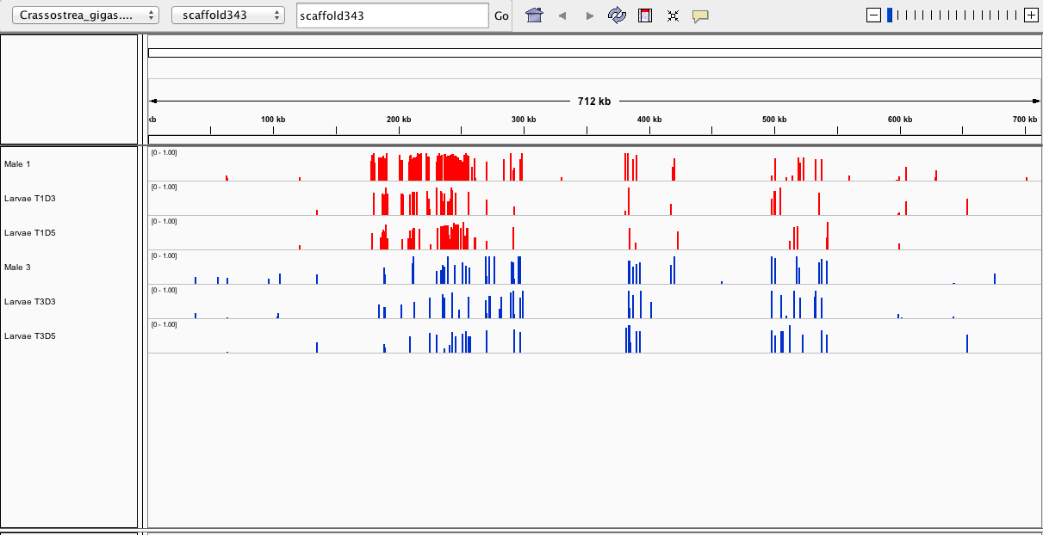
II. Methylation heritability
1_sperm
1_72hpf
1_120hpf
2_sperm
2_72hpf
2_120hpf
Notes:
One way to begin looking at the distribution of methylation patterns is to use genomic visualization tools- this program is called Integrative genomics viewer.
Visualize patterns of methylated and unmethylated regions in the oyster genome.
Showing a single scaffold of the genome, or about a 700kb region, containing 6 tracks for each of the oyster sperm or larvae samples I examined. The numerix prefix refers to the oyster lineage in which the sample originated from.
Each bar represents percent methylation for an individual CG loci.
We can see that overall there is about 15% genome methylation, which correlates with what we previously found in the oyster male gamete from the first part of my research.

Slide 44
II. Methylation heritability
1_sperm
1_72hpf
1_120hpf
2_sperm
2_72hpf
2_120hpf
Notes:
We can also begin to visualize patterns of differential methylation between the two oyster lineages.

Slide 45
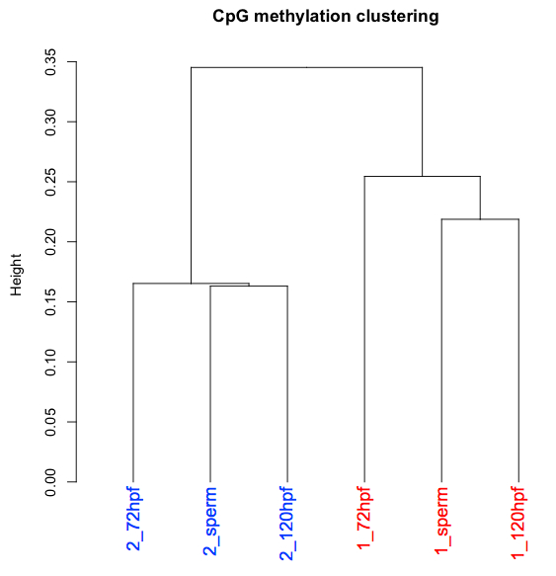
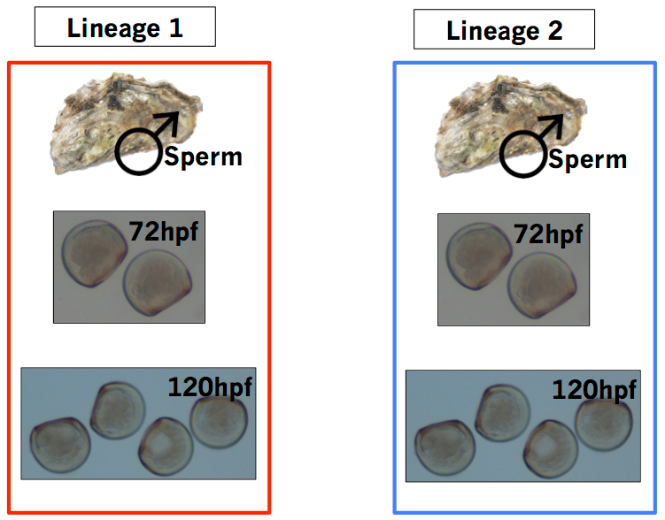
II. Methylation heritability
Oyster lineages more similar in their methylation patterns
Notes:
-One of the main findings from study: Oyster lineages are more similar in methylation patterns rather than developmental stages.
-This is a dendogram of the male sperm and larvae using Pearson’s correlation distance. Samples that grouped together are more similar in their genome-wide methylation profiles.
-Interesting bc we expected sperm to be similar as it is a single cell type, and larvae are mixed tissues. And in other organisms, DNA methylation has been shown to be variable across different tissue types and life history stages. The sperm samples were also full siblings, so we would assume a lack of genetic variation between these two individuals.
-1st indication that there appear to be different epigenetic patterns that may differ among oyster lineages

Slide 46
II. Methylation heritability
Of loci we have data for in male sperm samples:
  3,027 loci had a methylation difference of at least 90%
Notes:
-In fact, the two male sperm samples had the least similarity in methylation patterns out of all pair-wise comparisons.
-Specifically, we found that ~3k common loci between the sperm samples contained a methylation difference of at least 90%

Slide 47
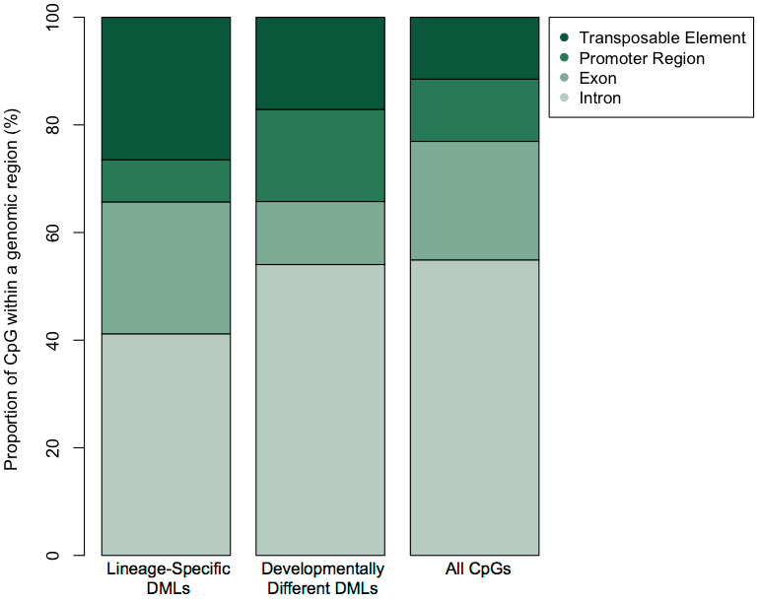
II. Lineage differential methylation
188 loci differing in methylation levels across lineages
Notes:
-To examine where in the oyster genome these differences were located, we identified loci that significantly differed in methylation levels between the two oyster lineages. These loci were therefore differentially methylated, and are termed differentially methylated loci, or DMLs. And there were 188 loci total that differed in methylation levels across 2 lineages. DMLs were classified with respect to oyster genomic regions (Intron, Exon….). And while we’re only examining regions of the oyster genome that have been annotated, we do see that a majority of DMLs are present among genes, or exons and introns, and also transposable elements.

Slide 48
II. Lineage differential methylation
Notes:
However, when examining the distribution of these DMLs, we need to consider how many CGs are located within each of these genomic regions. So we also need to take into account the distribution of all the CGs in the oyster genome as a comparison. If the distribution of these DMLs were random, we would expect a similar pattern as seen in the column showing the distribution of all CGs in the oyster genome.

Slide 49
II. Lineage differential methylation
High proportion of differentially methylated loci found within transposable elements
Notes:
And interestingly, we found a higher proportion of DML among TEs, when compared to the distribution of all CpG dinucldotides in the oyster genome. And this difference was statistically significant. We also see that the distribution of DMLs among genomic regions such as exons or introns, is not significantly different than the distribution of all CGs in the oyster genome.

Slide 50
II. Lineage differential methylation
? ? ?
High proportion of differentially methylated loci found within transposable elements
Notes:
So why did we observe a high proportion of DMLs present among TEs?

Slide 51
II. Lineage differential methylation
Genes
(Promoter, Exon, Intron)
Transposable Elements
Notes:
So if we have both genes (or promoter regions, exons, and introns), well as Transposable elements.
-Transposable elements (or TEs) are DNA sequences that have the ability to change position in the genome, also known as “jumping genes” bc they can “jump” to different locations within a genome.

Slide 52
II. Lineage differential methylation
X
X
X
X
X
X
X
X
X
X
X
X
X
X
X
X
X
X
X
X
X
X
X
X
X
X
X
X
X
X
X
X
X
X
X
X
Genes
(Promoter, Exon, Intron)
Transposable Elements
X
=Differentially methylated region
Notes:
I am proposing is that the differences in methylation we are observing may be random and that loci will be differentially methylated as a result of a random process.

Slide 53
II. Lineage differential methylation
X
X
X
X
X
X
X
X
X
X
X
X
X
X
X
X
X
X
X
X
X
X
X
X
X
X
X
X
X
X
X
X
X
X
X
X
Genes
(Promoter, Exon, Intron)
Transposable Elements
X
=Differentially methylated region
Notes:
But a change in methylation, or gene expression, among functional genes that are core to oyster survival would likely result in a lethal situation. It would therefore be beneficial for genes (or Promoter regions, exons, and introns) to have consistent methylation patterns, rather than being differentially methylated.
However, a change in methylation among TEs could potentially be a lethal situation if a TE insertion occurs in a core functional gene and disrupts gene expression. But TE mobility could also generate new genetic variation, which would be important for organisms like oysters, in which populations are living in stressful intertidal areas and may experience abrupt changes in environmental conditions. Therefore, I believe that this differential methylation is occurring among TEs because differences in methylation can be random, so it isn’t crucial if TEs are either methylated or unmethylated.
However, it is crucial for the methylation status of functional genes to be consistent.

Slide 54
II. Lineage differential methylation
High proportion of differentially methylated loci found within transposable elements
Notes:
So there is no discrimination of where the differentially methylated loci might occur, but the outcome results in a higher proportion of transposable elements because methylation differences in genes are more likely to result in a lethal situation.

Slide 55
II. Differences in development
Lineage 1
Lineage 2
Sperm
Sperm
72hpf
72hpf
120hpf
120hpf
Notes:
For this experiment, we were also interested in exploring developmental patterns of DNA methylation.

Slide 56
II. Differences in development
Lineage 1
Lineage 2
Sperm
Sperm
72hpf
72hpf
120hpf
120hpf
Notes:
And this involved comparing methylation patterns between developmental stages. This gives us information about the methylation changes that are occurring during oyster development, by looking at three developmental stages: sperm and larval oysters (72 and 120 hpf).

Slide 57
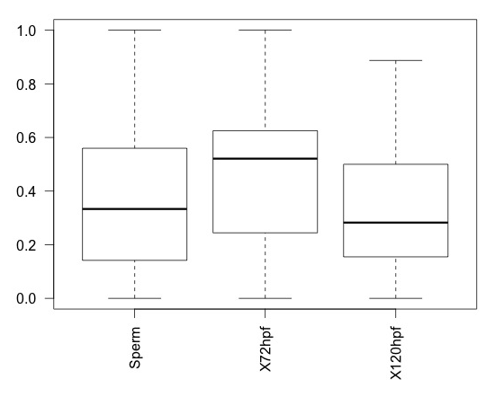
II. Differences in development
Limited differences in overall methylation levels among developmental stages
Average methylation level
Sperm
72hpf
120hpf
Notes:
And by examining overall DNA methylation levels during the first week of oyster development, these are boxplots showing the average methylation levels for each of the three developmental stages I examined. We see that DNA methylation levels do not vary significantly during developmental stages. But we were interested in understanding what differences in methylation were present between these 3 developmental stages, and what role these methylation differences might be playing…

Slide 58
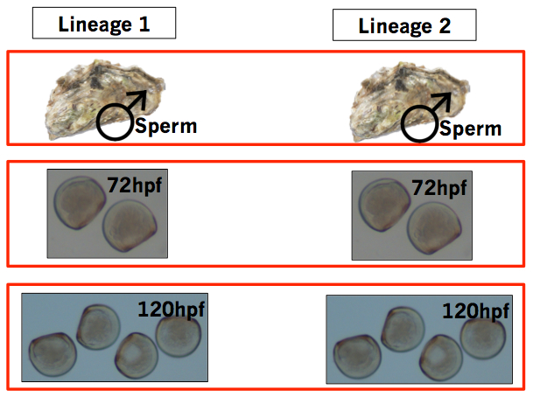
II. Development differential methylation
157 loci differing in methylation levels during developmental stages
Notes:
-So to examine any methylation differences that are occurring during oyster development, we again classified differentially methylated loci, or DMLs. And there were 157 loci that differed in methylation levels at different developmental stages (for example, between sperm 72hpf)
These DMLs were classified with respect to oyster genomic regions (Intron, Exon….). And we see that a majority of DMLs are present among introns and promoter regions.

Slide 59
II. Development differential methylation
Notes:
Again, we need to take into account the distribution of all the CGs in the oyster genome as a comparison, to consider how many CGs are located in each of these genomic regions.

Slide 60
II. Development differential methylation
Notes:
And examining this distribution, we found a significant difference in DML during oyster development located in both TEs again, but also in promoter regions, relative to the distribution of CpGs in the oyster genome.

Slide 61
II. Development differential methylation
? ? ?
Notes:
So why would a high proportion of DMLs present among promoter regions?

Slide 62
II. Development differential methylation
M
M
M
M
M
M
Gene
Gene
OR
M
M
M
M
Gene
Gene
Notes:
We didn’t look at gene expression levels for this study, so we don’t definitively know whether high or low methylation levels will decrease gene expression during oyster development. However, we previously found that there is variation in expression levels based on the amount of promoter region methylation. And we are seeing differential methylation among promoter regions during oyster developmental stages.
During oyster development, there will be many changes in gene expression, as cells are dividing and growing, and our data suggests that promoter methylation may be regulating this gene expression to play a role in oyster development. And this finding is consistent with previous research on oysters by Riviere, which found that DNA methylation may specifically control expression of some oyster developmental genes through methylation of promoter regions.

Slide 63
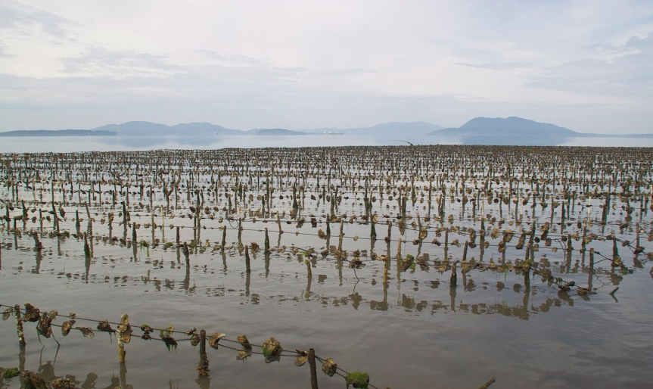
II. Conclusions: heritability
Research suggests epigenetic inheritance
Presence of lineage-specific methylation patterns
High proportion of differentially methylated loci among lineages found within transposable elements
Notes:
Conclusions form this second chapter…
-Our research suggests DNA methylation patterns are inherited, as methylation patterns were most similar between males and their offspring
-Interestingly, we found the presence of lineage-specific methylation patterns. This is different that what we expected as we thought the sperm samples would be similar in their methylation patterns as they were full siblings, and that male gametes are a single cell type.
-High proportion of DMLs among lineages present among TEs, compared to the distribution of CGs in the oyster genome. And I believe that these differences in methylation are random, but a change in methylation among Tes is less likely to be lethal than a change in methylation among genes.

Slide 64
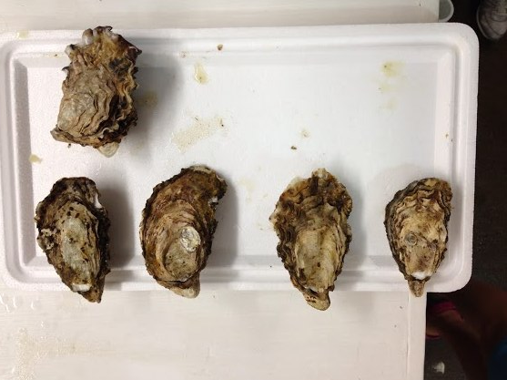
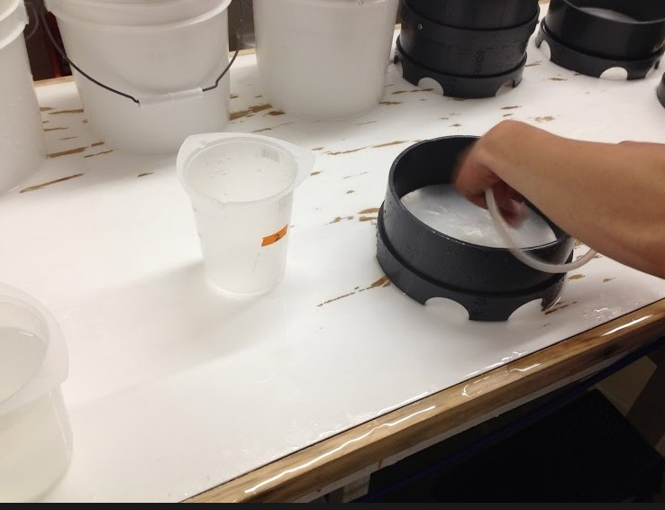

II. Conclusions: differences in development
DNA methylation levels not significantly variable between cell types or life history stages
Promoter methylation may play a role in oyster development
Notes:
We also did not observe any dramatic differences in methylation during oyster development, as have been observed in other species.
DNA methylation levels were similar across all samples, indicating that methylation does not significantly vary between cell types and life history stages in oysters.
However, when examining differences that do exist between developmental stages, we found differential methylation among promoter regions. So this suggests that promoter methylation may play a role in oyster development

Slide 65
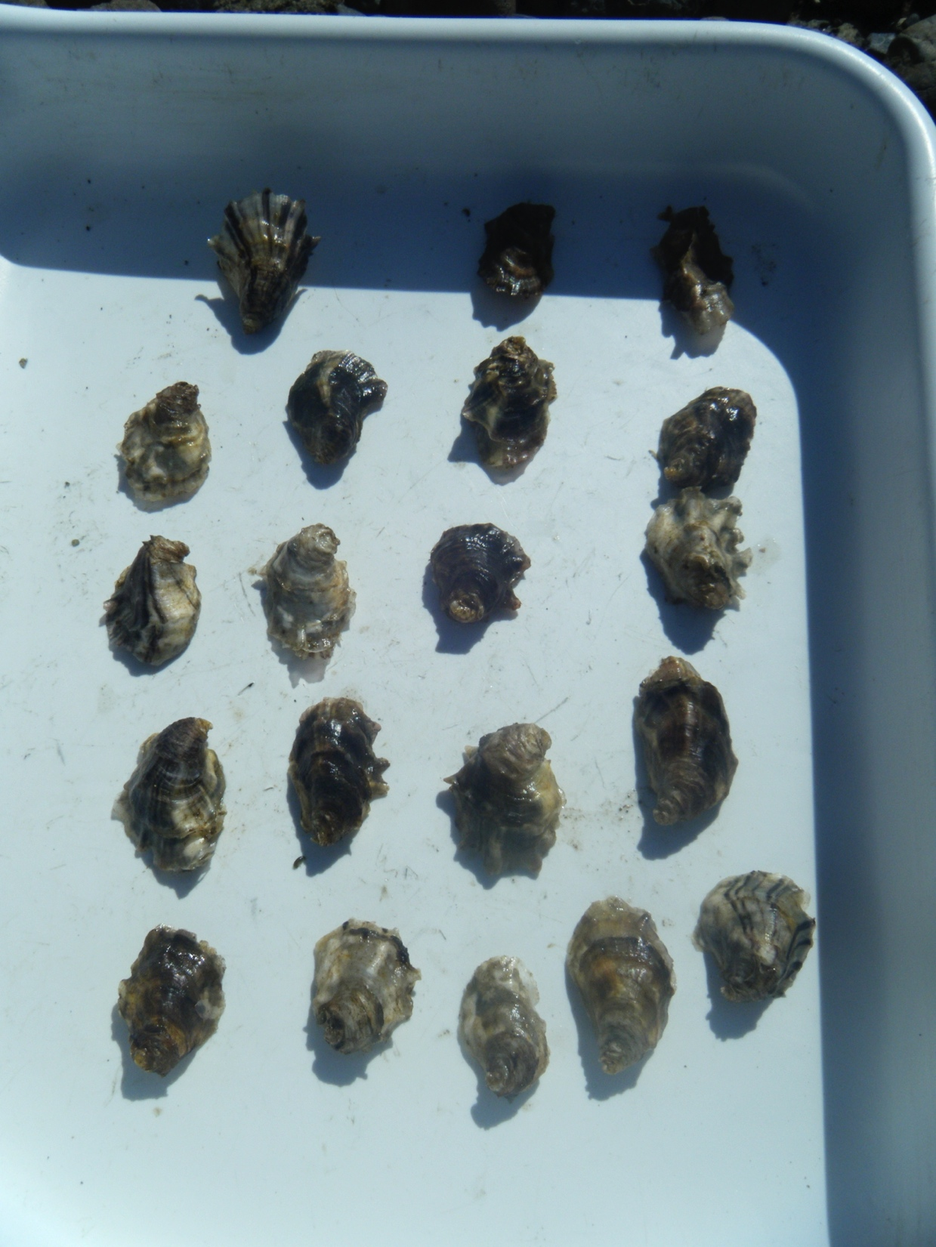
Summary
DNA methylation controlling transcriptional noise in oyster genome
DNA methylation patterns are inherited
Notes:
Overall, this research found a relationship between methylation status and gene expression. And I’m suggesting that DNA methylation may not directly be regulating gene activity, but rather controlling the amount of transcriptional noise that is present in the oyster genome.
Also shown that methylation patterns are likely inherited, as they were different between oyster lineages.
We also found differences in methylation among lineages to be present among transposable elements, and I propose that these differences in methylation are random, but a change in methylation among Tes is less likely to be lethal than a change in methylation among genes.

Slide 66
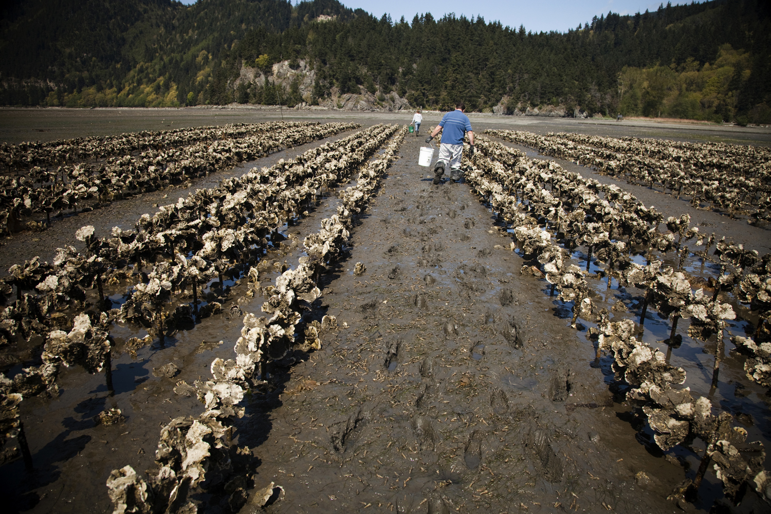
Implications
Organism survival in changing environments
Species adaptation over evolutionary time
Notes:
This research could have significant implications for the way organisms may respond to changing environments, particularly with respect to climate change.
Oysters are common models for studying adaptation of aquatic species to climate change, and epigenetic mechanisms like DNA methylation may explain how oysters are able to handle environmental change through a mechanism that can’t be explained by genetics alone.
DNA methylation could also underlie processes that allow species adaptation over evolutionary time.
If methylation is repeated across generations, successful methylation patterns could induce permanent changes in the genome. Therefore, this research could completely change the way we think about certain evolutionary concepts.

Slide 67


Acknowledgments
Roberts Lab
  Sam White
  Brent Vadopalas
  Mackenzie Gavery
  Emma Timmins-Schiffman
  Jake Heare
Committee
  Steven Roberts
  Lorenz Hauser
  Graham Young
Taylor Shellfish
  Molly Jackson
  Stuart Thomas
Notes:
I would like to thank all the members of the Roberts lab, who have provided me with feedback on both manuscripts and talks
I would also like to thank Taylor Shellfish for providing me with all of the oysters used in these studies, particularly Molly Jackson for helping me complete some of these experiments.
I would like to especially thank the members of my committee for their expertise and insight, especially my advisor, … for his patience and for challenging me intellectually during my time here.

Slide 68
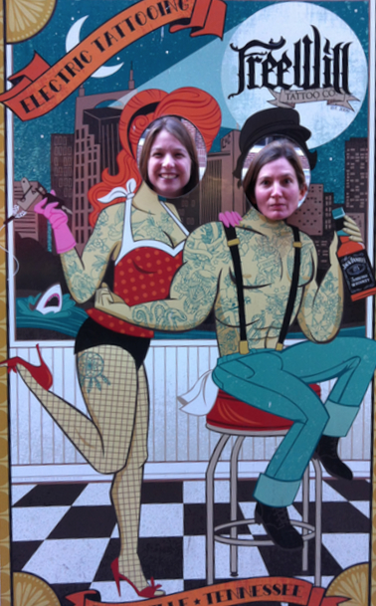

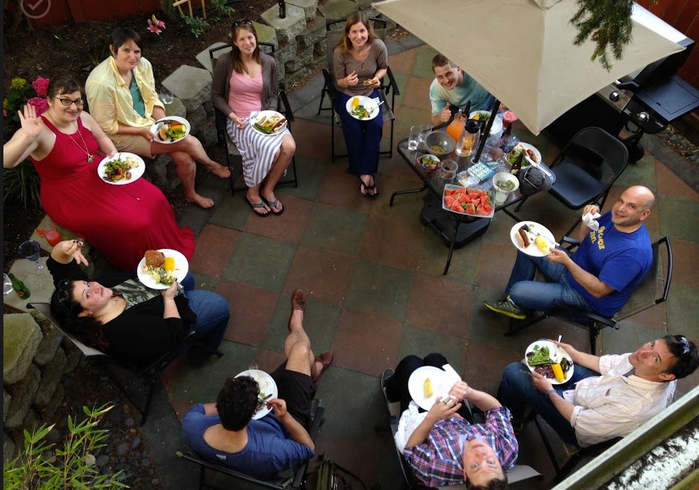



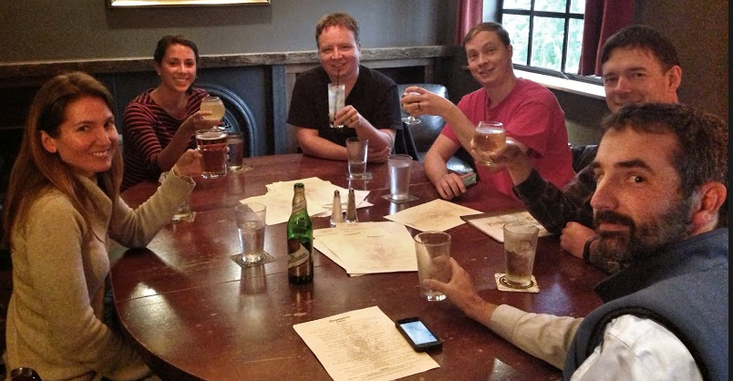
Roberts Lab
Notes:
I would like to thank all the members of the Roberts lab and extended Robert’s lab members, for all their helpful feedback and support but for also being the most fun group of people to hang out with outside of the lab.

Slide 69
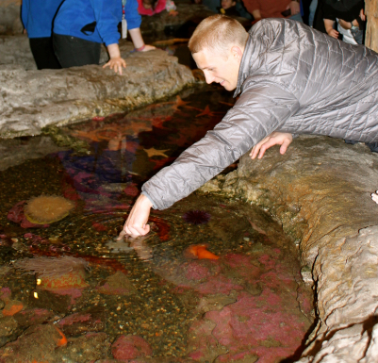
Family
Notes:
I’d also want to thank my husband Aaron, for taking a genuine interest in my research, even if he didn’t always understand what I was talking about.

Slide 70



Family
Notes:
And my family for all their support and for encouraging me throughout my endeavors.

Slide 71
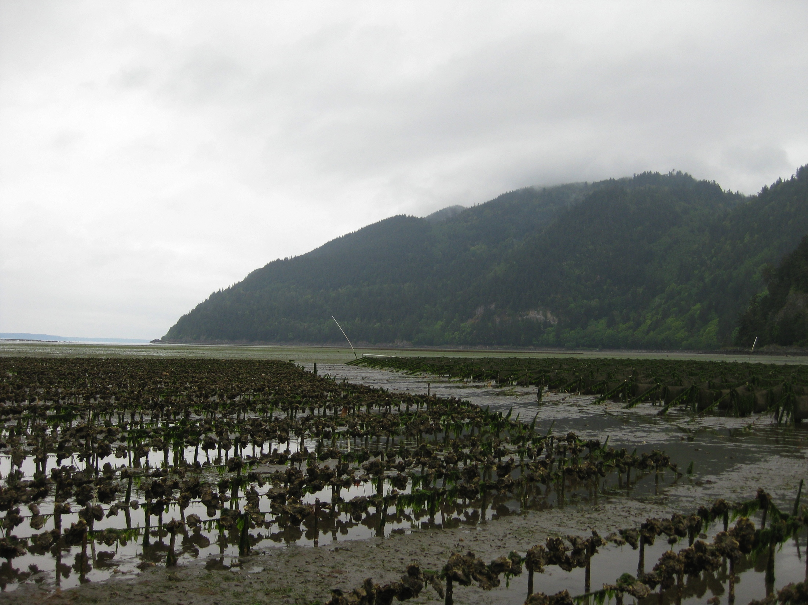
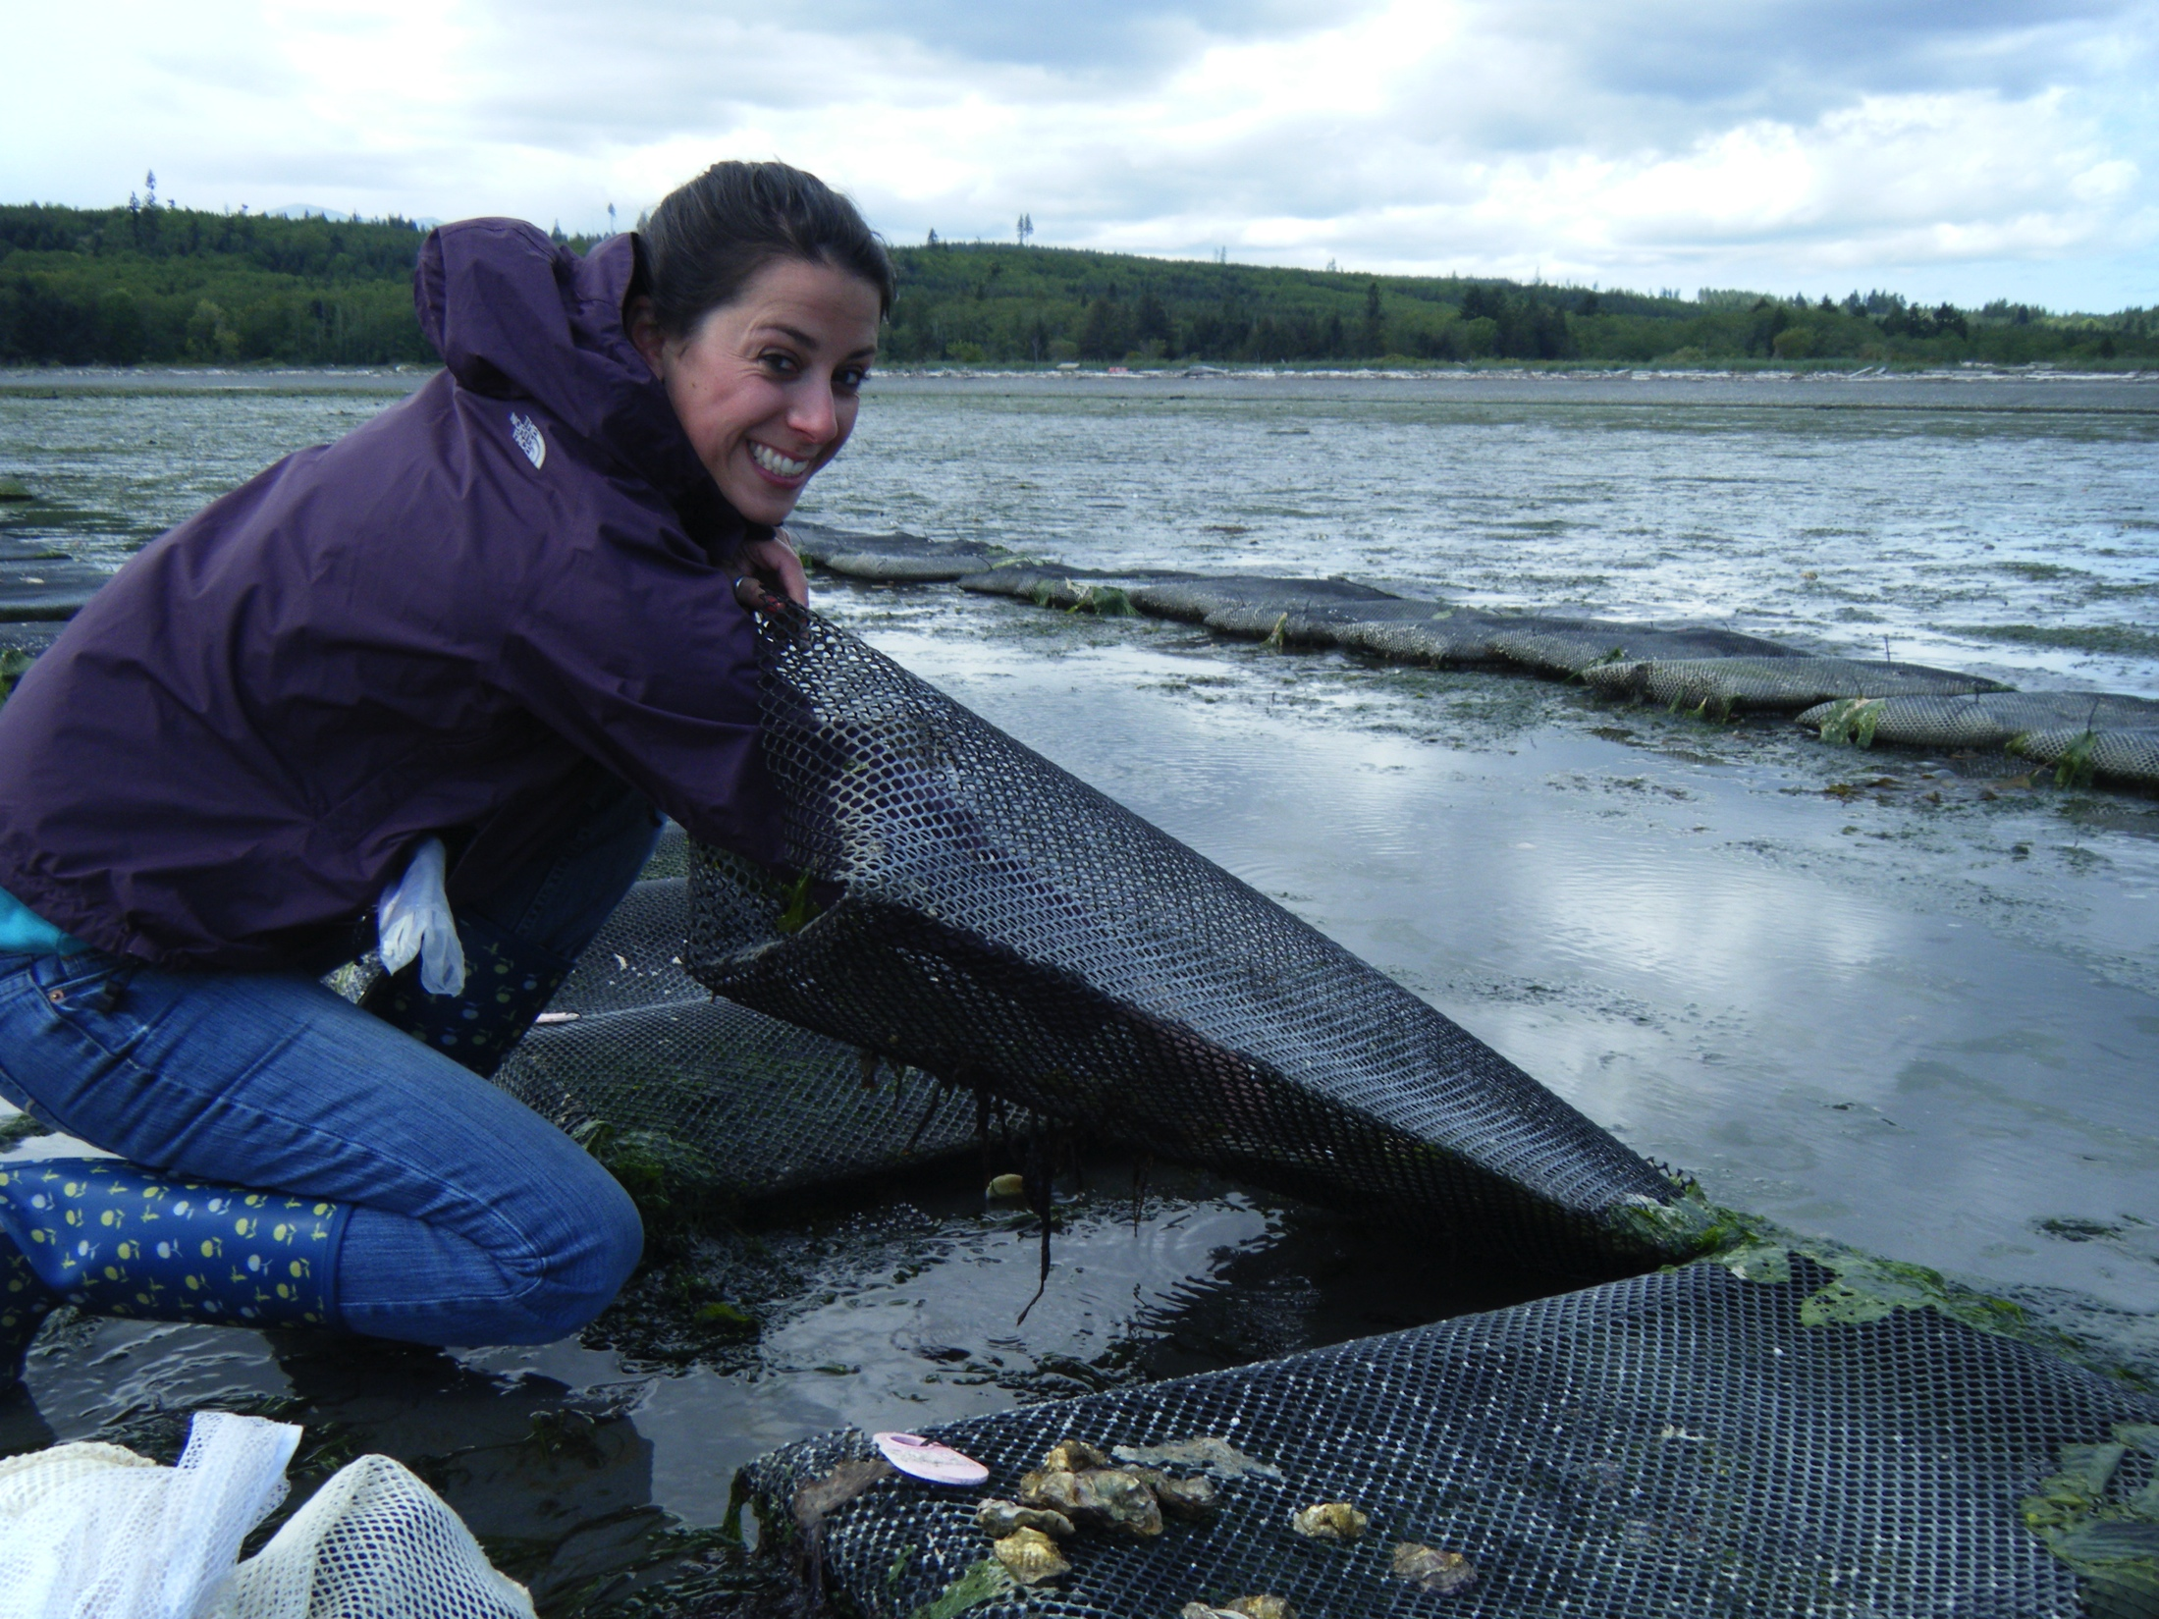
Questions?

