Slide 1
Evidence for lineage-specific DNA methylation patterns in the Pacific oyster
Claire Olson
Steven Roberts
University of Washington
School of Aquatic and Fishery Sciences
PCSGA
Vancouver, WA
September 2014
Notes:
Today I’m going to talk about…

Slide 2
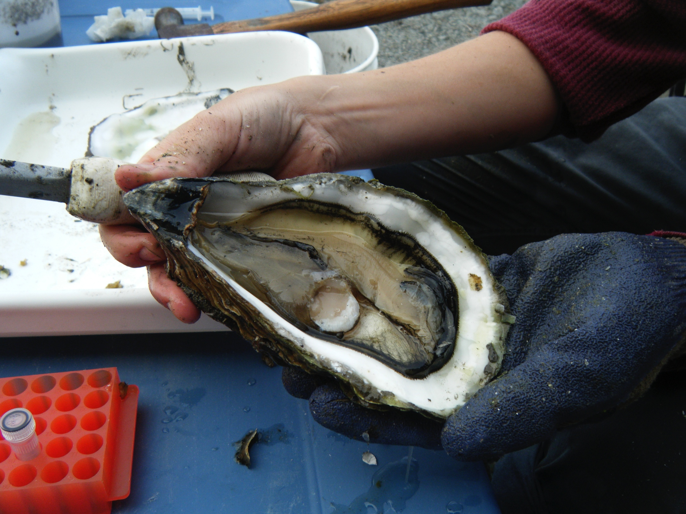
Outline
Background: epigenetics and DNA methylation
Results: characterizing DNA methylation and examining degree of heritability
Implications
Future work
Notes:
I’ll be presenting results from characterizing DNA methylation in oysters and examining degree of heritability of these marks.
But before I talk about results, I’d like to present some background information on DNA methylation

Slide 3
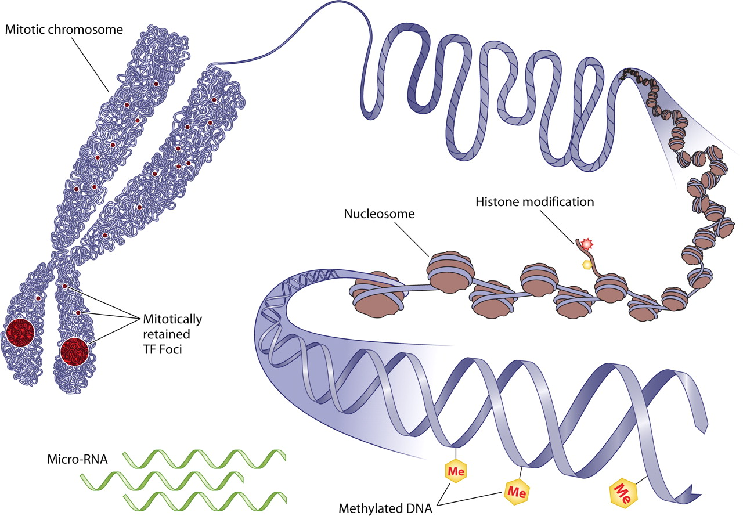
Epigenetics
Epi = “at, upon”
Epigenetics describes modifications to our genetic material that changes the way genes are expressed
Source: http://episona.com/short-introduction-epigenetics/
Notes:
The prefix “Epi” means at or upon. Therefore,
Epigenetics describes DNA modifications that change gene expression without altering the underlying nucleotide sequence. Examples of such modifications are DNA methylation and histone modifications. Both of these serve to regulate gene expression without altering the underlying DNA sequence.

Slide 4
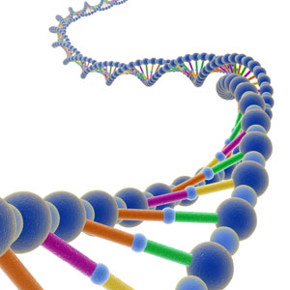
DNA methylation
DNA methylation in organisms is diverse, variable among species, and can change genome function under external influences
G
C
CH₃
Notes:
The most well understood epigenetic mechanisms is DNA methylation.
DNA methylation involves the addition of a methyl group to cytosine nucleotide- DNA methylation usually occurs in a CpG dinucleotide context.

Slide 5
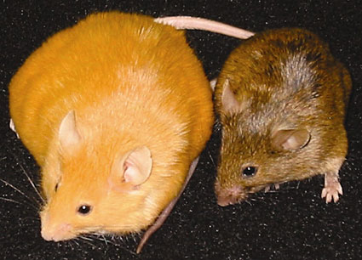
DNA methylation
Epigenetics affected by nutrition and environment
Genetically identical mice
Agouti gene is differentially methylated
Source: Waterland and Jirtle 2003
Notes:
Most of what is known about methy is from research on mammals and plants, less in invertebrates.
And we see dramatic affects of methylation on mammals, and in mice it has been shown that the diet can modify traits by affecting DNA methylation.
-Visual example of this can be seen in the agouti mice. These are two female mice that are genetically identical but have different DNA methy patterns giving rise to these 2 very different phenotypes.

Slide 6
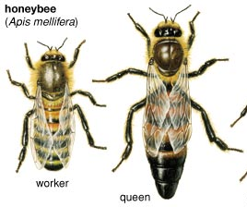
DNA methylation
Regulation of castes for honey bee queen and workers
Diet of royal jelly during larval development generates queen bees
Notes:
From the limited studies done on invertebrates, research has shown that DNA methylation has important regulatory functions in organisms such as honey bees.
Specifically, in honey bee colonies there are both workers and queen bees that are genetically identical, but being fed a diet of the substance royal jelly will influence the epigenetic status of the bees cells. Those fed royal jelly will become queen bees, while the rest will develop into worker bees.
As a result, there are two different outputs- fertile queens and non-reproductive workers generated from the same genome.

Slide 7
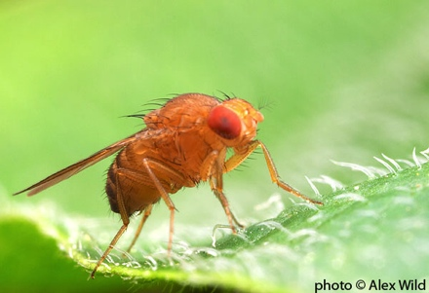
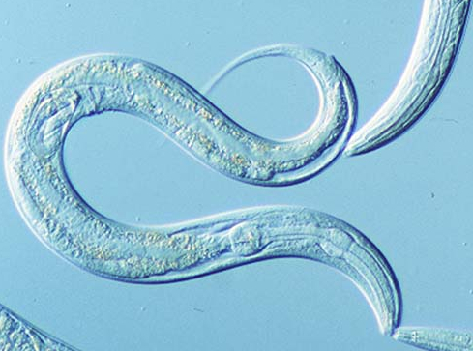
DNA methylation
Vertebrates: global methylation
Invertebrates: limited methylation
Model invertebrates lack DNA methylation
E.g. Drosophila and C. elegans
Non-model invertebrates have mosaic methylation
E.g. Oysters and sea squirts
Distribution and function is uncertain
Notes:
There’s also a wide range of DNA methylation patterns: from global methylation in vertebrate species (70-80% methylation), to limited or no methylation in model invertebrate species (Drosophila and C elegans). Invertebrates such as oysters contain mosaic pattern (heavily methylated areas dispersed within domains that are methylation free).
Illustrates the diversity of DNA methylation patterns and highlights gaps in understanding the evolutionary and functional significance.

Slide 8
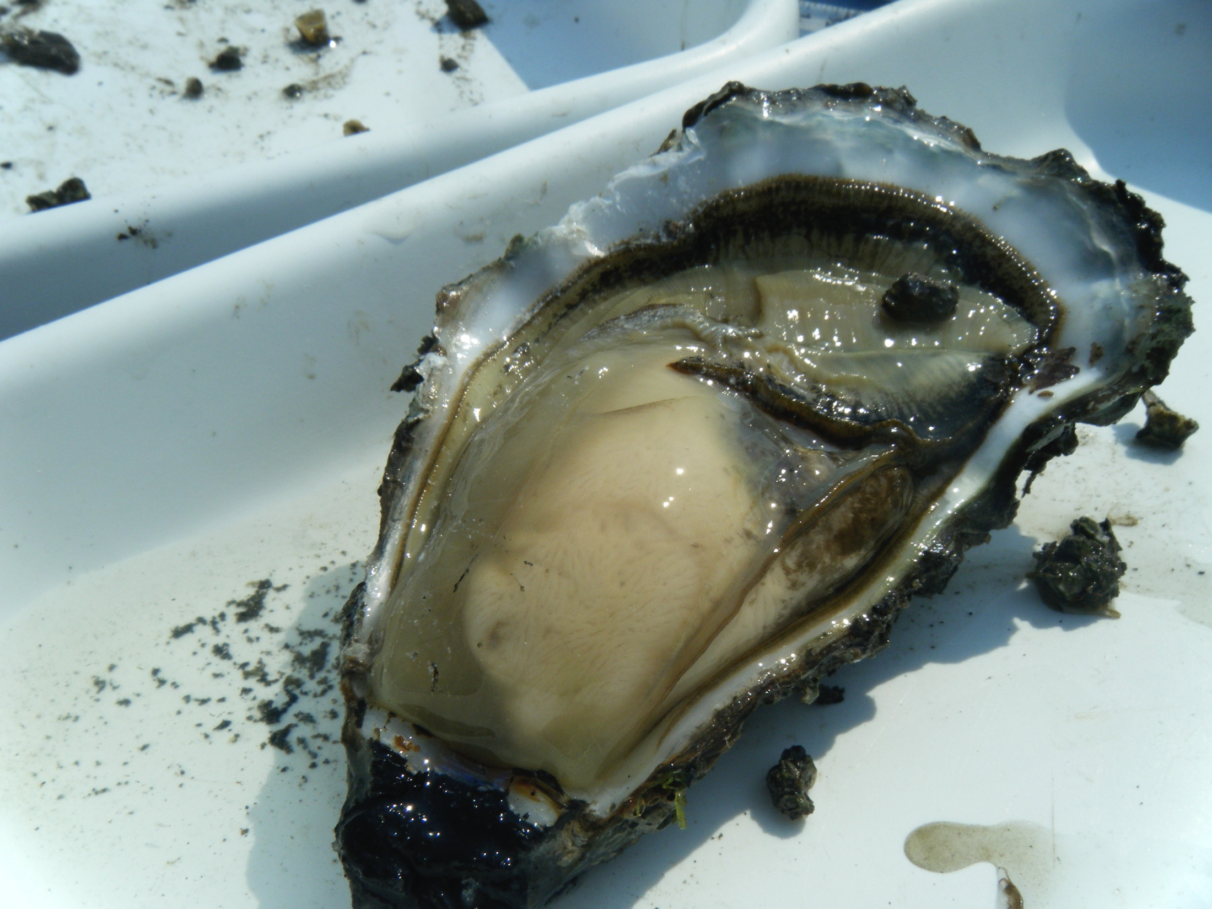
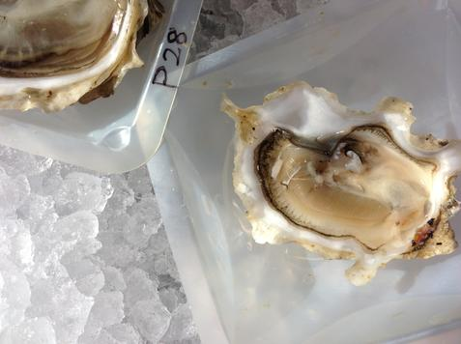
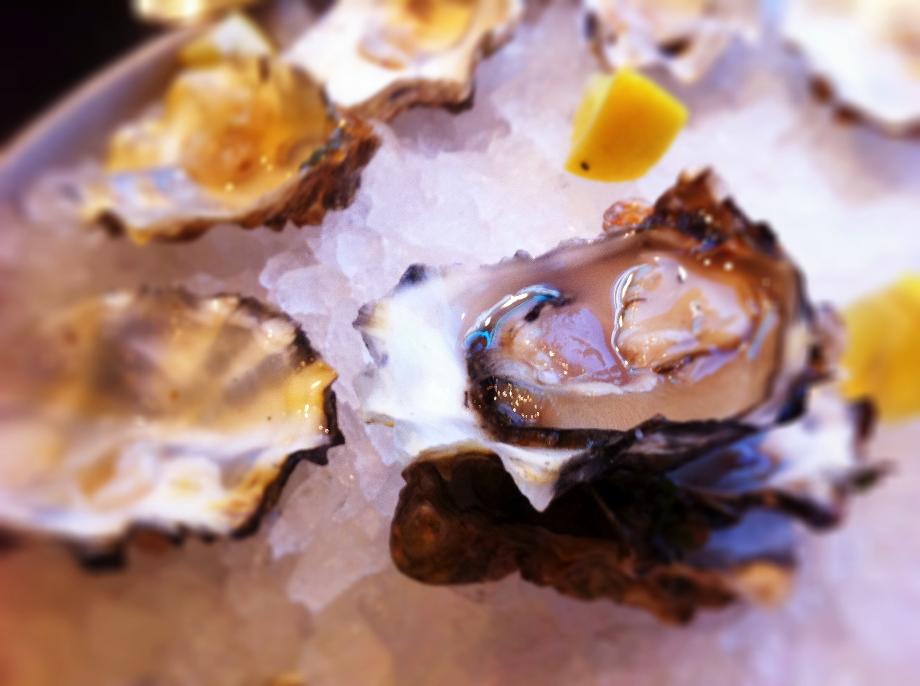
DNA methylation in C. gigas
Why oysters?
Important aquaculture resources
Genomic resources
Sessile
Notes:
-Oysters are important fishery and aquaculture species, models for studying adaptation of aquatic species to climate change
-Availability of genomic resources (genome)
-As sessile marine animals, oysters must cope with and adapt to extreme environmental conditions associated with the intertidal zone. Oysters are exposed to constant fluctuations in temperature and salinity, and must therefore implement mechanisms to cope with these stressors, and epigenetic mechanisms such as DNA methylation may explain how these organisms are able to adapt.
Goals of our research is to use the Pacific oyster as a model organism to characterize DNA meth patterns and understand the functional role of methylation.

Slide 9
Characterizing DNA methylation in C. gigas
Mosaic methylation associated with gene bodies
Overall 15% genome methylation
No methylation in mitochondrial genome
Positive relationship between methylation and gene expression
Source: Olson and Roberts, 2014
Notes:
-Here is some background data from our research. We have characterized DNA methylation on a genome-wide level in oyster male gamete cells (a single cell type)
-Found Mosaic methylation patterns which can be depicted in this figure which is showing the distribution of methylated cytosines in the oyster genome. There are heavily methylated areas dispersed within domains that are methylation free. Bars on the bottom depict the location of genes bodies.
-Overall 15% genome methylation: comparable to other inverts
-Oyster mitochondrial genome did not have DNA methylation
-Examine relationship between DNA meth and transcript expression in male gamete cells
-Positive association between methylation status and gene expression, suggesting DNA methylation is involved in gene regulatory activity.

Slide 10
To what degree are DNA methylation patterns:
Heritable?
Variable between individuals?
Notes:
However, there are still many things we don’t know about methylation in oysters, including if these patterns are heritable.
Therefore, the objectives of our next project were to examine…

Slide 11
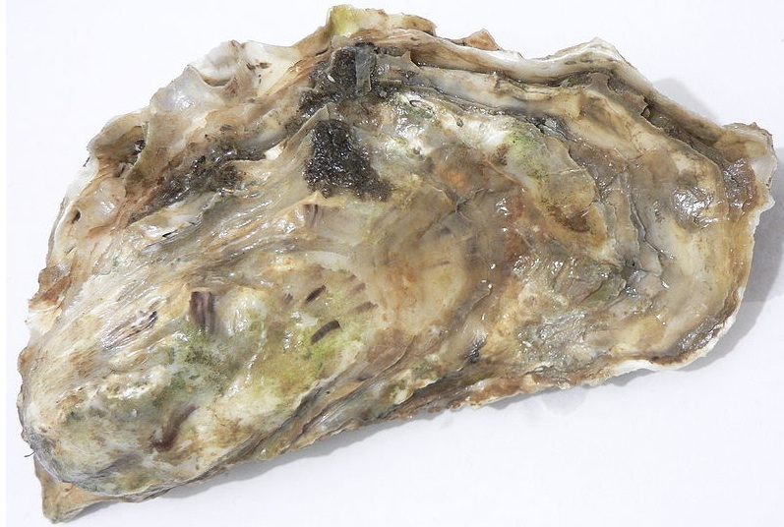
Experimental Design
Male 1
Male 2
Sperm
Sperm
Notes:
To examine degree of DNA methylation heritability in oysters, schematic showing experimental design
Fertilized sperm from two males with eggs from a single female
-2 males were fraternal (full siblings)
-Also used a single female to reduce any potential variability

Slide 12
Experimental Design
Male 1
Male 2
Sperm
Sperm
72hpf
Tank 1
120hpf
Tank 2
Notes:
Samples of oyster larvae at 72hpf and 120hpf
Whole genome bs-seq to examining methylation patterns from sperm and larvae from two lineages.
-individual heritability (sperm vs larvae, patterns between 2 lineages different)
-variability between individuals (comparing sperm samples)
-changes in development (comparing larvae across time)

Slide 13
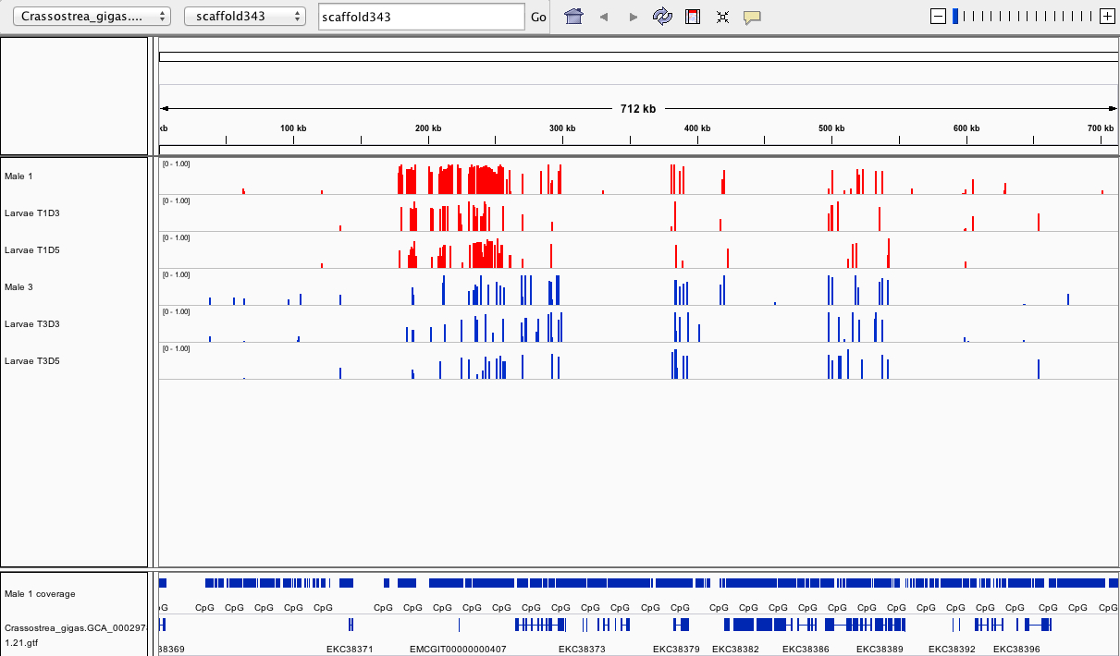
Results: Whole genome
1_sperm
1_72hpf
1_120hpf
2_sperm
2_72hpf
2_120hpf
Sperm coverage
Genes
Notes:
Working with lots of data, so use genome visualization tools to examine methylation patterns- Integrative genomics viewer.
Visualize patterns of methylated and non methylated regions in the oyster genome, as they relate to various genomic areas.
Showing a single scaffold of the genome.
Each bar represents percent methylation for an individual CG loci.
Can see that overall there is about 15% methylation

Slide 14
Results: Whole genome
1_sperm
1_72hpf
1_120hpf
2_sperm
2_72hpf
2_120hpf
Sperm coverage
Genes
Notes:
We can also begin to visualize patterns of differential methylation between the two oyster lineages

Slide 15
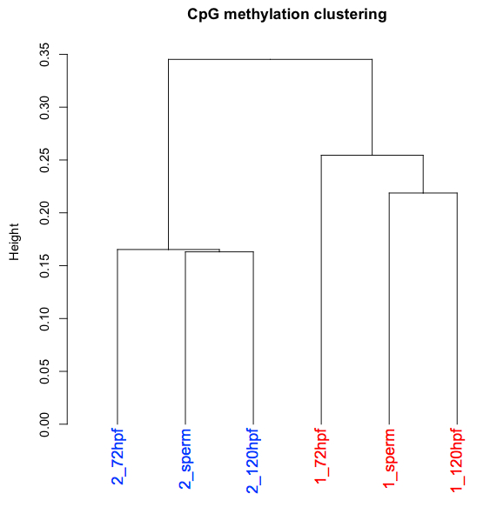
Results: Hierarchical clustering
Oyster lineages more similar in their methylation patterns
Notes:
-One of the main findings from study: Oyster lineages are more similar in methylation patterns rather than developmental stages.
-This is a dendogram of the male sperm and larvae genome-wide methylation profiles using Pearson’s correlation distance. Numeric prefix refers to lineage.
-Interesting bc we expected sperm to be similar as it is a single cell type, and larvae are mixed tissues. And the sperm samples were full siblings.
-1st indication that there appear to be different epigenetic patterns that may differ among oyster lineages

Slide 16
Results: Hierarchical clustering
Of loci we have data for in male sperm samples:
63,593 loci had a methylation difference of at least 20%
14,449 loci had a methylation difference of at least 50%
3,027 loci had a methylation difference of at least 90%
Notes:
-In fact, the two male sperm samples had the least similarity in methylation patterns out of all pair-wise comparisons.
-Specifically, we found that ~63k common loci between the sperm samples contained a methylation difference of at least 20%
-14k loci had a methylation difference of at least 50%
-and 3k loci had a methylation difference of at least 90%

Slide 17
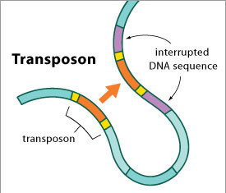
Results: Differential methylation
Majority of differentially methylated loci are found within transposable elements
Transposable element
Notes:
-To examine what was driving these differences in methylation among the two lineages we identified loci that were differentially methylated. These were common loci that significantly differed in methylation levels among the 2 lineages. Found these loci to be predominant among TEs, when compared to the distribution of all CGs in the oyster genome.
-TEs are DNA sequences that have the ability to change position in the genome, also known as “jumping genes”.
-and TEs are commonly known to be silenced by epigenetic mechanisms such as DNA methylation.
-We are still investigating why these differentially methylated loci are present among transposable elements.

Slide 18
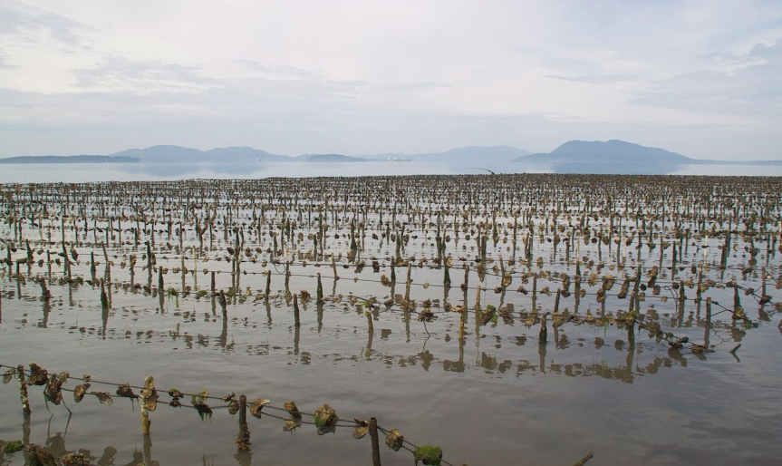
Conclusions
Research suggests epigenetic inheritance
Presence of lineage-specific methylation patterns
Majority of differentially methylated loci found within transposable elements
Notes:
-Our research suggests DNA methylation patterns are inherited, as methylation patterns were most similar between males and their offspring
-Also surprised to find the presence of lineage-specific methylation patterns. This is due to the fact that we expected sperm samples to be similar in their methylation patterns as they were full siblings, and that male gametes are a single cell type.
-Differentially methylated loci predominant among transposable elements (hypothesize that methylation among Tes is helping decrease transcriptional noise during oyster development to maintain genome integrity)
-While we’re beginning to understand some information about heritability of methylation patterns in oysters, we still don’t understand environmental influences on methylation.

Slide 19
Future Work
Preliminary evidence that environment can influence oyster epigenome
Different methylation patterns among oysters experiencing heat shock
Pre-exposure sampling
MBD-Chip
Tiling arrays
Heat Shock
compare
methylation
Post-exposure sampling
Notes:
-However, some preliminary evidence shows that the environment can influence the oyster epigenome…from an experiment examining changes in methylation as a response to an environmental stressor (heat shock). Use DNA tiling arrays to assess differential methylation in oysters pre-and post-stress.
-Different methylation patterns among oysters experiencing heat shock.
-This could have implications for aquaculture, if an organism’s offspring are more robust to an environmental stressor.
-This has been shown in plants, in which descendents of a epigenetically primed Arabidopsis plants exhibited resistance to biotic stress (bacteria).

Slide 20
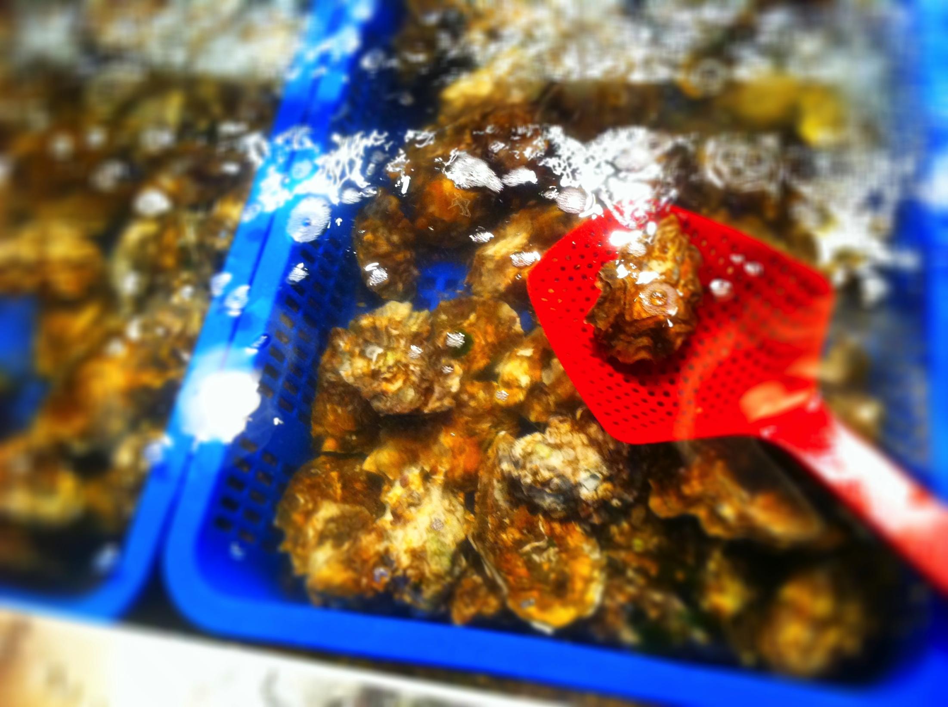
Implications
If future investigations confirm that DNA methylation is:
Heritable
Affected by environment
Different from genetic variation
Implications:
Selective breeding programs
Aquaculture
Notes:
-If future investigations confirm that DNA methylation is potentially heritable, can be affected by the environment, and if epigenetic variation is different from genetic variation, then this research has significant implications for oyster breeding programs in aquaculture.
-For example, a better understanding of DNA methylation may allow greater control in predicting and manipulating gene expression in oysters.
-If epigenetics and genetics are two separate mechanisms, it’s important to understand the influences of both, which could contribute to improved culture and performance in oysters.

Slide 21
Acknowledgments
Roberts Lab
Steven Roberts
Sam White
Brent Vadopalas
Mackenzie Gavery
Emma Timmins-Schiffman
Jake Heare
Taylor Shellfish
Molly Jackson
NSF
NSA-PCS

