Slide 1
MBD-Chip Analysis
Bioinformatics - Fish 546
Winter 2014

Slide 2
Overview
Question: Is the oyster’s response to estrogen (EE2) mediated by DNA methylation
Approach: MBD-Chip
Bioinformatics:
  R packages: Ringo, ChipPeakAnno
  Bedtools
  SQLshare
  DAVID

Slide 3
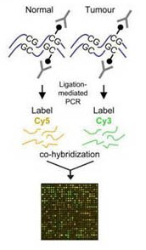
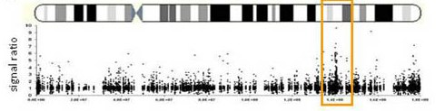
MBD-Chip Differential methylation

Slide 4
Array Design
3 x 720k design
Methylation changes in response to EE2
  Day 7
    Control Pool: 3 females
    EE2 Pool: 3 females
Pooled MBD (n=4)
Input
EE2: red
cntrl: green
EE2: green
cntrl: red
EE2: green
cntrl: red

Slide 5
Microarray Data Processing
Read Nimblegen files into R
Remove control probes
Loess normalize each array
Smooth log2 ratio values by computing a running median
Set a threshold for ‘enriched’ regions
Identify the overlap between replicates, and exclude regions where enrichment is present in control
Evernote link

Slide 6
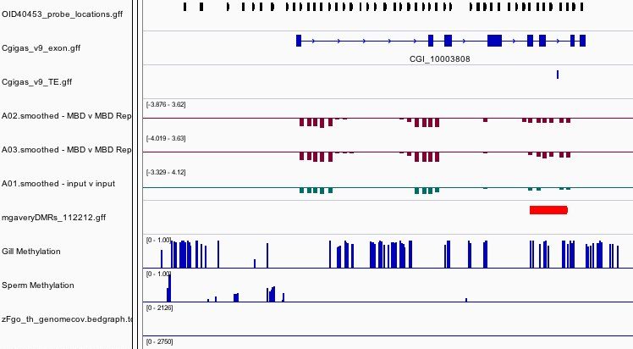
Product – IGV xml
Notes:
DNA topoisomerase

Slide 7
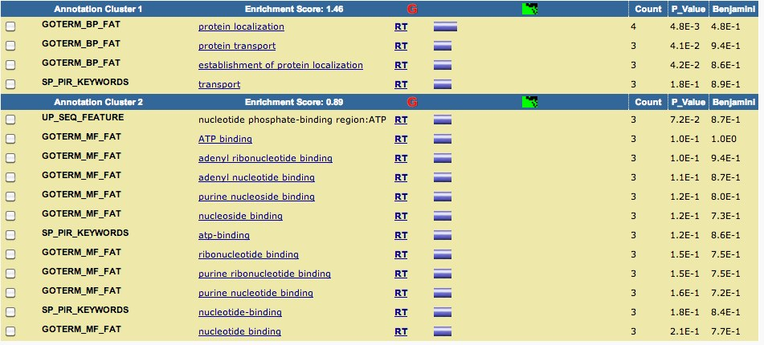
Next Steps: Functional annotation
Further annotation of DMRs
  DAVID, - Conserved Domain BLAST
  Conserved Domain BLAST

Slide 8
New Stuff!
Microarray analysis – Ryan Basom
Rpubs
IGV – making links to specific locations

Slide 9
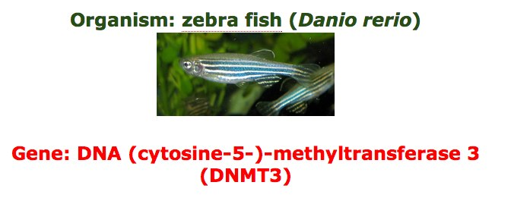
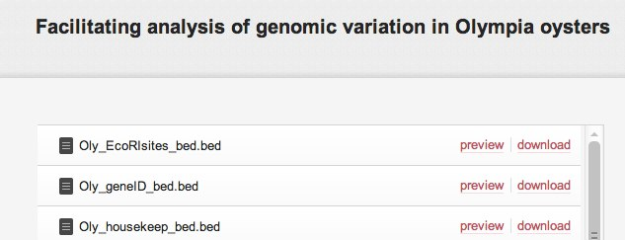
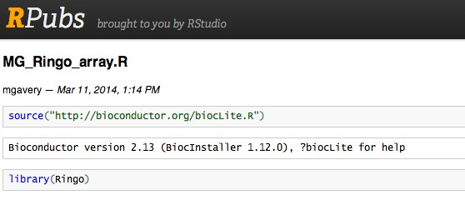
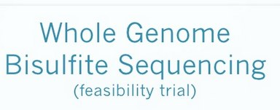
Bioinformatics though the ages…
2010 – MFG, GoogleDocs!
2013 – Galaxy, bedtools
2011 – no bisulfite aligners!
2014 – R packages, reproducibility

