Slide 1
High-throughput bisulfite sequencing reveals relationships between gene expression and DNA methylation in the bivalve, Crassostrea gigas
Mackenzie Gavery & Steven Roberts
University of Washington
School of Aquatic and Fishery Sciences
Seattle, WA USA

Slide 2
Open Science
Slides, links and related materials can be found at:
oystergen.es/norway
Notes:
Before I begin I’d like to note that our lab follow open science practices..
So all the slide and a majority of the data can be found at this link ..

Slide 3
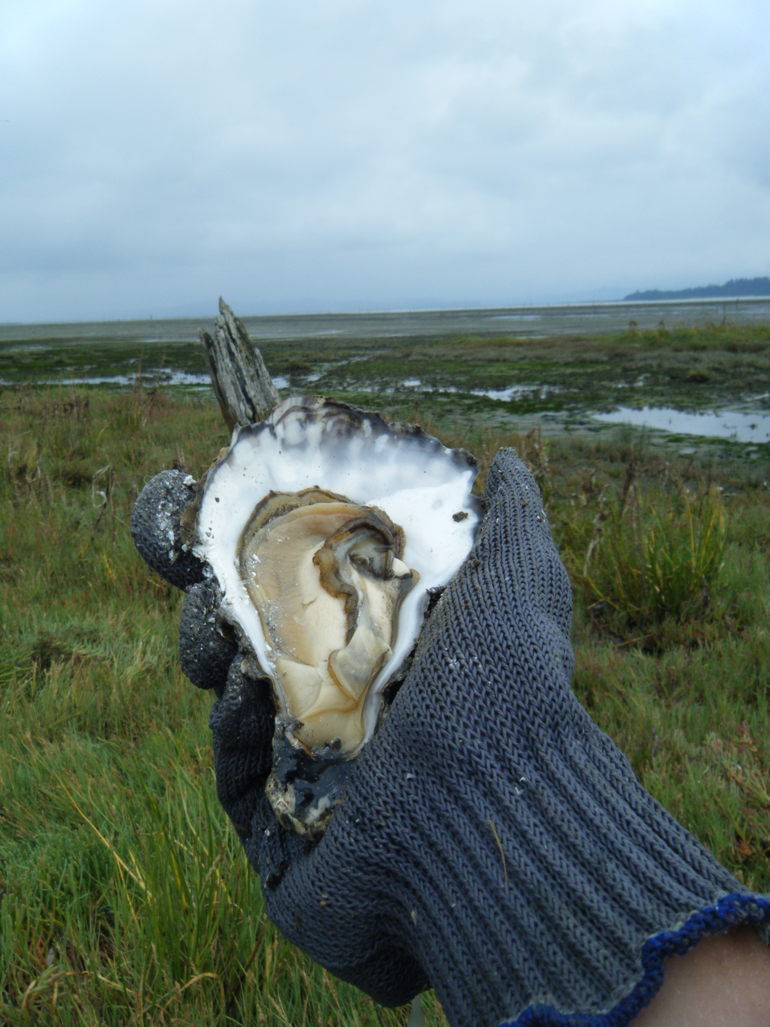
Outline
Background
DNA methylation in invertebrates
Results
Characterization of DNA methylation in Pacific oysters
Discussion & Future Directions
Notes:
Today I’ll be presenting.. ..using htbs
But before I talk about results, I’d like to present some background specifically about DNA methylation in invertebrates…

Slide 4
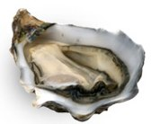
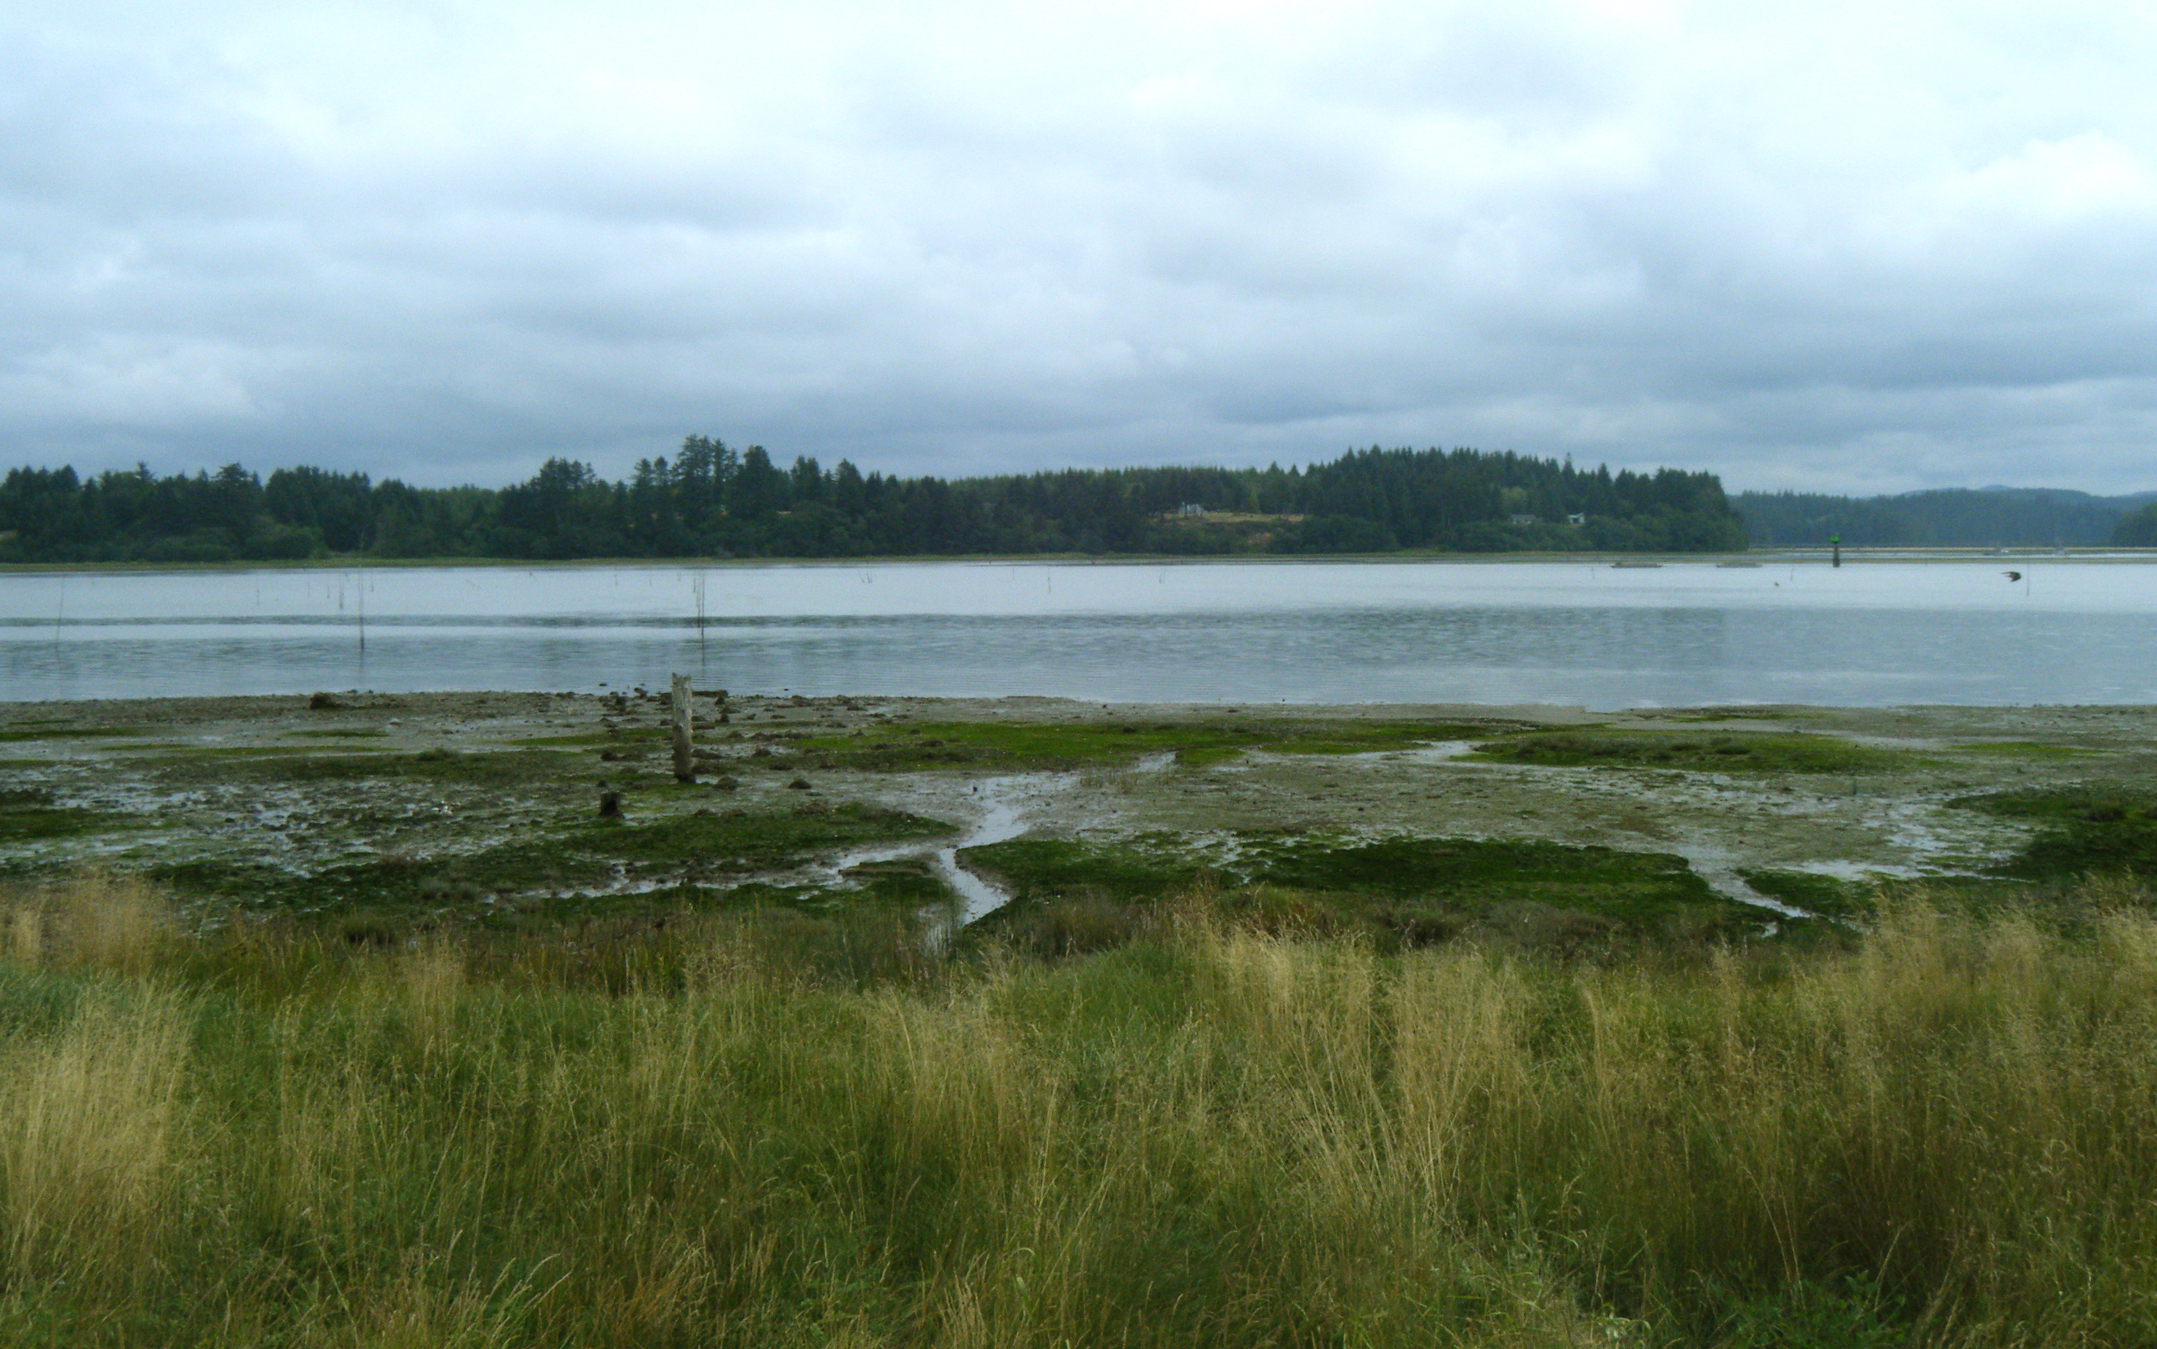
Background
color
disease resistance
growth
TRAITS
temperature
pathogens
nutrition
GENES (DNA)
ENVIRONMENT
Notes:
So first, why are we interested in epigenetics and DNA methylation in oysters….
and the answer is of course, because oysters are delicious, and because of this Pacific oysters are a widely cultured species– so it’s important to understand ALL of the factors contributing to their traits
In the past, we’ve typically considered 2 things influencing an organisms traits, genes and the environment..

Slide 5
Background
color
disease resistance
growth
TRAITS
temperature
pathogens
nutrition
EPIGENOME
(DNA methylation)
GENES (DNA)
ENVIRONMENT
Notes:
But what we now know Is that DNA isn’t everything….an organism also has an epigenome. And that these epigenetic marks, (such as DNA methylation) are important in gene regulation – meaning they can they can also affect TRAITS

Slide 6
Background
color
disease resistance
growth
TRAITS
temperature
pathogens
nutrition
EPIGENOME
(DNA methylation)
GENES (DNA)
ENVIRONMENT
Notes:
- and, they can be directly impacted by the environment – and in some cases these changes can even be heritable..

Slide 7
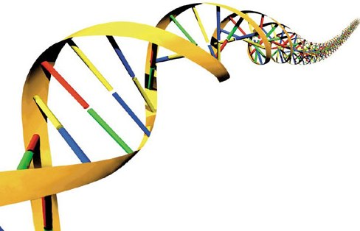
DNA Methylation
C
G
G
C
Me
Notes:
DNA methylation refers to the addition of a methyl group to a cytosine, In animals this occurs almost exclusively at CG loci,
It has many important regulatory functions (that you’ve already heard about? Hopefully?)

Slide 8
DNA Methylation
C
G
TF
X
G
C
Gene A
Me
Notes:
Mechanistically, the presence of DNA methylation has been typically associated with transcriptional silencing – for example, methylation found in a promoter region can block access to TF binding sites

Slide 9
DNA Methylation
VERTEBRATE
C
G
TF
X
G
C
Gene A
Me
Notes:
But when we talk about this model, we’re really talking about what is going on in vertebrates

Slide 10
DNA Methylation
VERTEBRATE
TF
X
Gene A

Slide 11
DNA Methylation
INVERTEBRATE
VERTEBRATE
TF
X
Gene A
Gene A
Notes:
And in fact, there is much less known about this mechanism in invertebrates
One of the first problems, when looking at invertebrates is that our model species: drosophila, c. elegans lack methylation in their genomes
What we’ve discovered since then, primarily from studies done in instects..

Slide 12
DNA Methylation
INVERTEBRATE
VERTEBRATE
TF
X
Gene A
Gene A
Notes:
Is that most invertebrate genomes DO contain dna methylation,
But when they it’s primarily found within gene bodies

Slide 13
DNA Methylation
INVERTEBRATE
VERTEBRATE
?
TF
X
Gene A
Gene A
Notes:
…Where it’s regulatory role remains unclear

Slide 14
DNA Methylation
INVERTEBRATE
VERTEBRATE
?
TF
X
Gene A
Gene A
Notes:
To paint the whole picture, Vertebrates have a lot of gene body methylation too.

Slide 15
DNA Methylation
INVERTEBRATE
VERTEBRATE
?
TF
X
Gene A
Gene A
Ancestral pattern
Notes:
What is emerging is that gene body methylation is the ancestral pattern
So the invertebrate pattern can serve as a simplified model to understand what gene body methylation may be doing in all taxa

Slide 16
DNA Methylation
INVERTEBRATE
VERTEBRATE
?
TF
X
Gene A
Gene A
Ancestral pattern
Important regulator of phenotype
Notes:
And from some really interesting studies done in honeybees, we know that this type of methylation is an important regulator of phenotye
..but, when I started this characterization, we still had no information about DNA methylation in molluscs..

Slide 17
DNA Methylation
Objectives:
Characterize DNA methylation in C. gigas
Gain an understanding of the functional role
Notes:
So the objectives of my research are to..
And this characterization has been a progression and so today I’ll be presenting the results of this research in 3 parts, with each experiment is building on the results of our previous finding

Slide 18
Part 1
Notes:
So the first part of this characterization..

Slide 19
Part 1
Approach
In silico analysis
Experimental analysis: MBD-Seq
Notes:
included 2 analyses an in silico analysis and an experimental analysis - these data have been published, so I won’t go over the methods, but I’d like to briefly summarize the results.

Slide 20
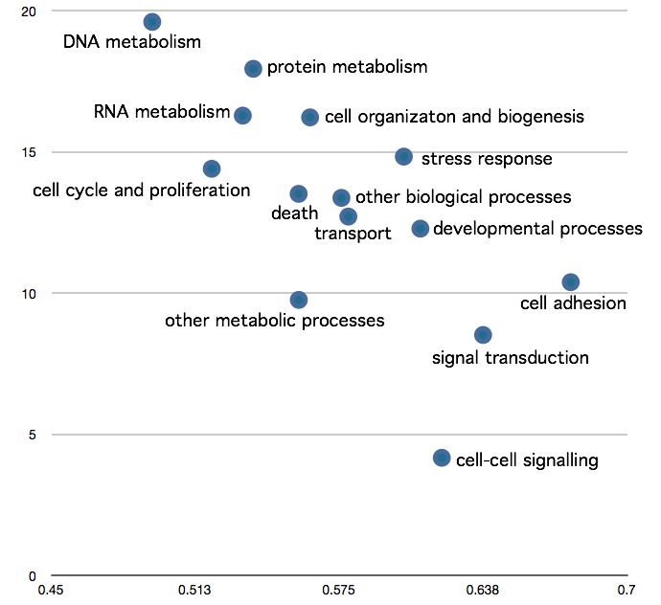
Part 1: Results
Enrichment level in MBD library
(Roberts & Gavery, 2011)
Measured degree of DNA methylation
CpG O/E
(Gavery & Roberts, 2010)
Predicted degree of DNA methylation
Notes:
Through this initial research we found patterns in DNA methylation that were associated with gene function…
And we were able to show, through both the in silico and experimental analysis is - Genes with differing regulatory requirements have different levels of DNA methylation

Slide 21
Part 1: Results
Enrichment level in MBD library
(Roberts & Gavery, 2011)
Measured degree of DNA methylation
CpG O/E
(Gavery & Roberts, 2010)
Predicted degree of DNA methylation
Notes:
Specifically that – we found housekeeping genes, such as those involved in basic metabolic functions such as … show a high degree of methylation

Slide 22
Part 1: Results
Enrichment level in MBD library
(Roberts & Gavery, 2011)
Measured degree of DNA methylation
CpG O/E
(Gavery & Roberts, 2010)
Predicted degree of DNA methylation
Notes:
While inducible genes, many of which are involved in environmental response pathways such as .. have the lowest methylation

Slide 23
Part 1: Results
Enrichment level in MBD library
(Roberts & Gavery, 2011)
Measured degree of DNA methylation
CpG O/E
(Gavery & Roberts, 2010)
Predicted degree of DNA methylation
Notes:
What we learned from these analyses is that gene bodies were methylated in pacific oysters
and more than that we learned that this type of mehtylation was functionally important
But, beyond this we still didn’t know was where the methylation was within the gene (whether is was in an exon or intron), or if methylation was present in other parts of the genome

Slide 24
Part 2

Slide 25
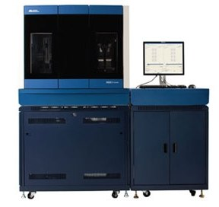
Part 2
Approach
High-throughput bisulfite sequencing:
Gill tissue
Additional resources:
RNA-seq data: gill tissue (Zhang et al, 2012)
genomic DNA
Notes:
We used htbs to analyze dna methylation in the gill tissue..
For this method, we prepare a genomic dna library for gill tissue, but prior to sequencing we treat the dna with sodium bisulfite and this allows us

Slide 26
Part 2
Approach
High-throughput bisulfite sequencing:
Gill tissue
Additional resources:
RNA-seq data: gill tissue (Zhang et al, 2012)
genomic DNA
Notes:
To quantitatively “see” where the metylation is when the reads are mapped back to a reference
We also took advantage of a publicly available RNA-seq data set for gill tissue to examine relationships between methylation, and expression.

Slide 27
Part 2: Results
> 2.5 million CG dinucleotides
Notes:
Doing this analysis we have quanitative methylation data for over 2.5k CG sites throughout the genome
..and one way we could look at how the methylation was distributed is by using genome visualization tools

Slide 28
Part 2: Results
0bp
200,000bp
CG
genes
exons
ex
%methylation
100%
0%
scaffold 86
(Galaxy Trackster)
Notes:
This is an snapshot of a visualizion done on the Galaxy showing a 200kb region of the oyster genome
The first track shows all the CG loci, these are all the potentially methylatedable sites
The next track shows location of genes, and below that the exons
The final track is showing Quantitive methylatio data:
Where each bar represents % methylation (between 0 -100%) of a particular CG locus
Now by scrolling through these different scaffolds we begin to see certain patterns..

Slide 29
Part 2: Results
0bp
200,000bp
CG
genes
exons
ex
%methylation
100%
0%
scaffold 86
(Galaxy Trackster)
Notes:
Some genes are heavily methylated

Slide 30
Part 2: Results
0bp
200,000bp
CG
genes
exons
ex
%methylation
100%
0%
scaffold 86
(Galaxy Trackster)
Notes:
And adjacent genes that show little to no methylation

Slide 31
Part 2: Results
0bp
200,000bp
CG
genes
exons
ex
%methylation
100%
0%
scaffold 86
(Galaxy Trackster)
Notes:
And now, with the release of the genome – we can see for the first time that DNA methylation is present in intergenic regions.

Slide 32
Part 2: Results
Distribution in genomic elements
Notes:
SO to summarize where the methylated cytosines were distributed in the gill tissue

Slide 33
Part 2: Results
Distribution in genomic elements
Notes:
70% of the methylation was in regions in gene bodies,
24% in exons, another 45% in introns (one interesting thing here is that oysters have a comparatively high amount of methylaiton in introns compared to other invertebrates)
4% in putative promoters
5% in TE – this is lower than expected, at least in vertebrates DNA meth used to silence Tes, but here we found TE’s were not preferentially methylated
22% he rest of the methylation was found in unannotated regions outside of genes.

Slide 34
Part 2: Results
Relationship with expression
Notes:
We were also Interested in using this data to identify relationship between gene body methylation and gene expression
following on our previous findings, if methylation in gene bodies is important we would expect to see a relationship between methylation and expression

Slide 35
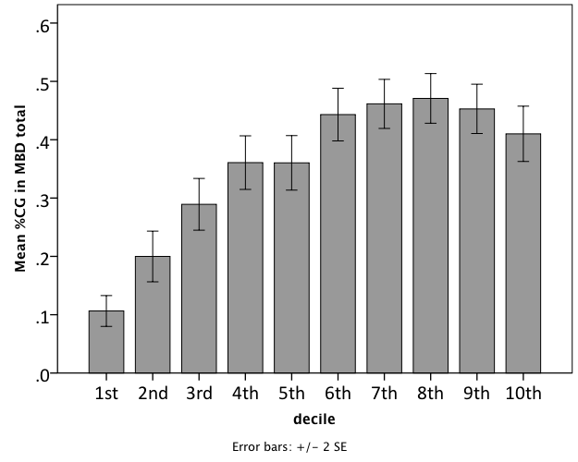
Part 2: Results
Relationship with expression
DNA methylation/gene
Gene expression (Deciles)
RNA-Seq data (Zhang et al., 2012)
Notes:
For this analysis, gene expression values were dividied 10 groups - those genes showing lowest expression in gill are in decile 1 and those with the highest expression are in decile 10.
Then we calculated and average % methylation for genes within each decile
We found that genes with the lowest expression in the gill tissue have significantly less DNA methylation than genes that are more abundantly expressed
What’s interesting, is that DNA methylaiton is typically associated with transcriptional silencing
– and what we are seeing with this analysis is that methylation within gene bodies is associated with transcriptional activity
--and this pattern is consistent with what is now being reported for vertebrates, where highly transcribed genes have high degree gene body methylation
So these data agaree our previous findings that gene body methylation is important in C.gigas

Slide 36
Part 3
Notes:
The next thing we wanted to do was to evaluate tissue specific methylation – we hypothesized that if methylation was playing a regulatory role in maintaining tissue specific expression, that we would see differences in methylation between tissues.

Slide 37
Part 3
Approach:
High-throughput bisulfite sequencing:
Gill tissue
Notes:
So in addition to the htbs data we generated for the gill,,

Slide 38
Part 3
Approach:
High-throughput bisulfite sequencing:
Gill tissue
Male gamete (sperm) tissue
Notes:
We generated htbs data for male gametes

Slide 39
Part 3: Results
0bp
6,000bp
CG
genes
%methylation: gill
%methylation: sperm
Notes:
Here is another visualization show methylation in the gill tissues

Slide 40
Part 3: Results
0bp
6,000bp
CG
genes
%methylation: gill
%methylation: sperm
Notes:
And now below that is methylation data for the sperm tissue, and overall we see that the patterns are pretty similar

Slide 41
Part 3: Results
0bp
6,000bp
CG
genes
%methylation: gill
%methylation: sperm
Notes:
But we definitely see regions where the methylatin is tissue specific..

Slide 42
Part 3: Results
Identify differential methylation (DM)
Notes:
Then we used an R-package called methylkit to identify differential methyatlion quantitatively

Slide 43
Part 3: Results
Identify differential methylation (DM)
Notes:
We found that the majority of methylatin was conserved between the 2 tissue types, but
7% of the CG loci are considered to be differentially methylated –

Slide 44
Part 3: Results
Identify differential methylation
1/3 of all genes had DM
Notes:
those were distributed throughout the genome, about 1/3 of genes had at least 1 DM
..we’re still analyzing patterns here..

Slide 45
Summary
Notes:
So to summarize these data

Slide 46
Summary
methylated
unmethylated
Notes:
We find that gene body methylation is important in oysters – and we’ve shown that there are differences between methylated and unmethylated genes and

Slide 47
Summary
methylated
unmethylated
Gene function:
Notes:
The first difference we were able to show is that genes with differing regulatory requirements had different amounts of dna methylation

Slide 48
Summary
methylated
unmethylated
Gene function:
housekeeping
inducible
Notes:
Specifically that methylated genes tended to be involved in housekeeping functions, whereas genes with inducible functions showed less methylation

Slide 49
Summary
methylated
unmethylated
Gene function:
housekeeping
inducible
Expression:
Notes:
Next we examined relationships between gene body methylation and expression where…

Slide 50
Summary
methylated
unmethylated
Gene function:
housekeeping
inducible
Expression:
high
low
Notes:
We saw that Genes with the highest expression were heavily methyalted where genes that were expressed less had lower methylation
So by Summarizing this data, we can start to explore possible mechanisms of regulation
For example it’s possible that the reason highly expressed, housekeeping genes are heavily methylated is that it allows for efficient transcription of these core genes- and reduces transcriptional noise, by preventing initiation outside of traditional start sites.
While the lack of methylation in the inducible genes may promote variation in expression – possibly through transient methylation in response to different stimuli, or alt splicing mechanisms

Slide 51
Summary
methylated
unmethylated
Gene function:
housekeeping
inducible
Expression:
high
low
Tissue specific methylation:
Notes:
Finally we examined Methylation patterns between tissues

Slide 52
Summary
methylated
unmethylated
Gene function:
housekeeping
inducible
Expression:
high
low
Tissue specific methylation:
patterns change at fine-scale
Notes:
Patterns change at a fine scale.., many genes are affected – and we are still exploring what these tissue specific differeneces mean

Slide 53
Summary
methylated
unmethylated
Gene function:
housekeeping
inducible
Expression:
high
low
Tissue specific methylation:
patterns change at fine-scale
Role of methylation in introns:
Notes:
Lots of methylation in introns..

Slide 54
Summary
methylated
unmethylated
Gene function:
housekeeping
inducible
Expression:
high
low
Tissue specific methylation:
patterns change at fine-scale
Role of methylation in introns:
unknown
Notes:
And while the function is unknown
One could speculate that the methylation state of an intron could promote the expression of alternative isoforms – this could be especially important for the unmethylated, induciblethis type of transcriptional variation could be beneficial in organisms such as the oyster that live in fluctuating environments.

Slide 55
Summary
methylated
unmethylated
Gene function:
housekeeping
inducible
Expression:
high
low
Tissue specific methylation:
patterns change at fine-scale
Role of methylation in introns:
unknown
Role of methylation in inter-genic regions:
Notes:
Finally we identified 30% of methylation in inter-genic regions

Slide 56
Summary
methylated
unmethylated
Gene function:
housekeeping
inducible
Expression:
high
low
Tissue specific methylation:
patterns change at fine-scale
Role of methylation in introns:
unknown
Role of methylation in inter-genic regions:
unknown
Notes:
While the function is unknown, it’s likely that oyster are using DNA methylation to regulate other protions of the genome as wel

Slide 57
Next Steps
EPIGENOME
(DNA methylation)
GENES (DNA)
Notes:
And so to understand these potential mechanisms better the next steps of this research are to

Slide 58
Next Steps
Explore relationships between DNA methylation and alternative splicing
Determine if DNA methylation mediates response to environmental stress in shellfish
Tool development: DNA tiling array (MeDIP-Chip)
EPIGENOME
(DNA methylation)
GENES (DNA)
Notes:
To do these comparative analyses we’ve developed an oyster DNA tiling array to perform MeDIP-chip

Slide 59
Acknowledgements
Roberts Lab:
Steven Roberts
Samuel White
Brent Vadopalas
Emma Timmins-Schiffman
Claire Ellis
Lisa Crosson
Taylor Shellfish:
Jonathan Davis
Molly Jackson
website: oystergen.es/norway

