Slide 1
Regulation of environmental responses in the Pacific oyster, Crassostrea gigas
Mackenzie Gavery
University of Washington
School of Aquatic and Fishery Sciences
Committee Meeting: April 15th, 2014

Slide 2
Agenda:
Research update
Proposed timeline

Slide 3
Environmental Response in Oysters
2009
2010
2011
2012
2013

Slide 4
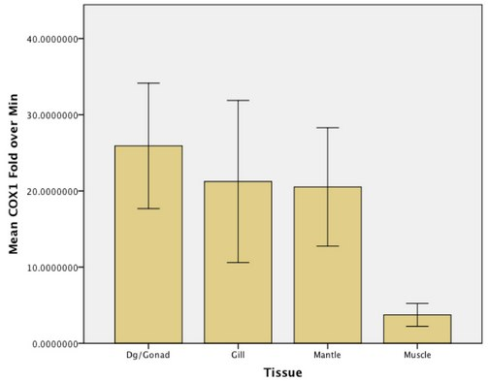
Environmental Response in Oysters
2009
2010
2011
2012
2013
Cyclooxygenase
characterization

Slide 5
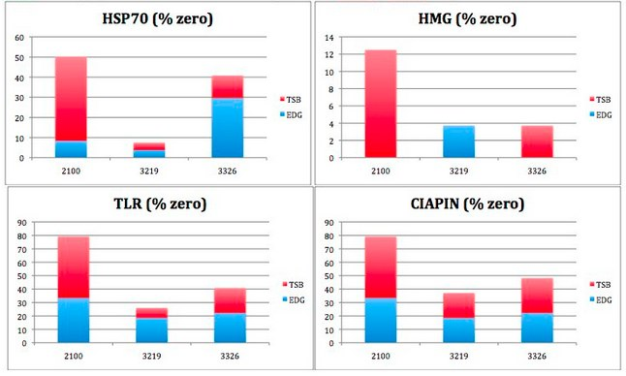
Environmental Response in Oysters
2009
2010
2011
2012
2013
Cyclooxygenase
characterization
Gene expression: disease resistance

Slide 6
Environmental Response in Oysters
2009
2010
2011
2012
2013
Chapter I. CBP: Part D
Cyclooxygenase
characterization
Whole transcriptome
Gene expression: disease resistance

Slide 7
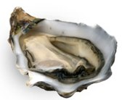
Chapter I.
RNA-Seq
LOW IMPACT
HIGH IMPACT

Slide 8
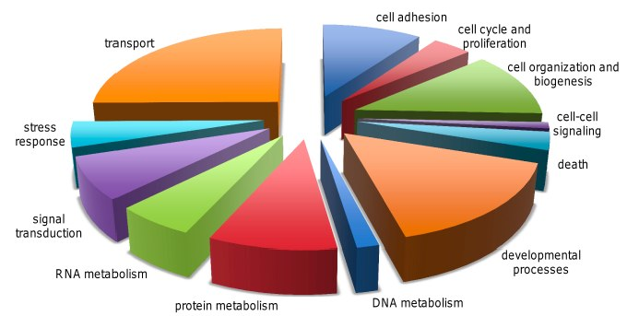
Chapter I.
RNA-Seq
LOW IMPACT
HIGH IMPACT
742 novel contigs
427 differentially expressed

Slide 9
Chapter I.
RNA-Seq
LOW IMPACT
HIGH IMPACT
742 novel contigs
427 differentially expressed
Ultra-short read technology is a powerful tool for gene discovery and expression analysis in organisms with limited genomic resources

Slide 10
Environmental Response in Oysters
2009
2010
2011
2012
2013
Chapter I. CBP: Part D
Cyclooxygenase
characterization
Whole transcriptome
Gene expression: disease resistance

Slide 11
Environmental Response in Oysters
2009
2010
2011
2012
2013
Chapter I. CBP: Part D
Cyclooxygenase
characterization
Whole transcriptome
Gene expression: disease resistance
DNA methylation:
single gene/in silico
Chapter II. BMC Genomics
Frontiers

Slide 12
Chapter II. in silico analysis
‘inducible’
‘housekeeping’
Predicted degree of DNA methylation

Slide 13
Chapter II. in silico analysis
‘inducible’
DNA methylation detected by targeted bisulfite sequencing and methylation specific PCR
DNA methylation patterns are different between functionally distinct classes of genes
‘housekeeping’
Predicted degree of DNA methylation

Slide 14
Environmental Response in Oysters
2009
2010
2011
2012
2013
Chapter I. CBP: Part D
Cyclooxygenase
characterization
Whole transcriptome
Gene expression: disease resistance
DNA methylation:
single gene/in silico
Chapter II. BMC Genomics
Frontiers

Slide 15
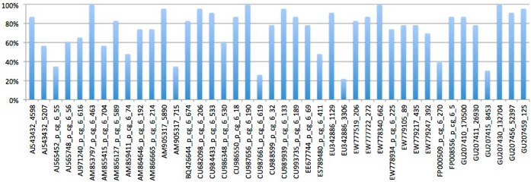
Environmental Response in Oysters
2009
2010
2011
2012
2013
Chapter I. CBP: Part D
Cyclooxygenase
characterization
Whole transcriptome
Gene expression: disease resistance
DNA methylation:
single gene/in silico
Nanostring
Chapter II. BMC Genomics
Frontiers

Slide 16
Environmental Response in Oysters
2009
2010
2011
2012
2013
Chapter I. CBP: Part D
Cyclooxygenase
characterization
Whole transcriptome
transgenerational (5-aza pesticide)
EE2
Gene expression: disease resistance
DNA methylation:
single gene/in silico
Nanostring
Chapter II. BMC Genomics
Frontiers

Slide 17
Environmental Response in Oysters
2009
2010
2011
2012
2013
Chapter I. CBP: Part D
Cyclooxygenase
characterization
Whole transcriptome
transgenerational (5-aza pesticide)
EE2
bringing it all together! meth & expression
Gene expression: disease resistance
DNA methylation:
single gene/in silico
Nanostring
Chapter II. BMC Genomics
Frontiers

Slide 18
Environmental Response in Oysters
2009
2010
2011
2012
2013
Chapter I. CBP: Part D
Cyclooxygenase
characterization
Whole transcriptome
Ch III. PeerJ
transgenerational (5-aza pesticide)
EE2
bringing it all together! meth & expression
Gene expression: disease resistance
DNA methylation:
single gene/in silico
Nanostring
Chapter II. BMC Genomics
Frontiers

Slide 19
Environmental Response in Oysters
2009
2010
2011
2012
2013
Chapter I. CBP: Part D
Chapter IV. Brief Func Gen
Cyclooxygenase
characterization
Whole transcriptome
Ch III. PeerJ
transgenerational (5-aza pesticide)
EE2
bringing it all together! meth & expression
Gene expression: disease resistance
DNA methylation:
single gene/in silico
Nanostring
Chapter II. BMC Genomics
Frontiers

Slide 20
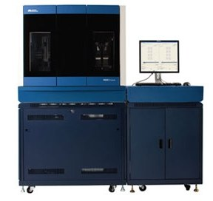
Chapter III: whole methylome
Approach
High-throughput bisulfite sequencing
genomic DNA

Slide 21
Chapter III: whole methylome
Approach
High-throughput bisulfite sequencing
genomic DNA

Slide 22
Chapter III: whole methylome
Approach
High-throughput bisulfite sequencing
RNA-Seq data
genomic DNA

Slide 23
Chapter III: whole methylome
Gill tissue: > 2.5 million CG dinucleotides

Slide 24
Chapter III: whole methylome
0bp
200,000bp
CG
genes
exons
ex
%methylation
100%
0%
scaffold 86
(Galaxy Trackster)

Slide 25
Chapter III: whole methylome
0bp
200,000bp
CG
genes
exons
ex
%methylation
100%
0%
scaffold 86
(Galaxy Trackster)

Slide 26
Chapter III: whole methylome
0bp
200,000bp
CG
genes
exons
ex
%methylation
100%
0%
scaffold 86
(Galaxy Trackster)

Slide 27
Chapter III: whole methylome
0bp
200,000bp
CG
genes
exons
ex
%methylation
100%
0%
scaffold 86
(Galaxy Trackster)

Slide 28
Chapter III: whole methylome
Distribution in genomic elements

Slide 29
Chapter III: whole methylome
Distribution in genomic elements

Slide 30
Chapter III: whole methylome
Relationship with expression

Slide 31
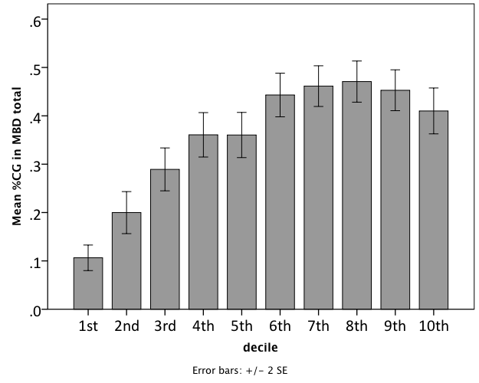
Chapter III: whole methylome
Relationship with expression
DNA methylation/gene
Gene expression (Deciles)
RNA-Seq data (Zhang et al., 2012)

Slide 32
Chapter III: whole methylome
Relationships with other gene specific attributes?

Slide 33
Chapter III: whole methylome
Relationships with other gene specific attributes?
Spatial
e.g. number of exons, length of mRNA
Gene expression (Zhang et al 2012):
Mean expression level across 9 tissues
Variation in expression between tissues (%CV)

Slide 34
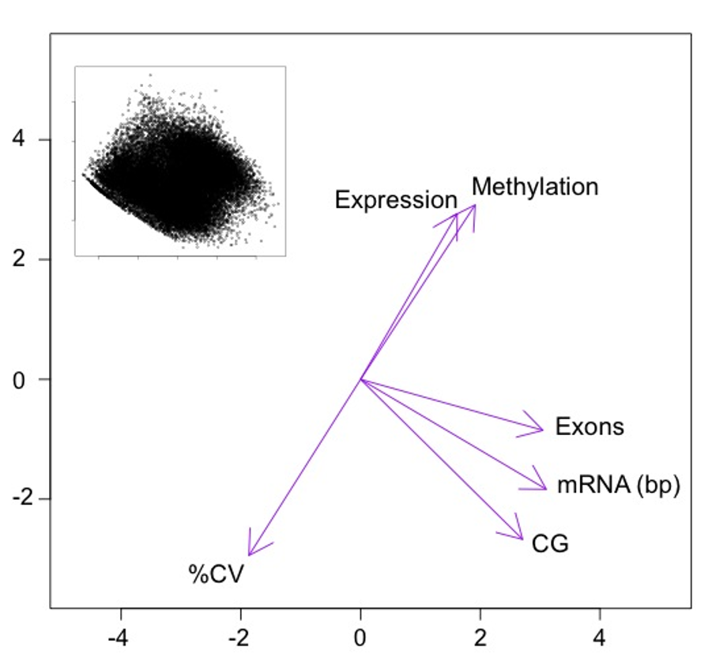
Chapter III: whole methylome
PC2 (26.1%)
PC1 (50.2%)

Slide 35
Chapter III: whole methylome
PC2 (26.1%)
PC1 (50.2%)

Slide 36
Chapter III: summary

Slide 37
Chapter III: summary
methylated
unmethylated

Slide 38
Chapter III: summary
methylated
unmethylated
Gene function:

Slide 39
Chapter III: summary
methylated
unmethylated
Gene function:
housekeeping
inducible

Slide 40
Chapter III: summary
methylated
unmethylated
Gene function:
housekeeping
inducible
Expression:

Slide 41
Chapter III: summary
methylated
unmethylated
Gene function:
housekeeping
inducible
Expression:
high
low

Slide 42
Chapter III: summary
methylated
unmethylated
Gene function:
housekeeping
inducible
Expression:
high
low
Tissue specific expression:

Slide 43
Chapter III: summary
methylated
unmethylated
Gene function:
housekeeping
inducible
Expression:
high
low
Tissue specific expression:
conserved
variable

Slide 44
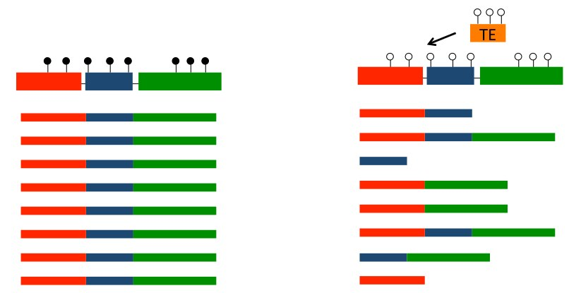
Chapter III: summary
methylated
unmethylated
Gene function:
housekeeping
inducible
Expression:
high
low
Tissue specific expression:
conserved
variable
Chapter IV.
A context dependent role of DNA methylation in bivalves (Gavery & Roberts 2014)

Slide 45
Summary of Chapters:
Transcriptomic approaches to understanding environmental response
First characterization of DNA methylation in oysters (in silico analysis)
DNA methylation & gene expression: whole genome analysis
Perspective/Review: DNA methylation in bivalves

Slide 46
Environmental Response in Oysters
2009
2010
2011
2012
2013
Chapter I. CBP: Part D
Chapter IV. Brief Func Gen
Cyclooxygenase
characterization
Whole transcriptome
Ch III. PeerJ
transgenerational (5-aza pesticide)
EE2
bringing it all together! meth & expression
Gene expression: disease resistance
DNA methylation:
single gene/in silico
Nanostring
Chapter II. BMC Genomics
Frontiers

Slide 47
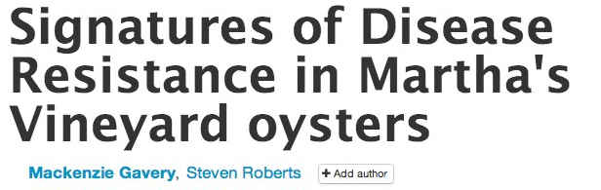
Environmental Response in Oysters
2009
2012
2013
2011
2010
Chapter I. CBP: Part D
Chapter IV. Brief Func Gen
Cyclooxygenase
characterization
Whole transcriptome
Ch III. PeerJ
transgenerational (5-aza pesticide)
EE2
bringing it all together! meth & expression
Gene expression: disease resistance
DNA methylation:
single gene/in silico
Nanostring
BMC Genomics
Authorea link
Frontiers

Slide 48
Agenda:
Research update
Proposed timeline

Slide 49
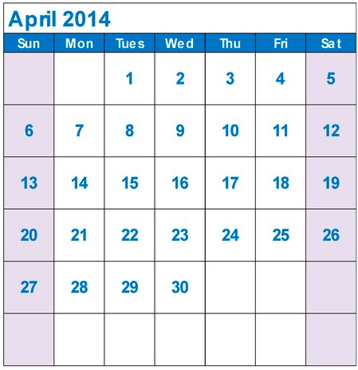
Proposed Timeline:
Draft proposal to reading committee: April 21st

Slide 50
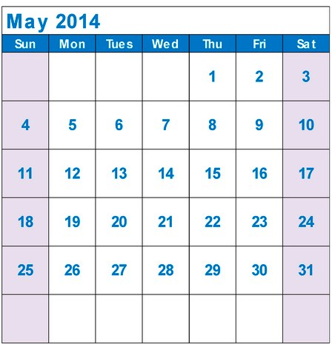
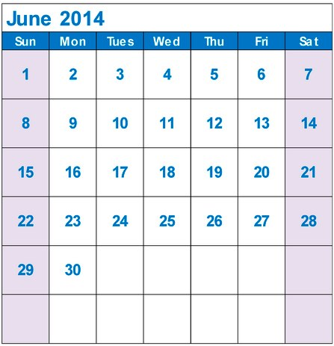
Proposed Timeline:
Spring End
Mem Day

Slide 51
Estrogen Experiment
Does DNA methylation mediate the phenotypic effects of estrogen exposure in bivalves?

Slide 52
Estrogen Experiment
Does DNA methylation mediate the phenotypic effects of estrogen exposure in bivalves?
EE2 (n=50/tank
control (n=50/tank)
Day 0
(n=10)
Day 7
(n=15/tx)
Day 35
(n=15/tx)
Day 60
(n=120/tx)

Slide 53
Estrogen Experiment
Does DNA methylation mediate the phenotypic effects of estrogen exposure in bivalves?
EE2 (n=50/tank
control (n=50/tank)
Day 0
(n=10)
Day 7
(n=15/tx)
Day 35
(n=15/tx)
Day 60
(n=120/tx)
7m / 3f

Slide 54
Estrogen Experiment
Does DNA methylation mediate the phenotypic effects of estrogen exposure in bivalves?
EE2 (n=50/tank)
control (n=50/tank)
Day 0
(n=10)
Day 7
(n=15/tx)
Day 35
(n=15/tx)
Day 60
(n=120/tx)
7m / 3f
10m / 5f - control

Slide 55
Estrogen Experiment
Does DNA methylation mediate the phenotypic effects of estrogen exposure in bivalves?
EE2 (n=50/tank)
control (n=50/tank)
Day 0
(n=10)
Day 7
(n=15/tx)
Day 35
(n=15/tx)
Day 60
(n=120/tx)
7m / 3f
10m / 5f - control
6m / 7f / 1? – EE2

Slide 56
Estrogen Experiment
Does DNA methylation mediate the phenotypic effects of estrogen exposure in bivalves?
EE2 (n=50/tank)
control (n=50/tank)
Day 0
(n=10)
Day 7
(n=15/tx)
Day 35
(n=15/tx)
Day 60
(n=120/tx)
7m / 3f
10m / 5f - control
6m / 7f / 1? – EE2

Slide 57
Estrogen Experiment
Does DNA methylation mediate the phenotypic effects of estrogen exposure in bivalves?
EE2 (n=50/tank)
control (n=50/tank)
Day 0
(n=10)
Day 7
(n=15/tx)
Day 35
(n=15/tx)
Day 60
(n=120/tx)
7m / 3f
10m / 5f - control
6m / 7f / 1? – EE2

Slide 58
Estrogen Experiment
Does DNA methylation mediate the phenotypic effects of estrogen exposure in bivalves?
EE2 (n=50/tank
control (n=50/tank)
Day 0
(n=10)
Day 7
(n=15/tx)
Day 35
(n=15/tx)
Day 60
(n=120/tx)
7m / 3f
10m / 5f - control
6m / 7f / 1? – EE2

Slide 59
Estrogen Experiment
Does DNA methylation mediate the phenotypic effects of estrogen exposure in bivalves?
EE2 (n=50/tank
control (n=50/tank)
Day 0
(n=10)
Day 7
(n=15/tx)
Day 35
(n=15/tx)
Day 60
(n=120/tx)
7m / 3f
10m / 5f - control
6m / 7f / 1? – EE2

Slide 60
Estrogen Experiment
Identifying differential methylation in day 7 females
Approach: MBD-Chip
Results:
45 differentially methylated regions
42 in genes, 3 upstream of genes
38 different genes identified
E.g.: CRHR, serotonin receptor, acetylcholine receptor, various DNA binding proteins
Next steps: validate DMRs by pyrosequencing

Slide 61
Appendices:
Gene expression:
Characterization of cycloxygenase in C. gigas
Gene expression in disease resistant oysters
DNA methylation:
Nanostring report
Transgenerational Experimental Design
EE2 experiment: phenotypic data & DNA methylation results

Slide 62
Prostaglandins in oyster immunity
Prostaglandins in oyster immunity
Sequenced full length gene
Phylogenetic analysis
Tissue Distribution
Immune Response

Slide 63
Gene Expression in Disease Resistant oysters
Crassostrea virginica
Resistant and Naïve population
Immune Related Genes
Major Findings:
Resistant population appeared to be ‘primed’ with higher level of baseline expression of genes prior to exposure

Slide 64
Nanostring Project
Targeted methylation analysis
nCounter system
Methylation at 48 target genes
About 30% of the targets performed well
Major findings
Identified first differential methylation between tissue types

Slide 65
Transgenerational Experiment
Do methylation patterns persist across generations?
Expsure to either:
5-azacytidine
Vinclozolin
Spawned and raised larvae
Parents sampled: nanostring assay
Growout
Samples 18 months later (gametes)
Findings: size difference, no meth difference by Nanostring

