Slide 1
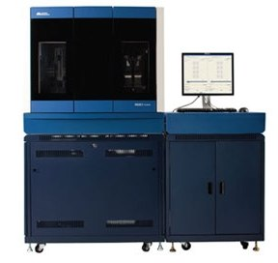
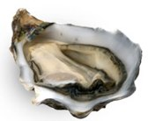
DNA methylation analysis
Approach
High-throughput bisulfite sequencing:
Gill tissue
Additional resources:
RNA-seq data: gill tissue (Zhang et al, 2012)
genomic DNA

Slide 2
DNA methylation analysis
Approach
High-throughput bisulfite sequencing:
Gill tissue
Additional resources:
RNA-seq data: gill tissue (Zhang et al, 2012)
genomic DNA

Slide 3
Using genomic intervals to summarize biological data
0bp
200,000bp
CpG
genes
exons
ex
%methylation
100%
0%
(Galaxy Trackster)

Slide 4
Mac: Using genomic intervals to summarize biological data
Create genomic interval files
Find number of overlapping intervals
Simple calculations to describe data
Analysis and visualization

Slide 5
Mac: Using genomic intervals to summarize biological data
Create genomic interval files
Find number of overlapping intervals
Simple calculations to describe data
Analysis and visualization
SQLShare

Slide 6
Mac: Using genomic intervals to summarize biological data
Create genomic interval files
Find number of overlapping intervals
Simple calculations to describe data
Analysis and visualization
SQLShare
bedtools

Slide 7
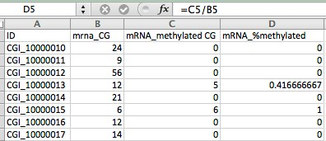
Mac: Using genomic intervals to summarize biological data
Create genomic interval files
Find number of overlapping intervals
Simple calculations to describe data
Analysis and visualization
SQLShare
bedtools
Excel

Slide 8
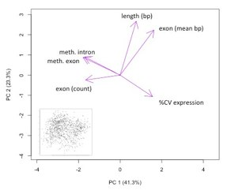
Mac: Using genomic intervals to summarize biological data
Create genomic interval files
Find number of overlapping intervals
Simple calculations to describe data
Analysis and visualization
SQLShare
bedtools
Excel
R

Slide 9
Tools
SQLShare – table manipulation, filtering, etc
Galaxy/IGV – genome browsing
iPlant – lots of genomic tools!
Evernote – notebook
R – analysis

