Slide 1
The role of DNA methylation in mediating the effects of estrogens in oysters
Mackenzie Gavery & Steven Roberts
School of Aquatic and Fishery Sciences
University of Washington

Slide 2
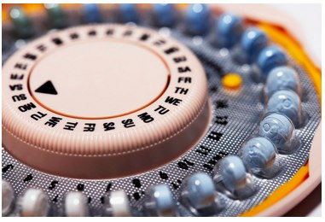
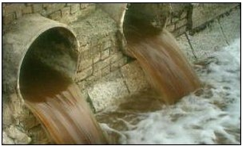
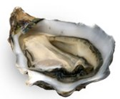
Outline
17α ethinylestradiol
(EE2)
?

Slide 3
Outline
17α ethinylestradiol
(EE2)
Background
  DNA methylation
  EDCs & bivalves
Results
Implications
?

Slide 4
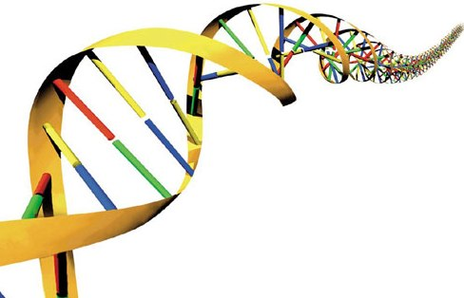
C
G
G
C
Me

Slide 5
TF
X
C
G
Gene A
G
C
Me

Slide 6
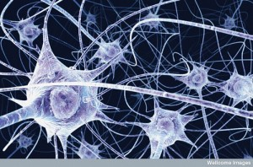
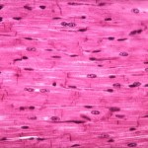
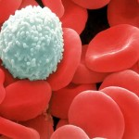
TF
X
C
G
Gene A
G
C
Me

Slide 7
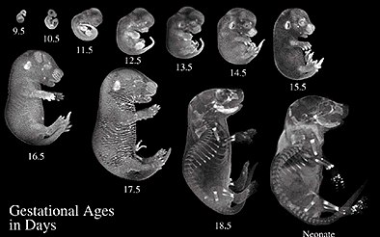
TF
X
C
G
Gene A
G
C
Me

Slide 8
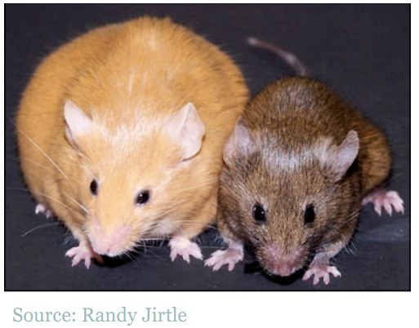
TF
X
C
G
Gene A
G
C
Me

Slide 9
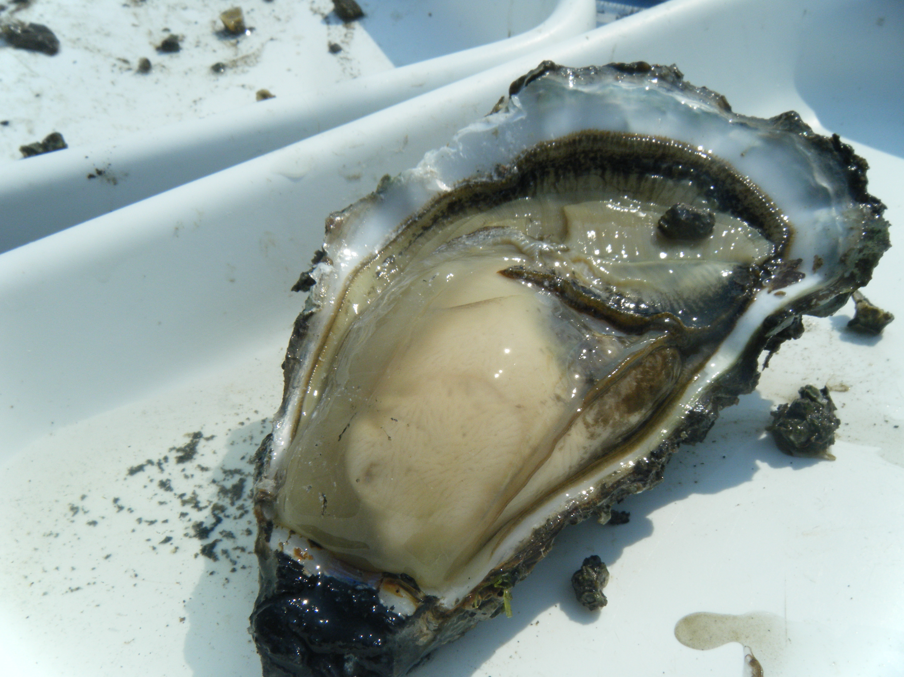
Reproduction in oysters
Pacific oysters are sequential hermaphrodites
Sex determination has a genetic component, but influenced by environmental factors

Slide 10
Reproduction in oysters
C. gigas are sequential protandric hermaphrodites
Sex determination has a genetic component, but influenced by environmental factors
Estradiol
induces sex reversal (Mori 1969)
17α ethinylestradiol (EE2)
⬆ rate of oocyte development (Andrew 2010)
Nonylphenol
offspring of exposed larvae had ⬆ intersex (Nice et al. 2003)

Slide 11
Hypotheses
EE2 exposure will result in phenotypes such as skewed sex ratios and increased rate of gonad development
DNA methylation patterns will be altered in oysters exposed to EE2

Slide 12
Hypotheses
EE2 exposure will result in phenotypes such as skewed sex ratios and increased rate of gonad development
DNA methylation patterns will be altered in oysters in upon exposure to EE2

Slide 13
Estrogen Experiment
500 ng/L EE2: 150 oysters (n=50/tank)
Control: 150 oysters (n=50/tank)

Slide 14
Estrogen Experiment
500 ng/L EE2: 150 oysters (n=50/tank)
Control: 150 oysters (n=50/tank)
Day 0
Day 7
Day 60
Samples: histology, gonad tissue

Slide 15
Estrogen Experiment
500 ng/L EE2: 150 oysters (n=50/tank)
Control: 150 oysters (n=50/tank)
Day 0
Day 7
Day 60
Samples: histology, gonad tissue

Slide 16
Results: Day 60
sex determination
57%

Slide 17
Results: Day 60
size of females

Slide 18
Results: DNA methylation
EE2 (500ng/L) 150 oysters (n=50/tank)
control 150 oysters (n=50/tank)
Day 0
Day 7
Day 60

Slide 19
Results: DNA methylation
EE2 (500ng/L) 150 oysters (n=50/tank)
control 150 oysters (n=50/tank)
Day 0
Day 7
Day 60

Slide 20
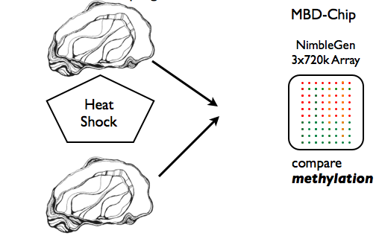
Results: DNA methylation
MBD-Chip
NimbleGen
3 x 720k Array
Y
MBD
control
EE2 exposed
MBD
Y
compare
DNA methylation

Slide 21
Results: DNA methylation
  Results:
    45 differentially methylated regions (DMR)
      DMRs were located in 38 different genes

Slide 23
Gene Ontology (GO Slim) | Count
transport | 10
cell organization and biogenesis | 8
other metabolic processes | 7
signal transduction | 6
protein metabolism | 5
RNA metabolism | 5
developmental processes | 4
cell cycle and proliferation | 3
death | 2
stress response | 2
cell-cell signaling | 1
DNA metabolism | 1

Slide 24
Gene Ontology (GO Slim) | Count
transport | 10
cell organization and biogenesis | 8
other metabolic processes | 7
signal transduction | 6
protein metabolism | 5
RNA metabolism | 5
developmental processes | 4
cell cycle and proliferation | 3
death | 2
stress response | 2
cell-cell signaling | 1
DNA metabolism | 1
ATP-binding cassette protein
Serotonin receptor
Low density lipoprotein receptor
Granulin

Slide 25
Next Steps
Validation of differentially methylated regions using pyrosequencing
Gene expression analysis
Histological analysis of female gonad samples
?

Slide 26
Implications
DNA methylation may play a role in mediating responses to EDCs in bivalves
Epigenetic marks may provide early indicators of EDC exposure in aquatic species

Slide 27



Acknowledgements
Roberts Lab:
  Steven Roberts
  Samuel White
  Emma Timmins-Schiffman
  Claire Ellis
  Brent Vadopalas
  Jake Heare
Taylor Shellfish:
  Joth Davis
  Molly Jackson
Irv Shultz (Battelle PNNL)

Slide 28
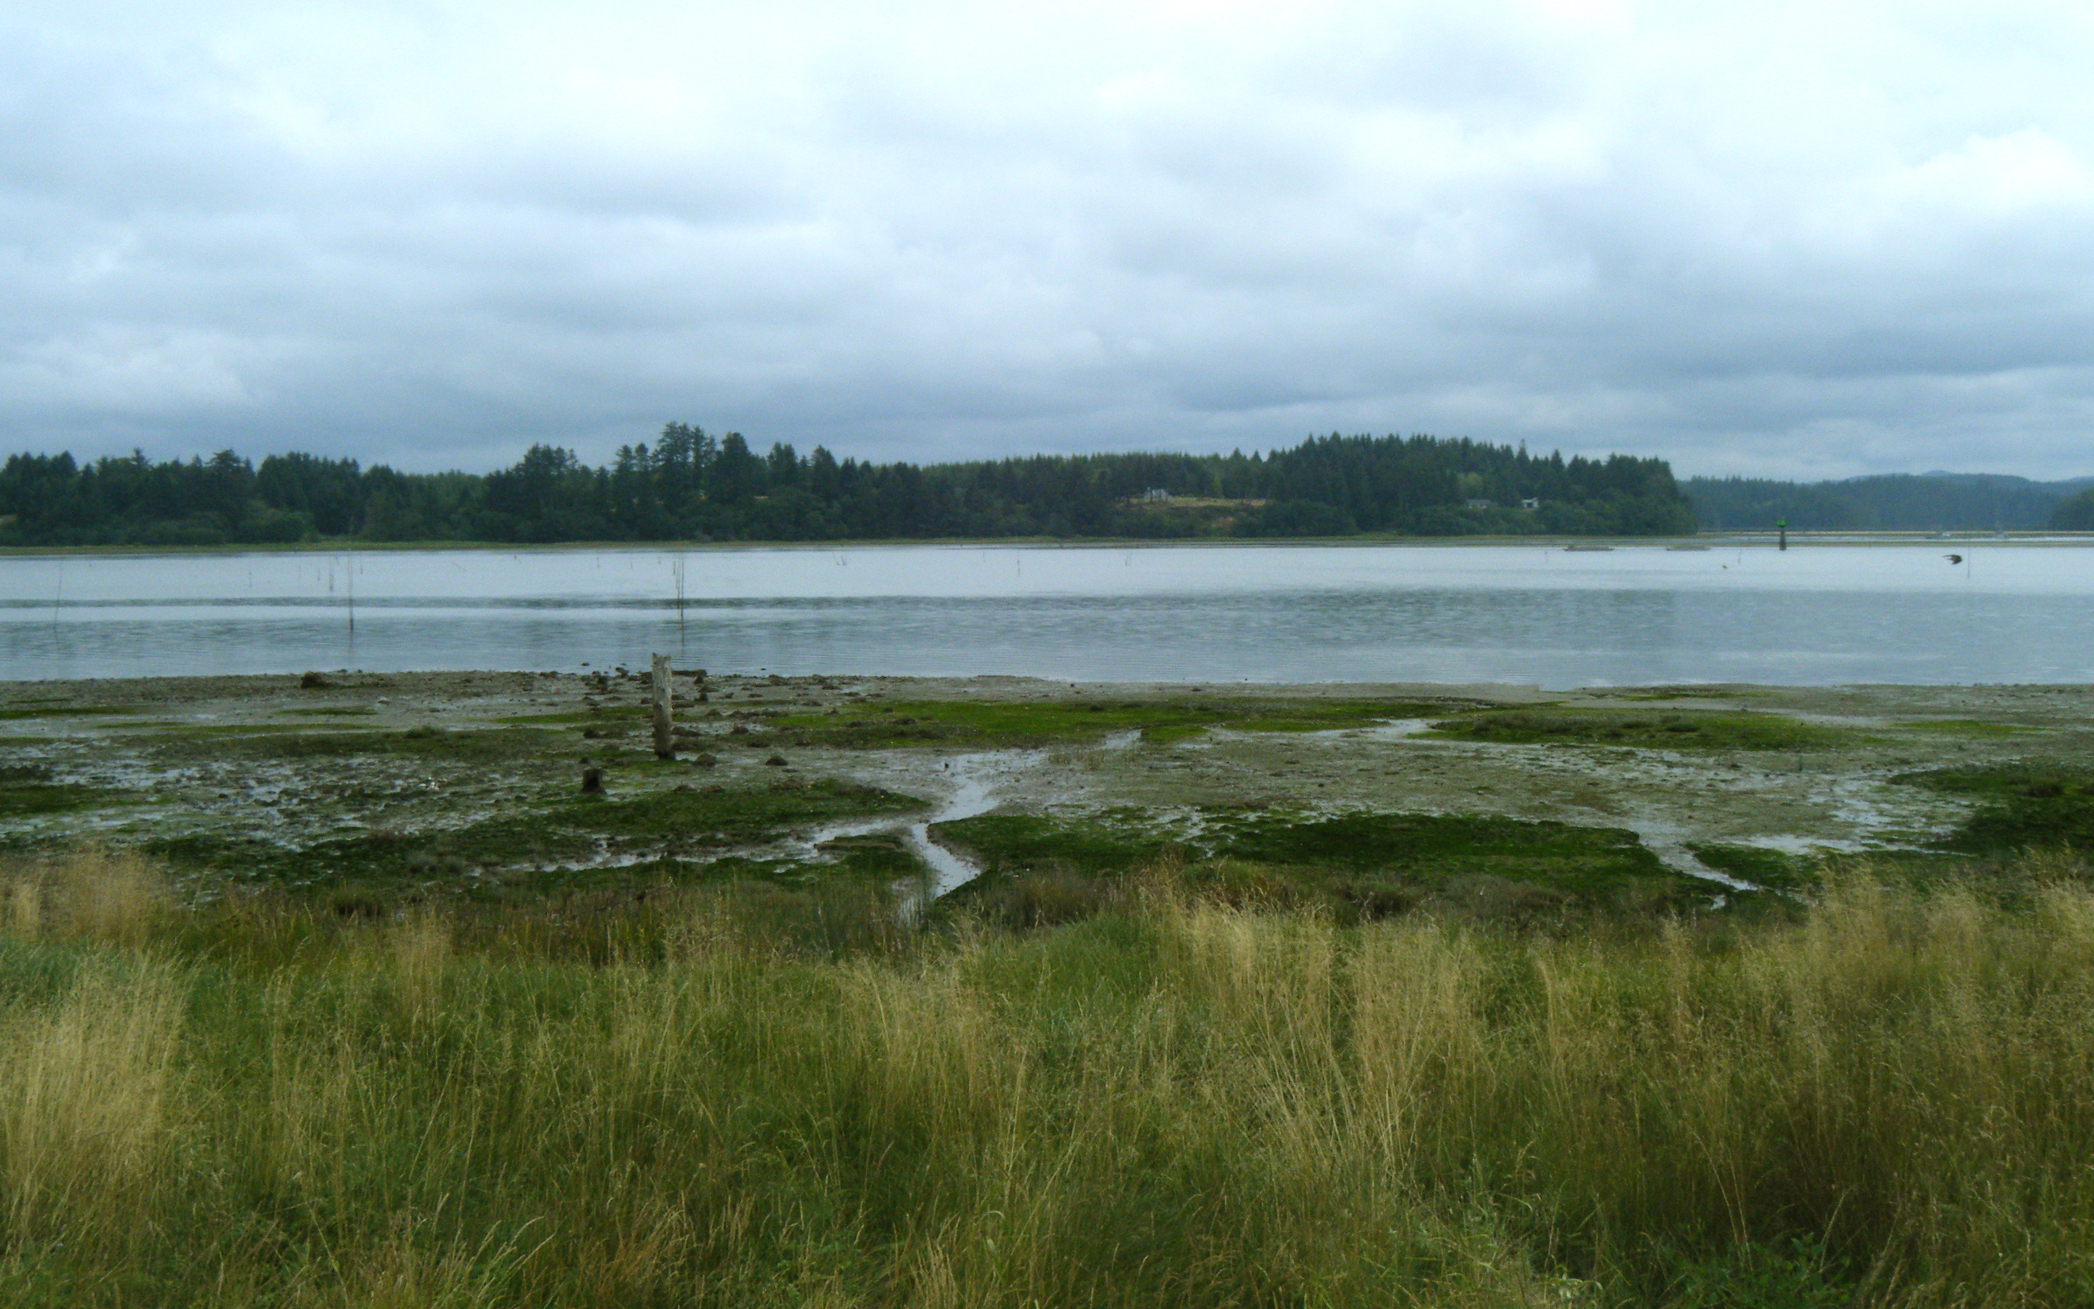
Background
color
disease resistance
growth
TRAITS
GENES (DNA)
ENVIRONMENT

Slide 29
Background
color
disease resistance
growth
TRAITS
EPIGENOME
(DNA methylation)
GENES (DNA)
ENVIRONMENT

Slide 30
Background
color
disease resistance
growth
TRAITS
EPIGENOME
(DNA methylation)
GENES (DNA)
ENVIRONMENT

Slide 31
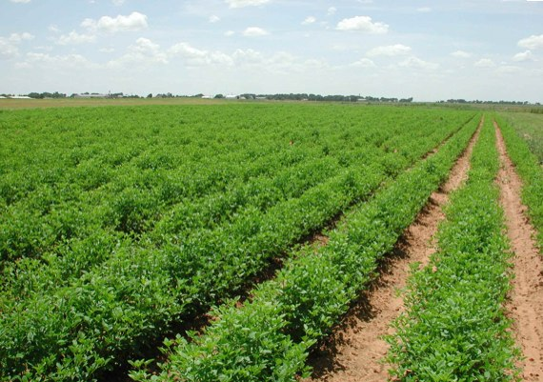
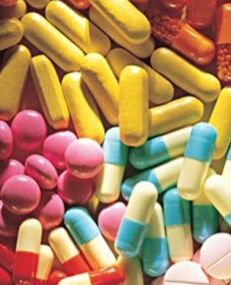

Background
color
disease resistance
growth
TRAITS
EPIGENOME
(DNA methylation)
GENES (DNA)
ENVIRONMENT

